Slide 1
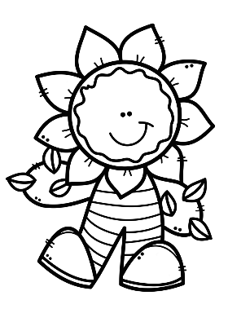
Mrs. Schimke’s Class Newsletter
April 29-May 3, 2019
Subject | What We’re Learning
Reading | We will read a fantasy called “The Journey of Oliver K. Woodman”. Our story skills are: sequence of events, formal/ informal language, and suffixes –er/-est. Our story summative will be next week.
Language Arts | We will continue learning about Pronouns. This week we will learn about possessive pronouns, contractions and homophones. We will also learn about when to use there, their, and they’re.
Math | We will review the chapter on Monday and take our Chapter 11 summative on Tuesday. We will then begin Chapter 12 – Geometry. We will start out learning about plane shapes, angles, and polygons.
Science & Social Studies | Science – we will continue learning about weather. Social Studies – we will learn about the birth of our nation.
Teacher Notes
*Our field trip is on Tuesday.
*Library books due on Wednesdays.
Grandparents/special person and book fair is on our library day.
*Miss Rott’s last day is coming up fast. Her last day is May 9^{th.}
Dates to Remember
4/30 Progress Reports
and Field Trip
5/1 Grandparents/Book Fair
5/2 Family Reading Night
5/22 Eagle’s Nest
5/24-5/27 No School
5/30 Hot Lunch
Spelling Words
singer 7. powerful 13. wonderful
loudly 8. farmer 14. truly
joyful 9. quickly 15. hopeful
teacher 10. careful 16. safely
fighter 11. friendly 17. listener
closely 12. speaker 18. calmly
Test Date May 10

