Slide 1
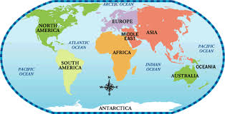
Geography Terms – Q3

Slide 2
Quarter 3 Geography terms 1-5

Slide 3
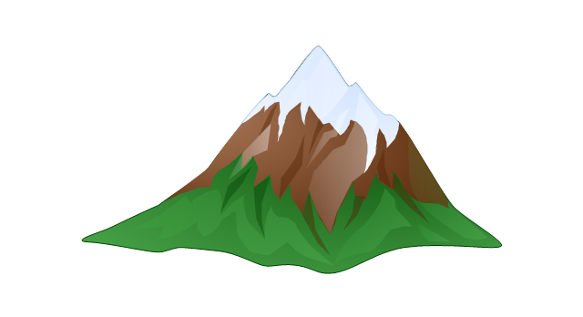
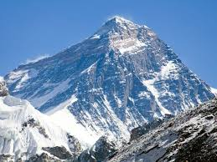
1. mountain
a high area of land with steep sides and a sharp peak

Slide 4
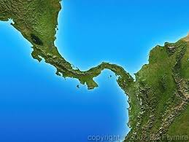
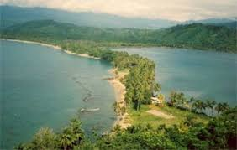
2. isthmus
a narrow strip of land that connects two larger land areas

Slide 5
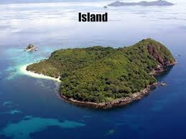
3. island
a piece of land that is surrounded by water

Slide 6
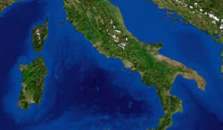
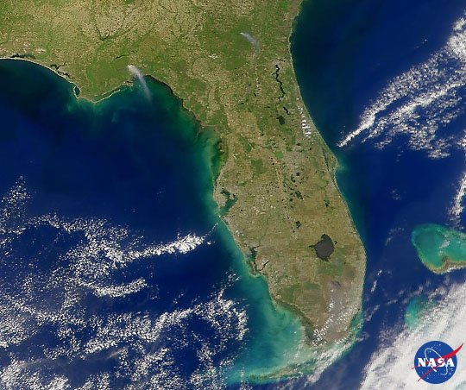
4. peninsula
a body of land with water on three sides

Slide 7
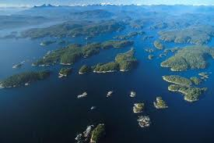
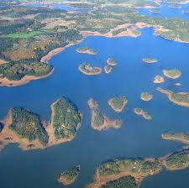
5. archipelago
a large group of islands

Slide 8
Review terms 1-5
Use slides 8-12 to review terms 1-5.
Complete the review in your spirals on the back of the 1-5 chart.

Slide 9
Terms 1-5--Review 1. Which geographical feature is this picture representing? How do you know?
On the page after your geographical terms chart, write your answer and explanation.
Write today’s date.
Use this sentence starter:
The geographical feature in this picture is…
It is a _______________ because …

Slide 10
Terms 1-5--review 2. Which geographical feature is this picture representing? How do you know?
On the page after your geographical terms chart, write your answer and explanation.
Write today’s date.
Use this sentence starter:
The geographical feature in this picture is…
It is a _______________ because …

Slide 11
Terms 1-5--review 3. Which geographical feature is this picture representing? How do you know?
On the page after your geographical terms chart, write your answer and explanation.
Write today’s date.
Use this sentence starter:
The geographical feature in this picture is…
It is a _______________ because …

Slide 12
Terms 1-5--review 4. Which geographical feature is this picture representing? How do you know?
On the page after your geographical terms chart, write your answer and explanation.
Write today’s date.
Use this sentence starter:
The geographical feature in this picture is…
It is a _______________ because …

Slide 13
Terms 1-5--review 5. Which geographical feature is this picture representing? How do you know?
On the page after your geographical terms chart, write your answer and explanation.
Write today’s date.
Use this sentence starter:
The geographical feature in this picture is…
It is a _______________ because …

Slide 14
Quarter 3 geography terms 6-10

Slide 15
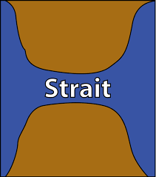
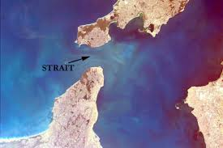
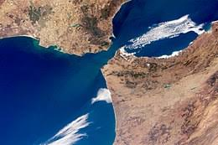
6. strait
a narrow body of water that connects two larger bodies of water

Slide 16
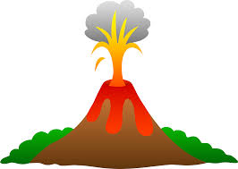
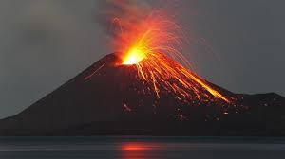
7. volcano
a hole in the earth’s crust through which lava, gasses and ash are released

Slide 17
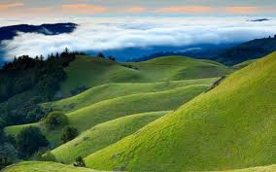
8. hill
a raised part of earth’s surface that is lower than a mountain

Slide 18
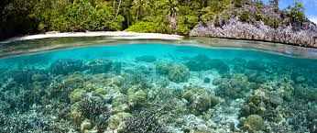
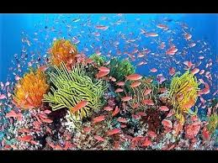
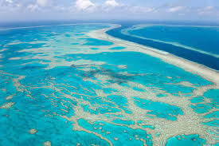
9. reef
a ridge of jagged rock, coral, or sand at or below the surface of water

Slide 19
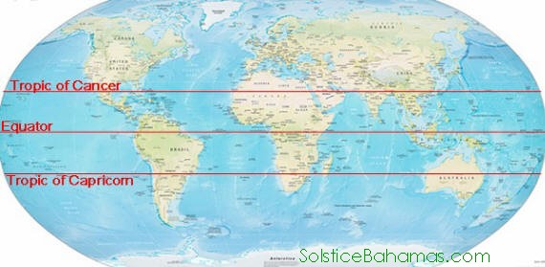
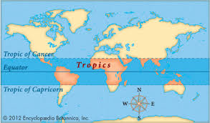
10. tropics
regions of Earth that lie roughly in the middle of the globe

Slide 20
Geography terms 6-10
Use slides 21-25 to review terms 6-10
Complete the review in your spirals on the back of the 6-10 chart.

Slide 21
Terms 6-10--review 1. Which geographical feature is this picture representing? How do you know?
On the page after your geographical terms chart, write your answer and explanation.
Write today’s date.
Use this sentence starter:
The geographical feature in this picture is…
It is a _______________ because …

Slide 22
terms 6-10—review 2. Which geographical feature is this picture representing? How do you know?
On the page after your geographical terms chart, write your answer and explanation.
Write today’s date.
Use this sentence starter:
The geographical feature in this picture is…
It is a _______________ because …

Slide 23
Terms 6-10--review 3. Which geographical feature is this picture representing? How do you know?
On the page after your geographical terms chart, write your answer and explanation.
Write today’s date.
Use this sentence starter:
The geographical feature in this picture is…
It is a _______________ because …

Slide 24
Terms 6-10--review 4. Which geographical feature is this picture representing? How do you know?
On the page after your geographical terms chart, write your answer and explanation.
Write today’s date.
Use this sentence starter:
The geographical feature in this picture is…
It is a _______________ because …

Slide 25
Terms 6-10 5. Which geographical feature is this picture representing? How do you know?
On the page after your geographical terms chart, write your answer and explanation.
Write today’s date.
Use this sentence starter:
The geographical feature in this picture is…
It is a _______________ because …

Slide 26
Geography terms 11-15

Slide 27
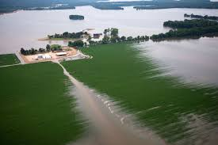
11. floodplain
fertile land around a river that is covered in times of flood

Slide 28
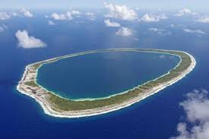
12. atoll
a ring of coral that encloses a pool of seawater

Slide 29
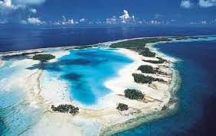
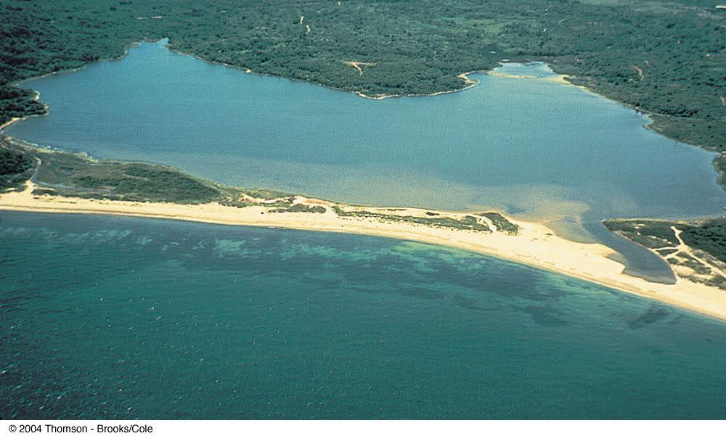
13. lagoon
a shallow body of water that is partly cut off from the sea

Slide 30
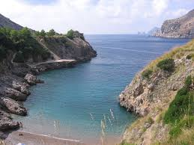
14. inlet
a bay or recess in the shore of a sea, lake, or river

Slide 31
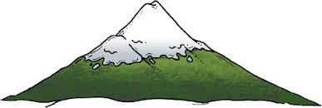
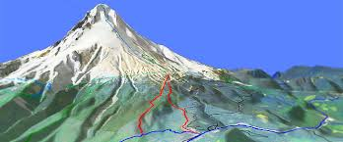
15. timberline
line on a mountain above which is too cold for trees to grow

Slide 32
Terms 11-15—review 1. Which geographical feature is this picture representing? How do you know?
On the page after your geographical terms chart, write your answer and explanation.
Write today’s date.
Use this sentence starter:
The geographical feature in this picture is…
It is a _______________ because …

Slide 33
Terms 11-15—review 2. Which geographical feature is this picture representing? How do you know?
On the page after your geographical terms chart, write your answer and explanation.
Write today’s date.
Use this sentence starter:
The geographical feature in this picture is…
It is a _______________ because …

Slide 34
Terms 11-15—review 3. Which geographical feature is this picture representing? How do you know?
On the page after your geographical terms chart, write your answer and explanation.
Write today’s date.
Use this sentence starter:
The geographical feature in this picture is…
It is a _______________ because …

Slide 35
Terms 11-15—review 4. Which geographical feature is this picture representing? How do you know?
On the page after your geographical terms chart, write your answer and explanation.
Write today’s date.
Use this sentence starter:
The geographical feature in this picture is…
It is a _______________ because …

Slide 36
Terms 11-15—review 5. Which geographical feature is this picture representing? How do you know?
On the page after your geographical terms chart, write your answer and explanation.
Write today’s date.
Use this sentence starter:
The geographical feature in this picture is…
It is a _______________ because …

