Slide 1
Pronouns

Slide 2
Pronouns and Antecedent
Pronoun- a word that replaces one or more nouns
Singular – I you he she it
Plural – we you they
Antecedent- is the noun or nouns that the pronoun replaces.

Slide 3
What is the pronoun & antecedent?
When George had enough money he bought a bike.
John likes to eat crackers and he loves dip.
Mary and Molly like to watch movies and they play volleyball.

Slide 4
Subject & Object Pronouns
Pronouns used as the subject of the sentence are subject pronouns.
The lines are difficult. They are hard to learn.
Pronouns used as the object of a verb or as the object of the sentence are object pronouns.
Roberto’s teacher helped him.
The teacher gave the book to him.
Subject Pronouns |  | Object Pronouns
Singular | Plural | Singular | Plural
I | We | Me | Us
You | You | You | You
He, she, it | They | Him, her, it | them

Slide 5
Subject & Object Pronouns
( I, Me) like to read novels.
Dad advised (I, me) to read Jane Austen’s Pride and Prejudice.
(She, Her) lived in England many years ago.

Slide 6
Possessive Pronouns
Possessive Pronouns- show ownership. They replace a possessive noun. Either used before nouns or used alone
Example:
This tomato came from Tom’s garden.
This tomato came from his garden.
Used before nouns |  | Used alone
My | Our | Mine | Ours
Your | Your | Yours | Yours
His, her, its | Their | His, hers, its | Theirs

Slide 7
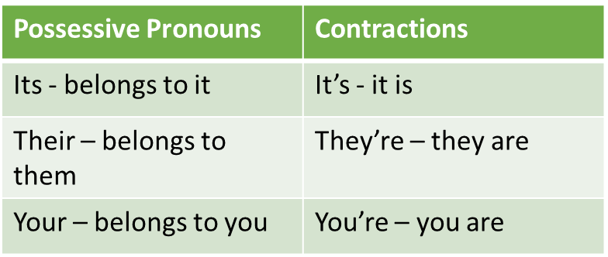
REMEMBER!!
(Its, It’s) color is yellow and bright red.
(Their, They’re) picked before they ripen.
Most stores’ tomatoes are not as sweet and juicy as (my, mine).

Slide 8
Pronouns in compounds
Two or more simple subjects joined by and or or make up a compound subject.
Use subject pronouns
If you want to include yourself, use I and
mention yourself last.
Johnny and I went to the concert.
Two or more objects joined by and or or makes up a compound object.
use object pronouns
The class invited him, her, and me.
To check if the pronoun is correct, ask yourself…
Which fits when used by itself?
Subject Pronouns |  | Object Pronouns
Singular | Plural | Singular | Plural
I | We | Me | Us
You | You | You | You
He, she, it | They | Him, her, it | them

Slide 9
Pronouns in Compounds
Carolyn and (I, me) stopped to eat lunch.
We were joined by Ken and (he, him).
You and (me, I) will lead the others.

Slide 10
Using we and us with Nouns
Use WE with a subject OR after a linking verb
Subject: We girls are the state champions.
After linking verb – The winning players were we boys.
LINKING VERBS – AM, IS, ARE, WAS, WERE, SEEM, BE , BEING, BEEN, BECOME, LOOK, APPEAR, FEEL, SMELL, TASTE
Use US with a direct object OR after words like to, in, for, and at
HINT: PREDICATE
With a direct object: The team needs us fans.
After words like to, in, for, at: The crowd cheers for us heroes.

Slide 11
Using we and us with Nouns practice HINT: cover noun to see if it makes sense
(We, Us) sixth graders are lucky.
The champions were (we, us) boys and girls.
The calculations were difficult of (us, we) learners.

Slide 12
Indefinite Pronouns
Indefinite pronouns refer to people, places, or things without specifying which ones.
Everybody (enjoy, enjoys) painting. All of them (is, are) on the table.
When choosing the correct verb, if the pronoun is singular add -s
Singular – agrees with his & her
Anybody | everybody | Nothing
Anyone | Everyone | Somebody
Anything | Everything | Someone
Each | Nobody | Something
Plural – agrees with their
All | Others
Both | Several
Few | Some
Many
is
are

Slide 13
Indefinite Pronouns
All of the campers (love, loves) Longacre Farm.
Many (come, comes) from faraway places every summer.
Some (get, gets) on the camp bus in New York City.

Slide 14
Reflexive and Intensive Pronouns
REFLECT and INTENSIFY SUBJECT
Myself, himself, herself, itself, ourselves, and themselves
Reflexive pronouns are used to refer to the subject of the sentence. They are a necessary part of the sentence.
Shane made himself a sandwich.
Intensive pronouns are used to emphasize another noun or pronoun.
That means that they do not need to refer to the subject. They can refer to any old noun or pronoun in the sentence.
Jana herself scored 48 points at the basketball game.

Slide 15
Reflexive and Intensive Pronouns
When you go shopping for me, buy a present for yourself.
The man talked to himself as he walked down the street.
The parrot admired itself in the mirror for several hours each day.

Slide 16
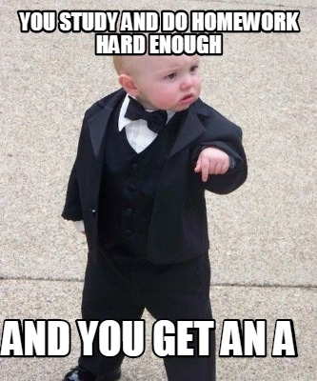
Now time to study for the summative!!!

