Slide 1
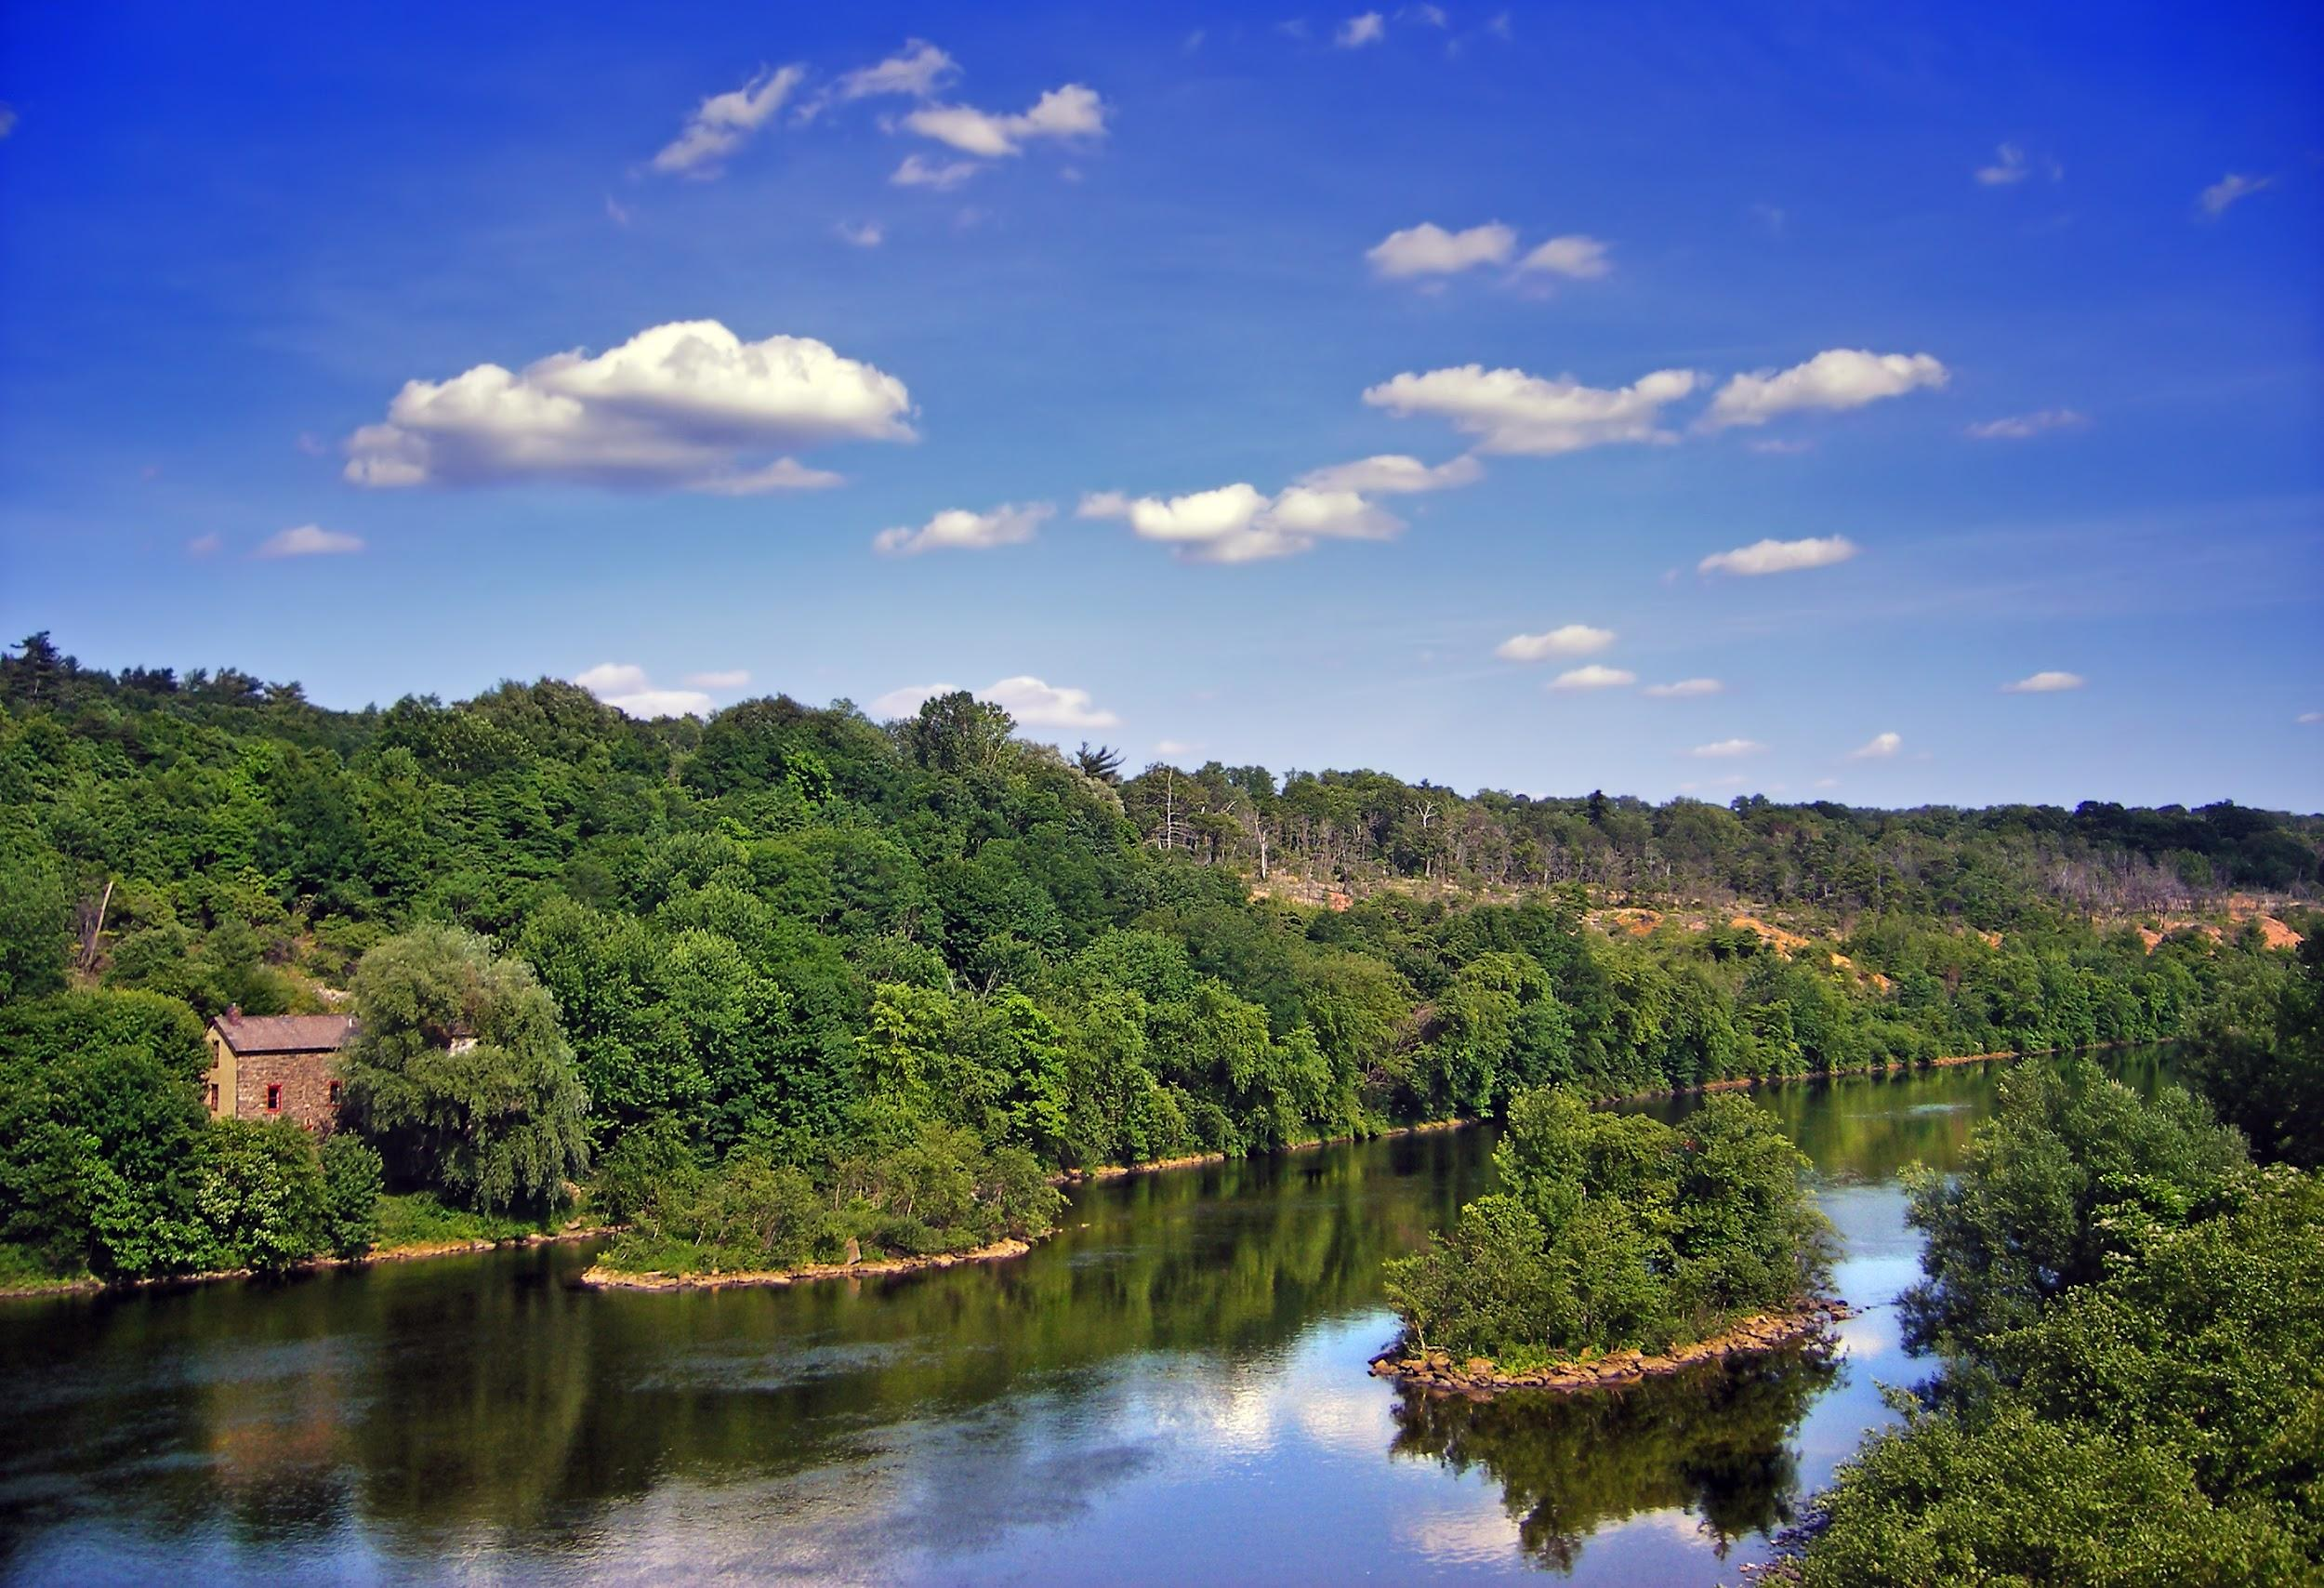
The Ohio River Valley: A Battle for Territory

Slide 2
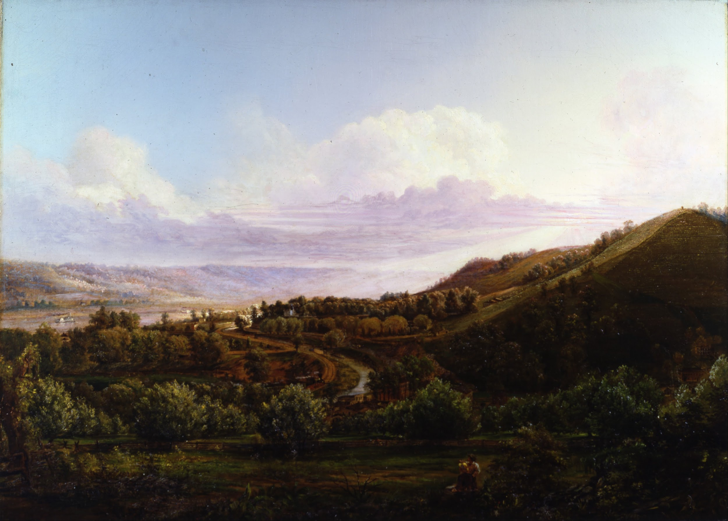
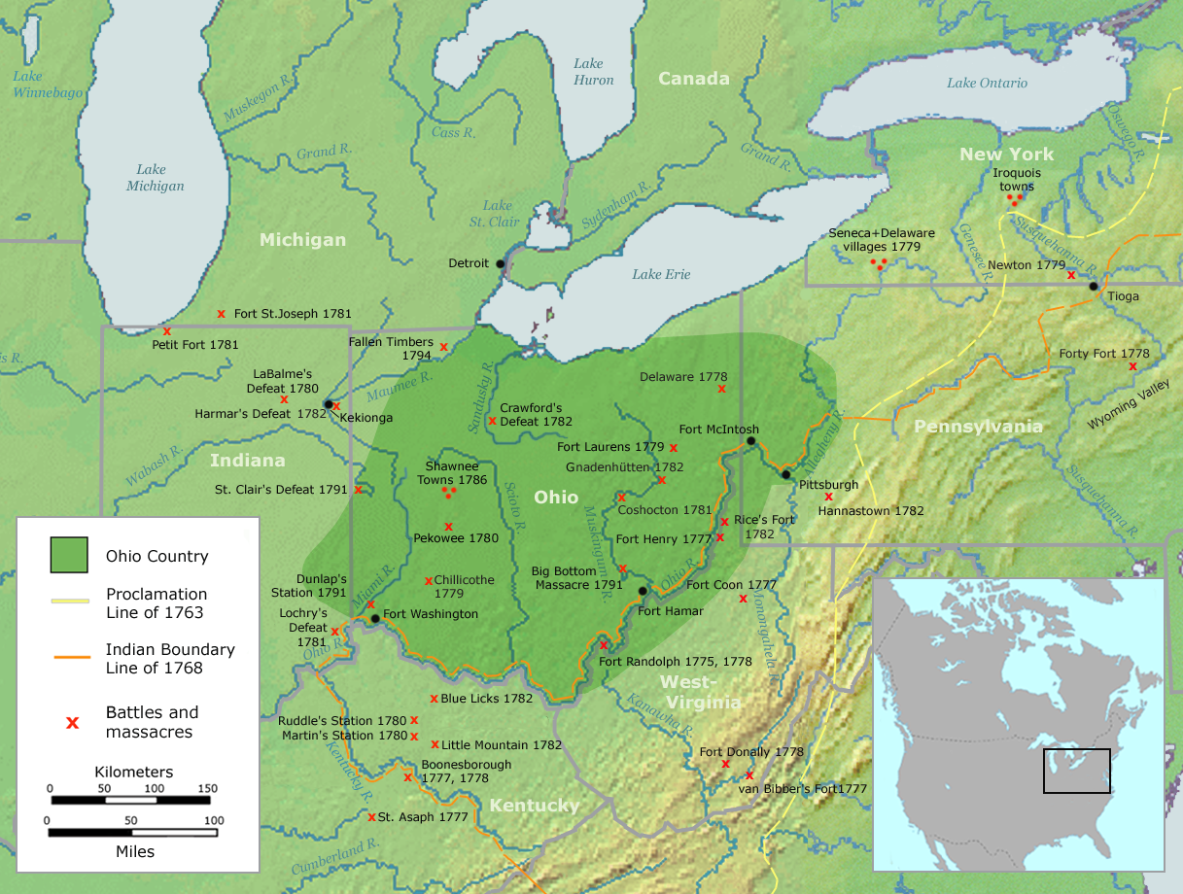
In the early 1700’s more and more people started moving to an area just west of the thirteen British colonies. This area was known as the Ohio River Valley.

Slide 3
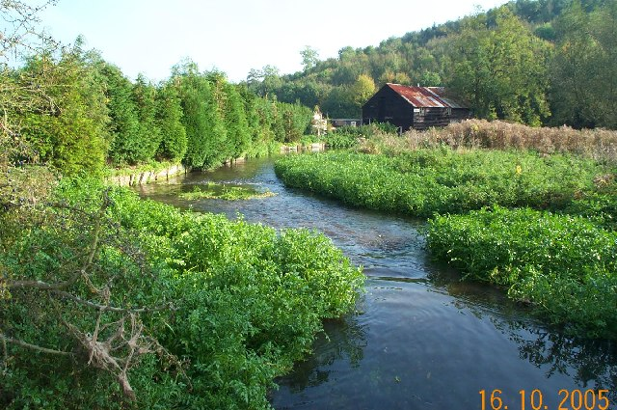
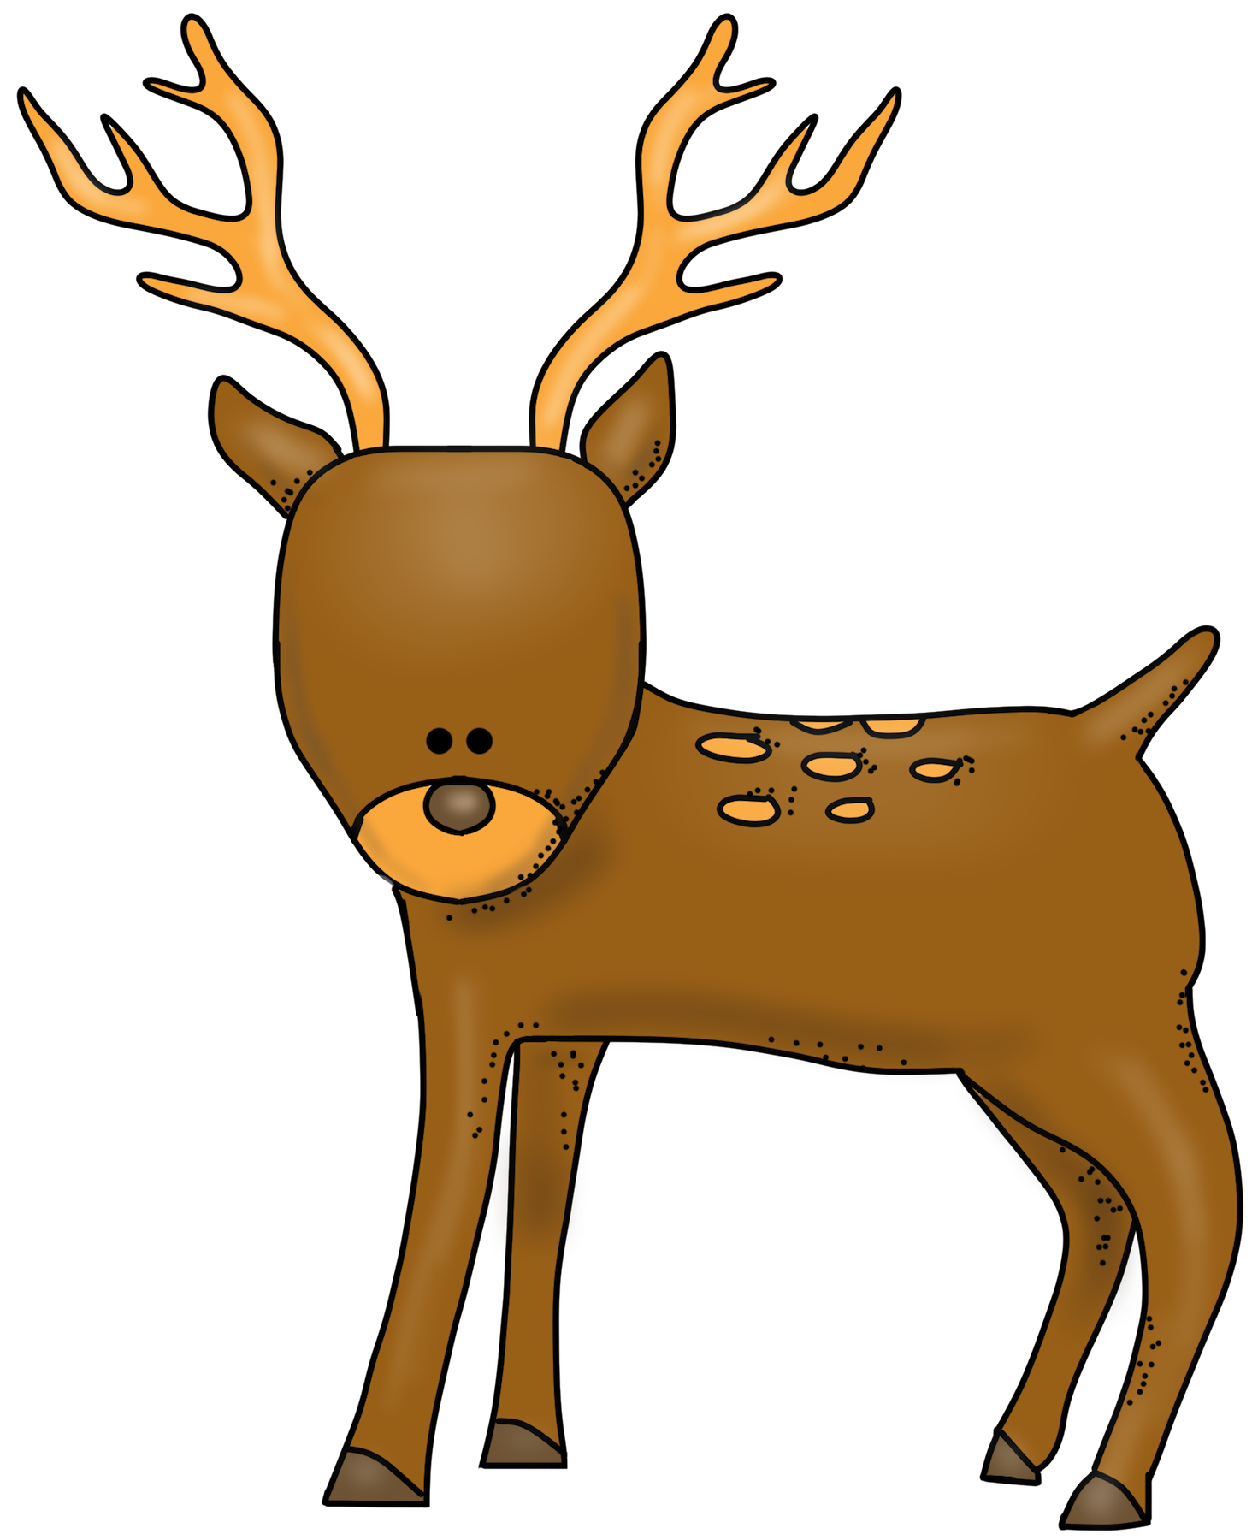
The land around the Ohio River was attractive to people because it offered two things:
Amazing Farmland!
Fabulous Forests for Hunting!!!

Slide 4
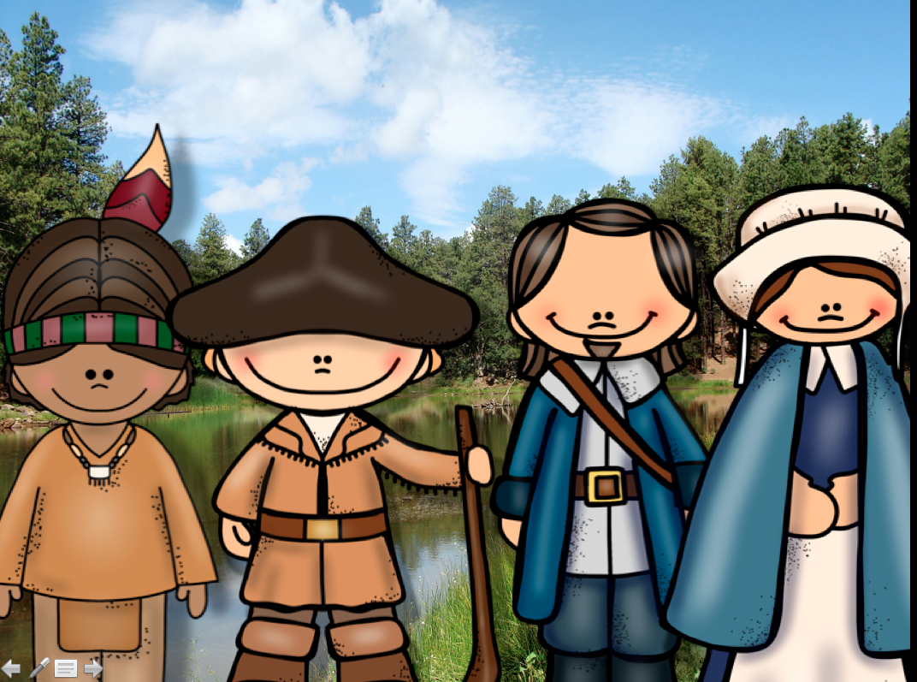
Three major groups wanted to claim this land...
French Fur Trappers
Native Americans
British Settlers

Slide 5
NOW YOU HAVE TO JOIN A GROUP!!

Slide 6
Everyone in your group needs to roll the dice. The highest number gets to choose to be:
A Native American
A French Fur Trapper
A British settler
The second highest roll chooses from the two not picked. The third highest gets the last choice that isn’t picked.
If you have more than 3 people in a group, start the process again. If, for example, you have two Native Americans, they will share resources and play together.

Slide 7
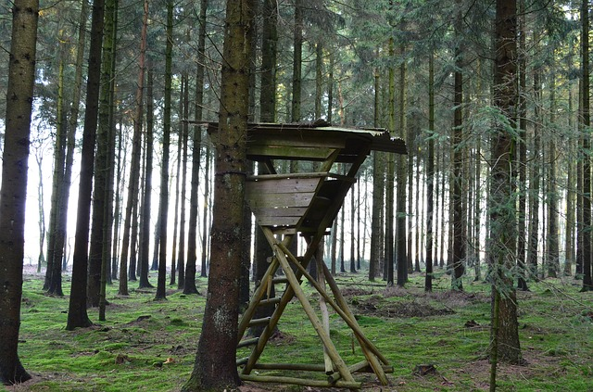
Your object is to take over as much of the Ohio River Valley as possible. To do this the Native Americans need to gain hunting grounds, the French need to build forts, and the British settlers need to build houses. Each of these is represented with tokens.

Slide 8
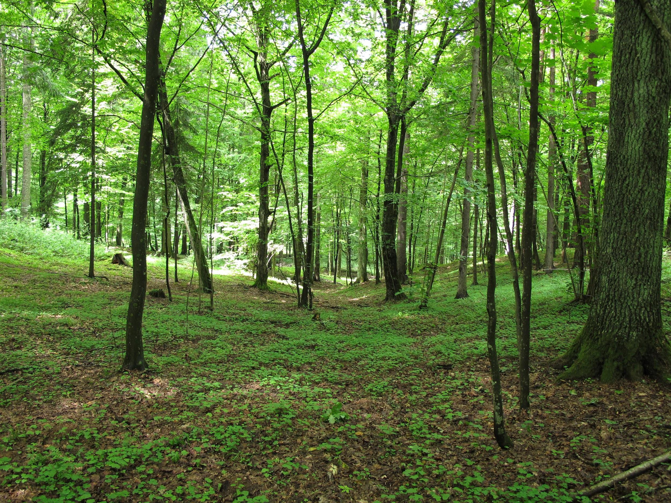
Native Americans will start with 5 hunting ground tokens.
French fur traders will start with 5 fort tokens.
British settlers will start with 5 houses tokens.

Slide 9
1
2
3
4
5
6
7
8
9
10
Click to End Game

Slide 10
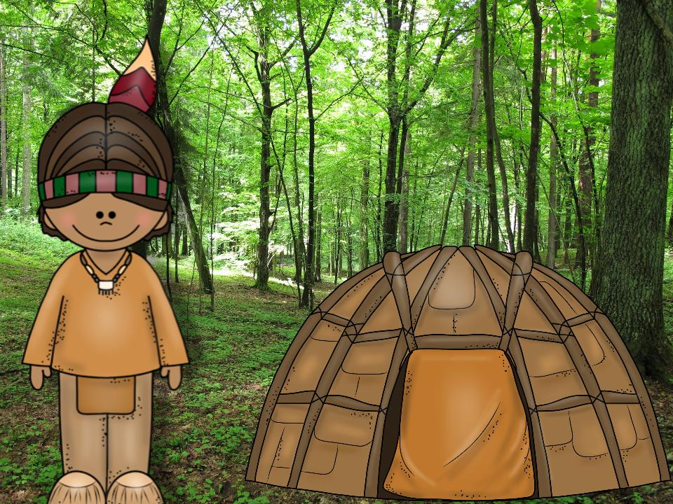
You are a Native American . You are part of the Shawnee tribe. As colonists came to America, your tribe was pushed westward to the Ohio River Valley. Recently, you found some British settlers trying to build houses on your hunting lands. During the night, you and members of your tribe attack the British settlement.
Task:
Take back your hunting lands. Spin the spinner to determine how many.
Destroy a British house. Spin the spinner to determine how many.
Go Back to Choice Screen

Slide 11
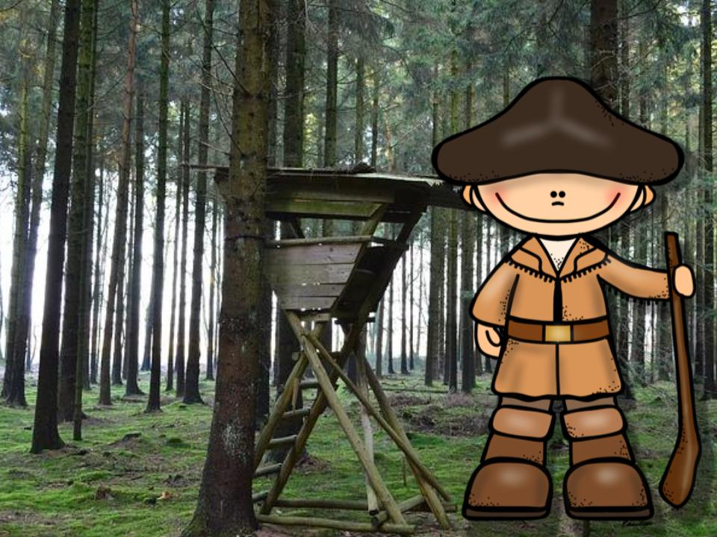
You are a French fur trapper who has worked in the Ohio River Valley for the last year. You move from fort to fort and trade with the Native Americans.
Task:
Build forts. Spin the spinner to determine how many.
Your alliance helps build one Native American hunting ground.
Destroy a British house. Spin the spinner to determine how many.
Go Back to Choice Screen

Slide 12
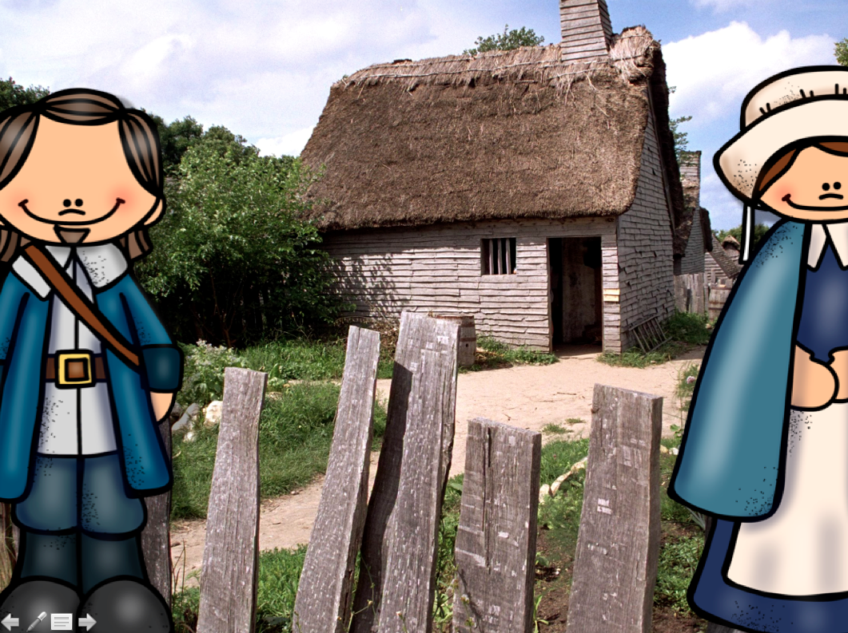
You are a colonial family living in Virginia. You found it very difficult to find a decent sized farm in your area and the ones you have found are way too expensive for you and your small family. You found that the Ohio company is selling land for half of what it costs in Virginia. You decide to start a new life and move out west.
Task:
Build houses. Spin the spinner to determine how many.
Destroy Native American hunting lands. Spin the spinner to determine how many.
Go Back to Choice Screen

Slide 13
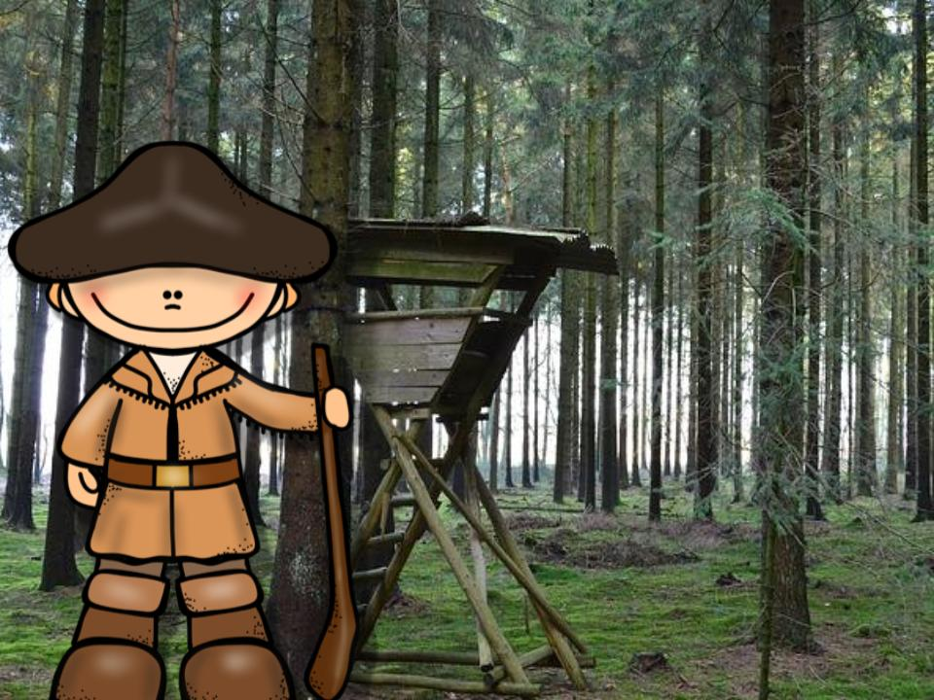
You are a French fur trapper who has worked in the Ohio River Valley for 10 years. You have lived with the local Native Americans and have even married one of the women of the tribe.
Task:
Build forts. Spin the spinner to determine how many.
Give Native Americans 1 hunting land.
Destroy a British house. Spin the spinner to determine how many.
Go Back to Choice Screen

Slide 14
You are a Native American . You are part of the Delaware tribe. Your economy is based on farming, hunting, and fishing. You have formed an alliance with some local French fur trappers because, unlike the British, you don’t mind them because they like to trade with you and don’t want to build villages. This helps maintain your hunting grounds.
Task:
Take back your hunting lands. Spin the spinner to determine how many.
Your alliance helps build 1 French fort.
Destroy a British house. Spin the spinner to determine how many.
Go Back to Choice Screen

Slide 15
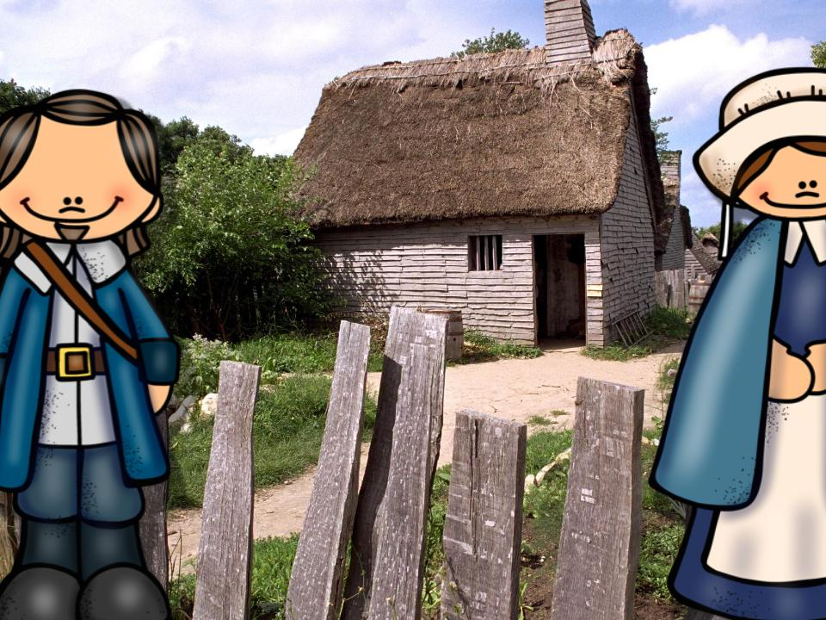
You are a British colonial family living in the Ohio River Valley. Life has become difficult. The Native Americans have been raiding the British villages at night and the French are building more and more forts in the valley.
Task:
Lose houses. Spin the spinner to determine how many.
Give Native American hunting lands. Spin the spinner to determine how many.
Give the French forts. Spin the spinner to determine how many.
Go Back to Choice Screen

Slide 16
You are a French fur trapper. The British have been moving steadily into your land and trying to make you leave your forts.
Task:
Lose forts. Spin the spinner to determine how many.
Build British houses. Spin the spinner to determine how many.
Go Back to Choice Screen

Slide 17
You are a young British family that has recently moved to the thirteen colonies. They are very overcrowded. Governor Dinwiddie, the governor of Virginia, has claimed that their original charter means they own all the lands from their colony to the Pacific Ocean. You decide to get a fresh start and move to the lands of the Ohio River Valley
Task:
Build houses. Spin the spinner to determine how many.
Destroy Native American hunting lands. Spin the spinner to determine how many.
Destroy 1 French fort.
Go Back to Choice Screen

Slide 18
You are a Native American . Your tribe was pushed into the Ohio River Valley by the British settlers in the thirteen colonies and now they are trying to push you out of the Ohio River Valley.
Task:
Losehunting lands. Spin the spinner to determine how many.
Build a British house. Spin the spinner to determine how many.
Go Back to Choice Screen

Slide 19
Go Back to Choice Screen
You are a young British family that has been living in the Ohio River Valley. You really enjoy your lives in the valley and decide to invest some money into more property that you can sell to other British settlers.
Task:
1) Build houses. Spin the spinner to determine how many.
2)Destroy 1 French fort.
3) Destroy Native American hunting lands. Spin the spinner to determine how many.

Slide 20
So...
who won?

Slide 21
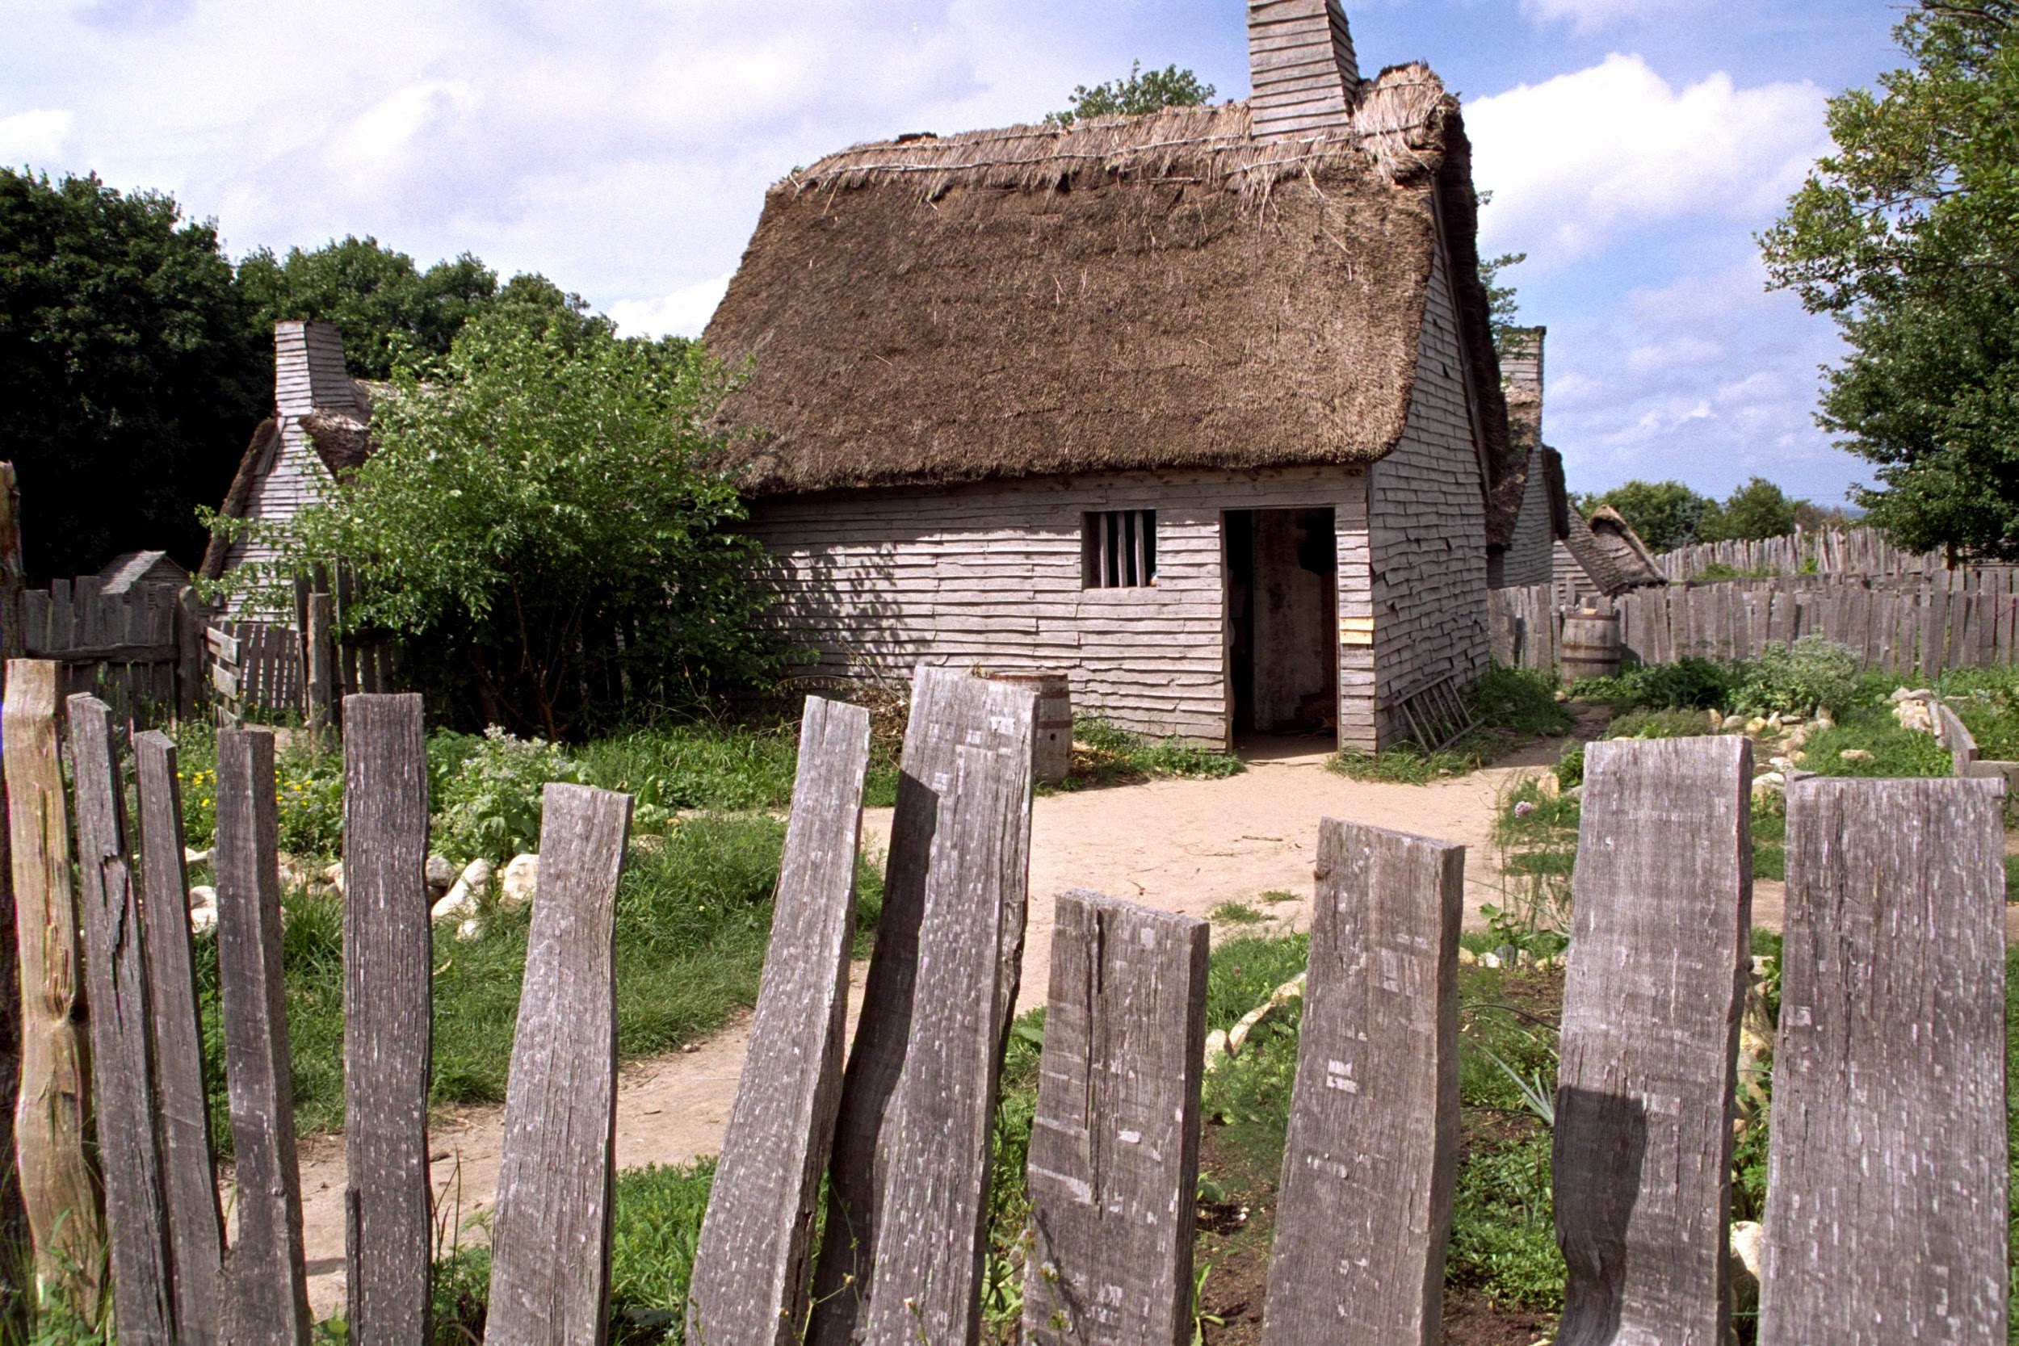
To win, one group would need to control the whole board. This means that they would have be the only group with any tokens on the board.

Slide 22
Did this happen in your group? What about other groups in your class?

