Slide 1
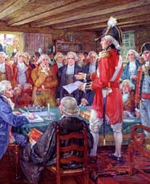
The Road To War
An American Revolution Choose Your Own Adventure Activty
Created by Colleen Maranto
Click here to begin your adventure

Slide 2
British Parliament needed money to pay for the French & Indian war. Since the war had been fought on American soil, Parliament convinced King George to tax the colonists to pay off this debt. This set off a series of events that created a power struggle between the colonists and King George. These events forced the colonists to take sides. colonists who opposed British rule were known as patriots. They were willing do anything (even risk their lives) for freedom. Colonists who wanted to remain Loyal to king George and Britain were known as loyalists.
Loyalists
Pick your role
Patriot
Will you be a Loyalist and remain true to the King no matter what hardships he places upon you?
Or
Will you be a Patriot risking your life, your property, and possibly putting your family in danger to stand up to the king and fight for your rights.

Slide 3
Loyalists
As a Loyalist you oppose your fellow colonists who want to fight for freedom. You like the security of the British government and are happy with how things are with King George in control. You don’t want to upset the king and make matters even worse. However, you risk persecution by your fellow colonists who are Patriots.
Previous slide Continue

Slide 4
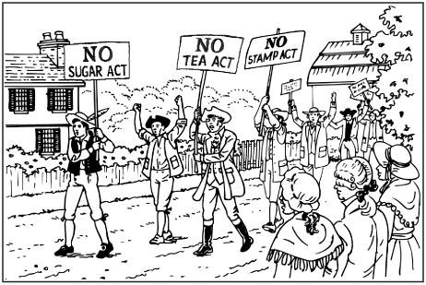
Patriot
As a Patriot, it is dangerous for you to speak out against British rule. If you anger the king or upset parliament you could be charged with treason and possibly hung. However, you feel strongly that the king is abusing his power and treating the colonists unfairly. You feel you must take a stand to protect your future.
Go Back Continue

Slide 5
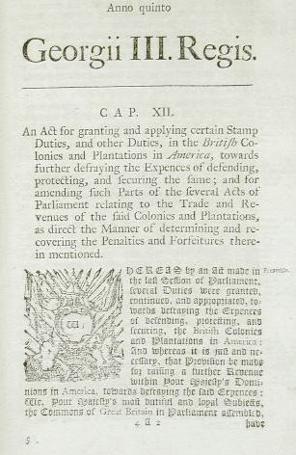
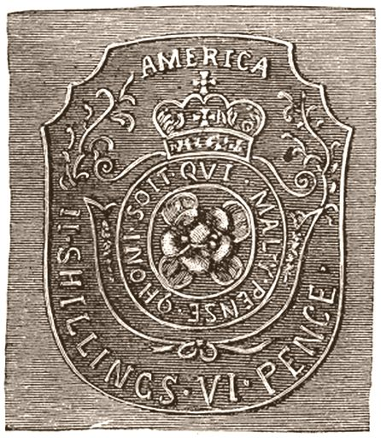
The Stamp Act
In 1765 Parliament placed a tax on all printed materials in the colonies. This law put a tax on legal documents, newspapers, and even playing cards. When colonists bought these items they had to buy a stamp and put it on the item to show they had paid the tax.
Continue as a loyalist
Continue as a Patriot

Slide 6
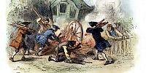
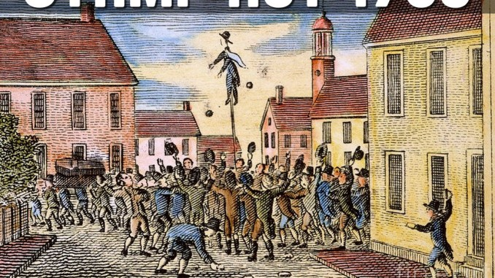
Loyalists As a Loyalist you are becoming more afraid to voice your opinion. Colonists who are unhappy with the Stamp Act try to intimidate you and scare of stamp agents with pictures like these. Many loyalist are changing their opinions and no one wants to be a stamp agent!
The Patriots protests work and in October 1765, Parliament votes to repeal or cancel the Stamp Act. You are hopeful that the repeal puts an end to this conflict and life in the colonies can return to normal.
Previous slide Continue

Slide 7
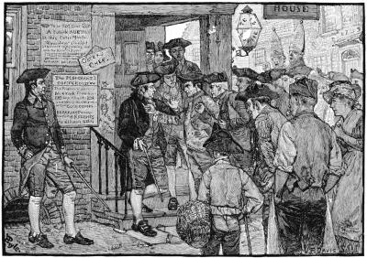
Patriots
You are angry about the Stamp Act. You feel it is unfair for Parliament to tax you since as a colonist you never voted for the British Parliament. This idea leads you to join in with the popular protest cry,
“No taxation without representation!”
You join William Henry as he leads the colonists’ in protest against the Stamp Act. You are victorious! In October 1765, Parliament votes to repeal or cancel the Stamp Act.
Continue

Slide 8
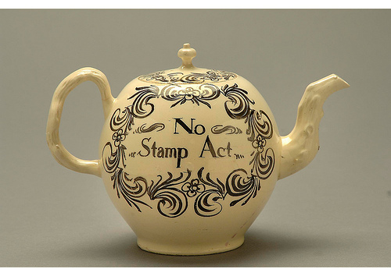
The Townsend Act
However, Britain still needs money to pay for the war so parliament imposes a new tax on all imported items. The Townsend Act taxes paper, wool, tea, and other goods the colonists import from Britain. British leaders hope the colonists will agree to pay these taxes. However, they have another goal as well – to show the colonies who is in charge!
This new tax makes the colonists even more mad. They decide to boycott any items imported from Britain.

Slide 9
Do you stay loyal to the king enjoying your favorite imported items from Britain or do you side with the patriots giving up many of your favorite luxuries such as tea and wool that come from England?

Slide 10
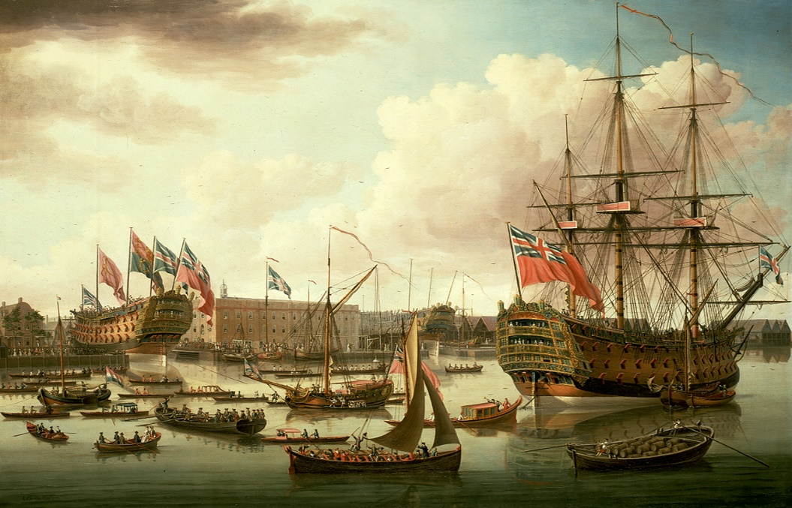
Other colonists looked down upon you. They consider you a coward for not standing up to the king. The boycott is hurting British businesses which is making the situation worse for everyone. As a result the king decides to take action and sends warships into Boston Harbor. British soldiers now walk the streets. As a Loyalist you are starting to became fearful of both the Patriots and the soldiers.
Previous slide Continue
Loyalists

Slide 11
Patriots
The situation with Britain is getting worse. The boycott is hurting British businesses. As a result the king decides to take action and sends warships into Boston Harbor. Now British soldiers walk the streets intimidating colonists and making them fearful of retributions from the king.
Previous slide Continue

Slide 12
THE Boston Massacre
Tensions are rising in Boston since the arrival of British soldiers. Fist fights between soldiers and colonists are becoming a common sight in the streets. Then on the night of March 5th 1,770 angry colonists surround a group of soldiers. The soldiers panic and fire into the crowd killing five people.

Slide 13
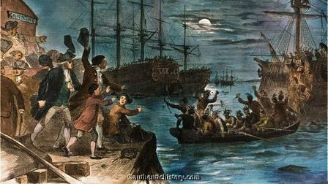
The Boston Tea Party
The Patriots have had enough! They are tired of the kings taxes and British soldiers intimidating them in the streets. Late one night, three ships carrying British tea sail into Boston Harbor. The Patriots disguise themselves as Mohawks and row out to the British ships shouting “Boston Harbor a teapot tonight!” They board the ships and dump all the tea into the harbor.

Slide 14
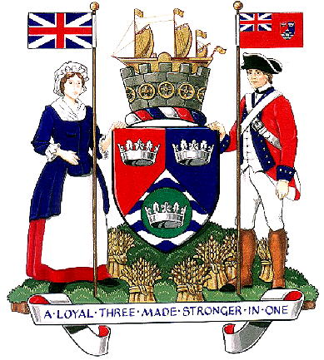
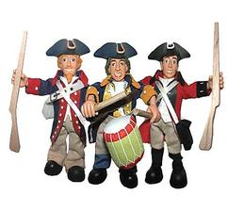
The Boston Tea Party infuriates the king. He closes the port of Boston. No ships will be allowed in until the colonists have paid for the tea they destroyed.
Do you remain Loyal to the King?
Do you stick with the Patriots?

Slide 15
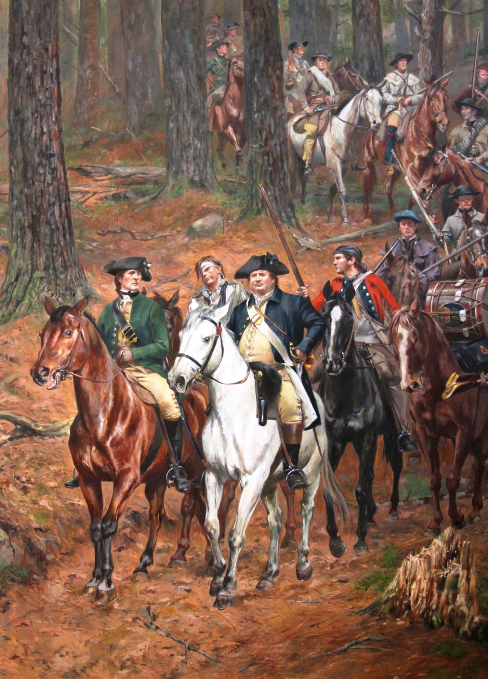
Loyalist
As a Loyalist the next decade will be hard for you. The Patriots will Declare Independence and the Revolutionary war will begin. Even though you are loyal to the king the battles will still be fought on your home front. You will be caught in the middle as your friends, neighbors, and maybe even some of your relatives fight the war. However, in the end you will see the birth of a new nation and become a proud citizen of the United States of America.
Return to beginning
This Photo by Unknown Author is licensed under CC BY-SA

Slide 16
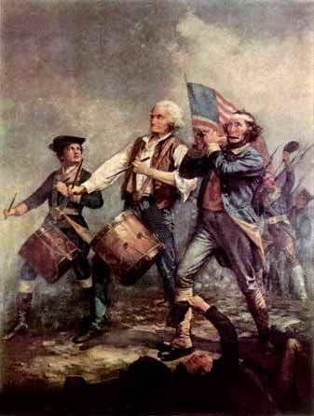
As a Patriot your battle for freedom is just beginning. In 1776 the Continental Congress, made up of delegates from each of the thirteen colonies, will vote to Declare Independence and the Revolutionary War will begin. The next ten years will be harsh for everyone in the colonies as the war continues. In the end you will be proud of the role you played to help form our nation –
The United States of America!
Return to beginning

