Slide 1
Opinion Writing
Mrs. Maranto Fifth Grade ELA/Social Studies
Adapted from lancasterschools.org/cms/lib/NY19000266/Centricity/Domain/593/powerpoint.pptx

Slide 2
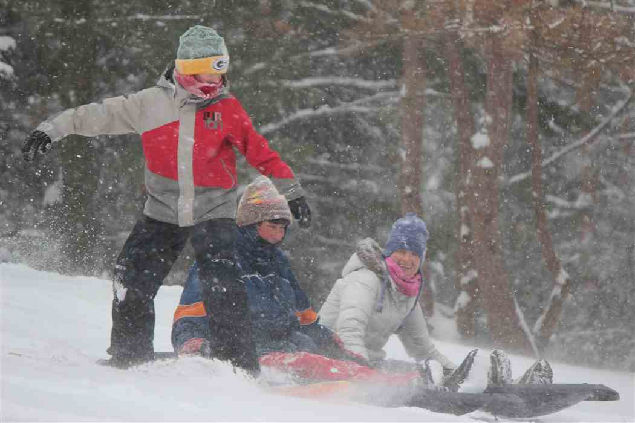
Do you think students should have to make up snow days?

Slide 3
Opinion Writing
What is Opinion Writing?
Opinion writing states a claim and gives the writer’s views on a topic.
It persuades readers to think or feel a certain way or calls them to take some action.

Slide 4
A claim states your opinion
I think schools should have to make up snow days.
I think schools should not have to make up snow days.
When school is closed students fall behind because important skills are not covered
Spending time at school is important in helping students develop positive social skills
School work could be online during snow days so students wouldn’t fall behind in their studies.
The school year is already long enough, student’s need the summer months to relax and spend time with their families.

Slide 5
Practice writing a claim about exercise
Start your claim with strong words or a phrase that lets your readers know your are stating your opinion.

Slide 6
Opinion Writing
What are the goals of an opinion paper?
To state the writer’s opinion
To support the opinion with logically ordered reasons reinforced by unbiased facts and details

Slide 7
Opinion Writing
You can find opinion writing in many places:
advertising
letters to an editor
book reviews
magazine articles
newspaper columns

Slide 8
Opinion Writing
Opinion Writing Traits
A clear opinion in a thesis statement
Strong supporting reasons and facts
Counterclaims anticipated and addressed
A logical organization: the introduction includes an opinion, the body includes a strong argument, and the conclusion ends with a summary or call to action
Effective transitions that link opinions and reasons

Slide 9
Opinion Writing
Opinion Writing Traits
A voice and tone that are appropriate for the purpose and audience
Language that is fair, balanced, and precise

Slide 10
Opinion Writing
Opinion Writing Traits
A variety of sentences that add interest to the writing and are easy to read
No or few errors in grammar, usage, mechanics, and spelling

Slide 11
Opinion Writing
Opinion Writing Example
I think students at Garrett Elementary School should not have to wear school uniforms. Many people believe that a dress code allows students to focus on their grades. However, other schools in the city that do not have dress codes also receive excellent academic rankings. In addition, the uniforms are uncomfortable and expensive. Consequently, the teachers should let the students at Garrett Elementary wear their own clothes.
Writer’s Opinion

Slide 12
Opinion Writing
Opinion Writing Example
I think students at Garrett Elementary School should not have to wear school uniforms. Many people believe that a dress code allows students to focus on their grades. However, other schools in the city that do not have dress codes also receive excellent academic rankings. In addition, the uniforms are uncomfortable and expensive. Consequently, the teachers should let the students at Garrett Elementary wear their own clothes.
Reasons

Slide 13
Opinion Writing
Opinion Writing Example
I think students at Garrett Elementary School should not have to wear school uniforms. Many people believe that a dress code allows students to focus on their grades. However, other schools in the city that do not have dress codes also receive excellent academic rankings. In addition, the uniforms are uncomfortable and expensive. Consequently, the teachers should let the students at Garrett Elementary wear their own clothes.
Linking Words and Phrases

Slide 15
Opinion Writing
Opinion Writing Example
I think students at Garrett Elementary School should not have to wear school uniforms. Many people believe that a dress code allows students to focus on their grades. However, other schools in the city that do not have dress codes also receive excellent academic rankings. In addition, the uniforms are uncomfortable and expensive. Consequently, the teachers should let the students at Garrett Elementary wear their own clothes.
Concluding Statement

Slide 16
Opinion Writing
Some common types of opinion writing include the following:
Editorial
Response to Literature
Opinion Essay
Letter to Editor
Speech

