Slide 1
Academic Improvement – Reading Ms. Schmidt

Slide 2
Academic Improvement Goals
Increase comprehension and understanding of fiction and nonfiction text.
Increase critical thinking, going beyond what is written in the text.
Increase fluency (rate, speed, accuracy).
Increase vocabulary and decoding skills.

Slide 3
Placement Into Reading Improvement
Based on:
-Previous STAR scores (Fall, Winter, Spring)
-Will start with NWEA during the 18-19 school
year
-Teacher Recommendation
Students are progress monitored with NWEA and AIMSweb throughout the year to make sure placement is correct.
After data review, if a student proves not to need the Academic Improvement course, he/she will be placed into the Encore rotation.

Slide 4
Textbooks
Reading Express Workbook – Comprehension Intervention
Be a Better Reader Workbook – Supplemental Comprehension
Lexia – Supplemental online comprehension and word study work

Slide 5
materials
Class Workbooks (stay in classroom, unless homework is assigned)
AR Book
Folder
Pencil

Slide 6
Grading
Pass = 100% - 70%
Fail = 69% and below
Per Summit Hill School District 161 Policy:
Formative Assessment is the formal and informal processes teachers and students use to gather evidence for the purpose of improving learning. Assessment for learning is how we provide students valuable feedback on their progress toward achieving the specific learning target.
Summative Assessment provides evidence of student achievement for the purpose of making a judgment about student competence or program effectiveness. Assessment of learning is how we know our students have achieved specific learning expectations.

Slide 7
Summative Reassessment
Students may complete a reassessment on a summative score.
The most recent score will be recorded.
Students must complete the summative reassessment form and all items listed on the form.​
Assistance is available during advisory or student may attend intramural study hall.
Students complete pretest corrections in class as part of test study prior to initial test.
Students will complete an alternate review of test material.

Slide 8
Behavior & Discipline
Students will receive verbal reminders, parent/guardian phone calls, and detention as needed
Follow all rules outlined in the student handbook.
Be respectful to staff, students, and yourself.
Make complete efforts on all assignments and participate in class.

Slide 9
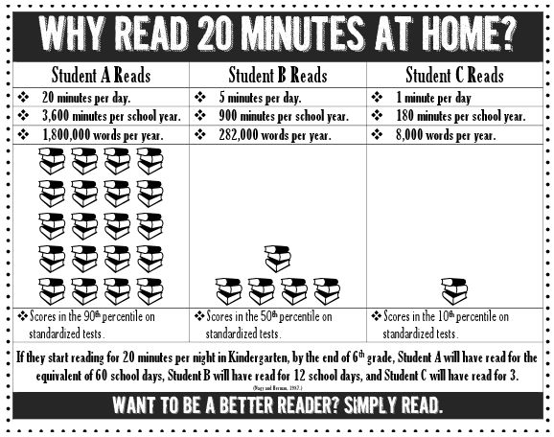
Why Reading Is Important

Slide 10
Topics Covered
Vocabulary Skills: Prefixes, Suffixes, and Root Words, Content Clues, Multiple Meaning Words
Text Features: Charts, Graphs, Maps
Text Structures: Compare/Contrast, Cause/Effect, Chronological Order, Problem/Solution
Reading Comprehension: Author’s Purpose, Main Idea and Supporting Details, Inferences and Conclusions, Fact and Opinion, Propaganda
Literary Elements: Plot, Conflict, Character, Theme, Mood and Tone, Irony, Symbolism
Genres: Short Stories, Myths and Legends, Poetry, Informational Materials, Autobiographies and Biographies
Reading Strategies: Previewing, Self-Questioning, Making Connections, Summarizing

Slide 11
Contact Information
Please see my class website.
Lesson plans are listed under downloads.
Feel free to contact me via email: lschmidt@summithill.org
I am available for phone calls before school from 7:30-7:40, from 10:30-11:15, and after school from 2:30-2:40.

