Slide 1

Welcome to Curriculum Night
2018-2019
Dr. Julian Rogus School
Third Grade
Mrs. Labedz

Slide 2
All about me…
Graduated from Saint Xavier University with Degree in Elementary Education
Graduated with a Master’s Degree in Teacher and Leadership from Saint Xavier University
Middle School Endorsement
Teaching for 16 years
Experience in teaching grade levels K, 1st, 3rd, 4th and 5th

Slide 3

The Rogus Family Values-
ABC’s of Positive Classroom Culture
A-ACCEPTANCE
B-BELONGING
C-COMMUNITY

Slide 4

Rogus Expectations:
Positive Behavioral Intervention
&
Supports
PBIS supports a positive school climate. Be Respectful, Be Responsible, Be Safe
Students will have the opportunity to earn Eagle Tickets.
Tickets are used to redeem for various rewards, prizes, or experiences like “Lunch with the Teacher”.
We will visit the Eagle’s Nest Store once a month.

Slide 5
Celebrate the Child
I look forward to getting to know each of your children as individuals and helping in assist in their academic growth this year.
Goal Setting
Birthday Bag
Eagle Tickets
Star of the Week
Classroom Helpers
Catch you Being Kind
Marble Jar & Weekly Raffle
Desk Fairy

Slide 6
Classroom Expectations
Behavior Clip Chart: "How far can I clip up today?" This chart is multicolored and on each color it states: purple=OUTSTANDING, blue=GREAT JOB, light blue=GOOD DAY, green=READY TO LEARN, yellow=THINK ABOUT IT, orange=TEACHER CHOICE, red=PARENT CONTACT
If a student moves their clip down to orange=Teacher Choice, they will have minutes taken away from activity time and will write in the Behavior Log.
If the student moves their clip to red=Parent Contact, I will contact you directly by phone or in writing and a disciplinary form will be written. The student will also have minutes taken away from activity time and will write in the Behavior Log. This will be done on a daily basis and every day each child will start with a clean slate.
If a student is "off the charts", they will earn an eagle ticket to use at the Eagle's Nest for fabulous incentives!

Slide 7



Specials Schedule
Monday=P.E., Technology
Tuesday=P.E., Art, Library
Wednesday=P.E., Music
Thursday=P.E., Music
Friday=P.E.

Slide 8
Subjects
ELA/Reading= We will use our reading textbooks, short stories, small passages, and novels. On average, we will spend 2 weeks on a story out of the Journey's textbook.
ELA/Language Arts= We will work on grammar as well as writing. A weekly Daily Oral Language Review will be administered for whole class practice. We will use the English textbook on a daily basis. Students will create a variety of writing samples to place in their writing portfolios throughout the year.
ELA/Spelling=There will be a bi-weekly spelling summative and a spelling homework menu for each story.
Math= We will continue using the math curriculum this year, Go Math! The concepts taught this year will be: review of addition and subtraction, graphing and tables, multiplication, division, fractions, measurement and geometry.
Science= Stem Scopes include: objects in motion, electric and magnetic forces, weather and climate, Earth and space, inheritance and traits, life cycles, social and group behavior
Social Studies=Topics include: Geography/Map study and The American Revolution. Review of geography and map skills will be practiced daily.
For a complete list of Common Core State Standards, please see the district website.

Slide 9

Formative assessments
Help the teacher determine next steps during the learning process as the instruction approaches the summative assessment of student learning.
Help students identify their strengths and weaknesses as well as target areas that need work.
Help teachers understand where students are having difficulty to address that need immediately.
Examples: Homework, In class assignments, Practice problems, Short quizzes, Exit slips
Weighted 25% in PowerSchool

Slide 10

Summative Assessments
Summative Assessments are designed to measure student growth.
Often given at the end of a unit or skill.
Weighted 75% in PowerSchool
Can be broken up into skill or concept taught.
Examples:
-Final project
-End of unit portfolio
-End of unit test
-End of skills test
-Chapter Test

Slide 11
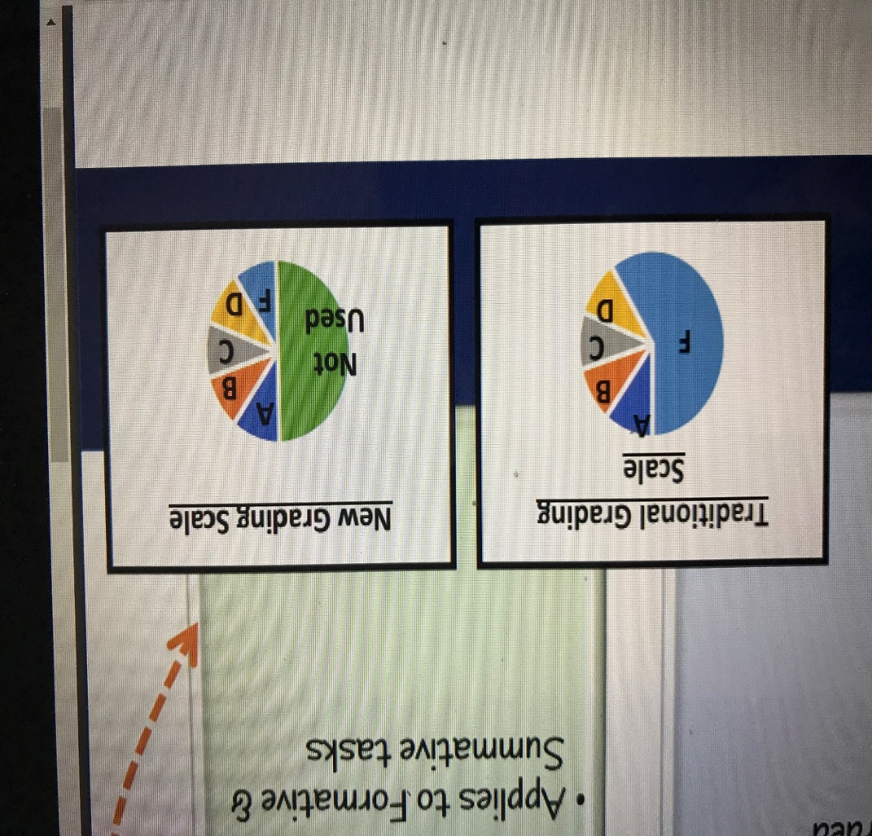
New District grading Scale
A new grade scale has been created to better reflect student growth. The following now applies to the grade scale:
The reporting system has been adjusted to equalize the influence of each score. Equal increments will be used to report student achievement.
A=100-90
B=89-80
C=79-70
D=69-60
F=59-50
The lowest possible score a student will receive on a summative assessment will be a 50%. If a student’s final score falls below a 50%, a 50% will count as the final score, but the actual score will be listed in the comment section of the assignment in PowerSchool.

Slide 12
District Grading & Assessment Retake Policy
Third and fourth grade teachers believe that learning is a priority and a process. In an effort to promote student growth, teachers are allowing students the opportunity to retake certain summative assessments completed in school. The following re-take procedures apply:
All D or F scores on a summative assessment WILL be reassessed one time.
Students who score an A, B, or C on a summative assessment will have the opportunity for a retake assessment once per quarter per subject.
For any reassessment, the most recent score will be recorded as per district policy.
For scores of A, B, or C a parent must request a reassessment in writing within 2 days of receiving the assessment.
Once a teacher receives a reassessment request from a parent, the teacher will notify the parent when the reassessment will take place.
SEE REASSESSMENT FORM INCLUDED IN POWER POINT HANDOUT

Slide 13
Homework is an extension of the day.
Assigned Monday-Thursday
The district requires 30-40 minutes of HW a night in 3rd grade.
Check and sign your child’s assignment notebook.
Absence Assignments missed due to illness will be given one day per day of absence plus one day. Requests for homework should be given to the school office before 11 A.M. and picked up at the school at the end of the school day. Summit Hill School District 161 appreciates parents taking an active role in the child’s education both at school and at home.
Reading calendar-Students should be reading 20 minutes daily. Be sure to initial your child’s reading calendar each day.
Homework incentives-ROGUS letters
Students must have at least one letter remaining in order to participate in quarterly incentive.

Slide 14
Procedures
Students are expected to come to school prepared to learn everyday. Upon entering, each student will be responsible for emptying his/her take-home folder of any notes or homework and putting them in the appropriate place.
We will have a brain break and snack time every morning. Please send your child with a small, healthy snack.
Lunch & recess is at 12:30
Dismissal at 3:30

Slide 15
Weapons Policy
Illinois law requires school officials to expel a student who is determined to have a weapon at school or any school-sponsored activity or event that bears a reasonable relationship to school. Weapons include not only guns, but also look alikes and any object used to cause or threaten injury. The expulsion from school must be for a period of not less than one year except that the Superintendent or the School Board may modify the expulsion period on a case-by-case basis. Student threats to use a weapon, even if intended as a joke, will also be dealt with severely in order to maintain the safety of students and District 161 employees.

Slide 16

Communication
Newsletters will be sent home weekly and are posted on my teacher website.
Monday folders will go home with graded formative and summative assessments. Return the Monday folder back with a parent signature.
Use the assignment notebook as a communication tool.
Email = klabedz@summithill.org
Call before or after school=1-815-464-2034

Slide 17

Thank you for coming!
-unknown author

