Slide 1
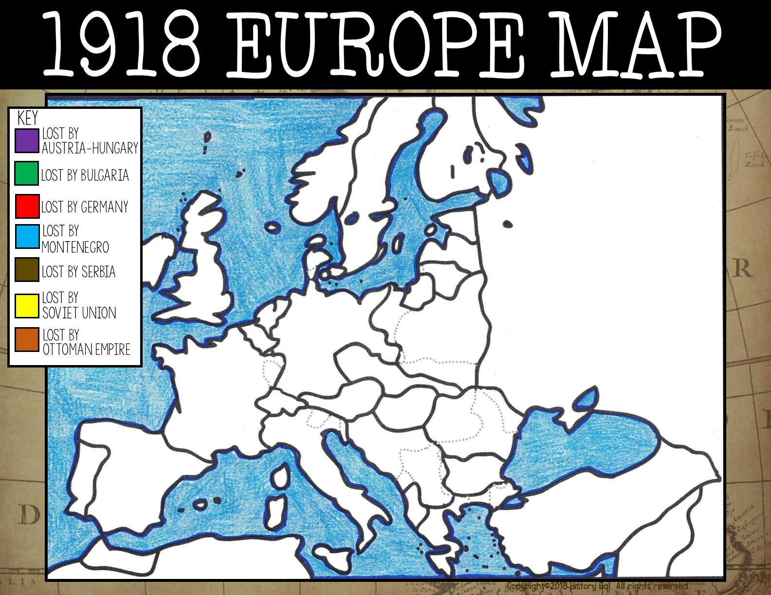

Slide 2
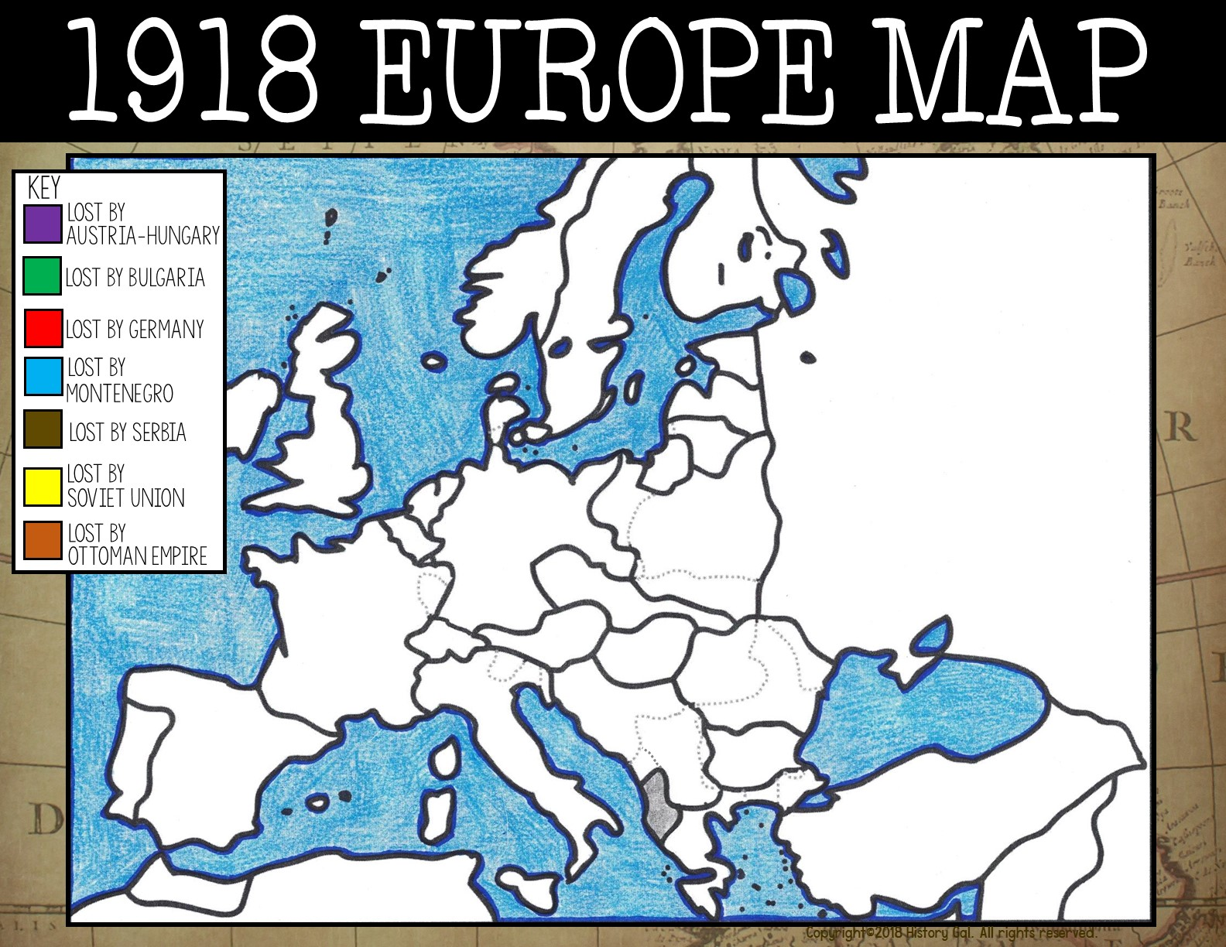
Albania

Slide 3
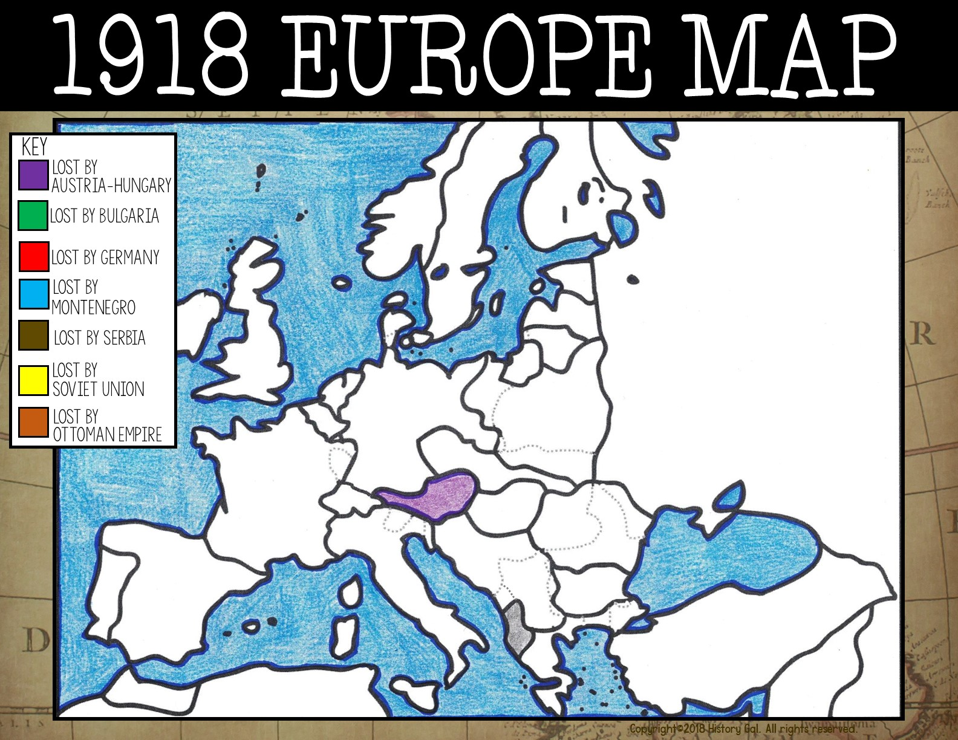
Austria
Albania

Slide 4
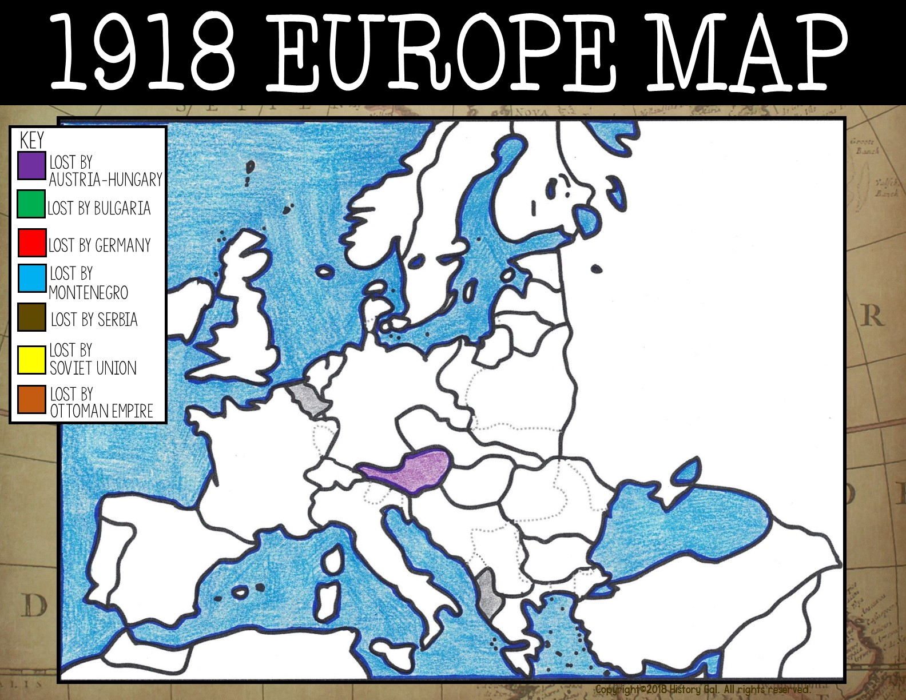
Belgium
Austria
Albania

Slide 5
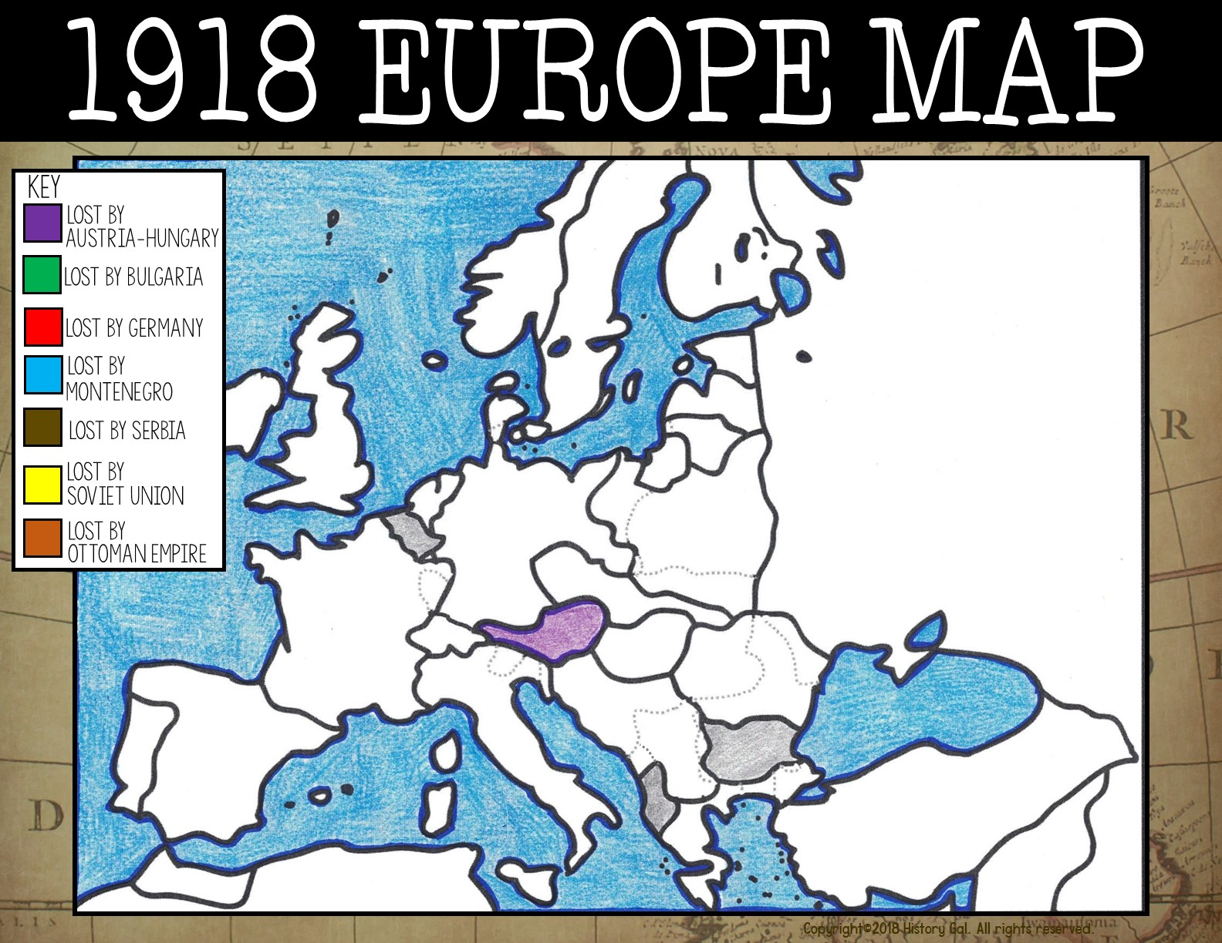
Belgium
Austria
Bulgaria
Albania

Slide 6

Belgium
Czechoslovakia
Austria
Bulgaria
Albania

Slide 7

Denmark
Belgium
Czech.
Austria
Bulgaria
Albania

Slide 8

Denmark
East Prussia (Germany)
Belgium
Czech.
Austria
Bulgaria
Albania

Slide 9

Estonia
Denmark
East Prussia
Belgium
Czech.
Austria
Bulgaria
Albania

Slide 10

Finland
Estonia
Denmark
East Prussia
Belgium
Czech.
Austria
Bulgaria
Albania

Slide 11
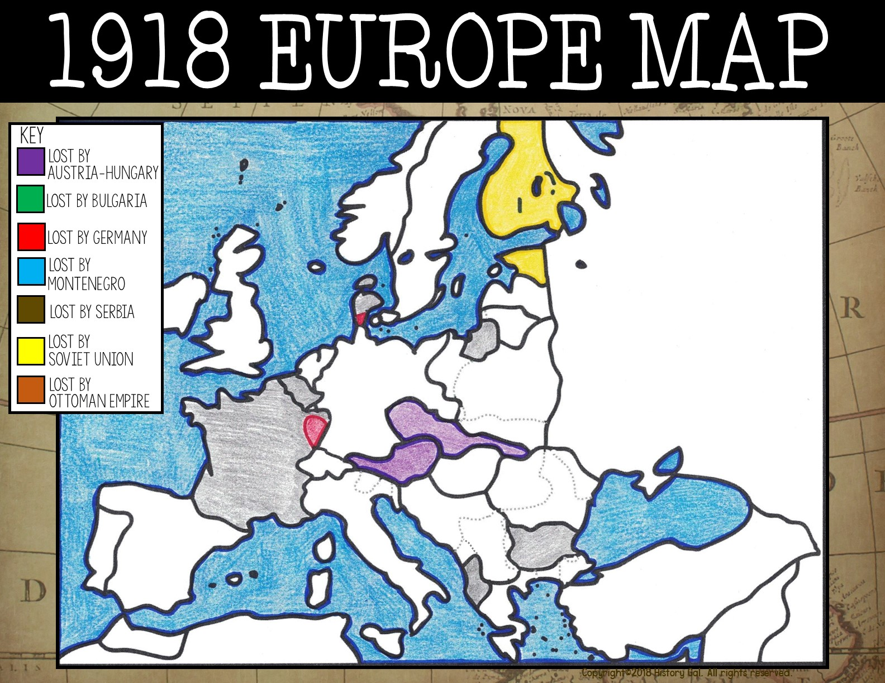
Finland
Estonia
Denmark
East Prussia
Belgium
Czech.
France
Austria
Bulgaria
Albania

Slide 12
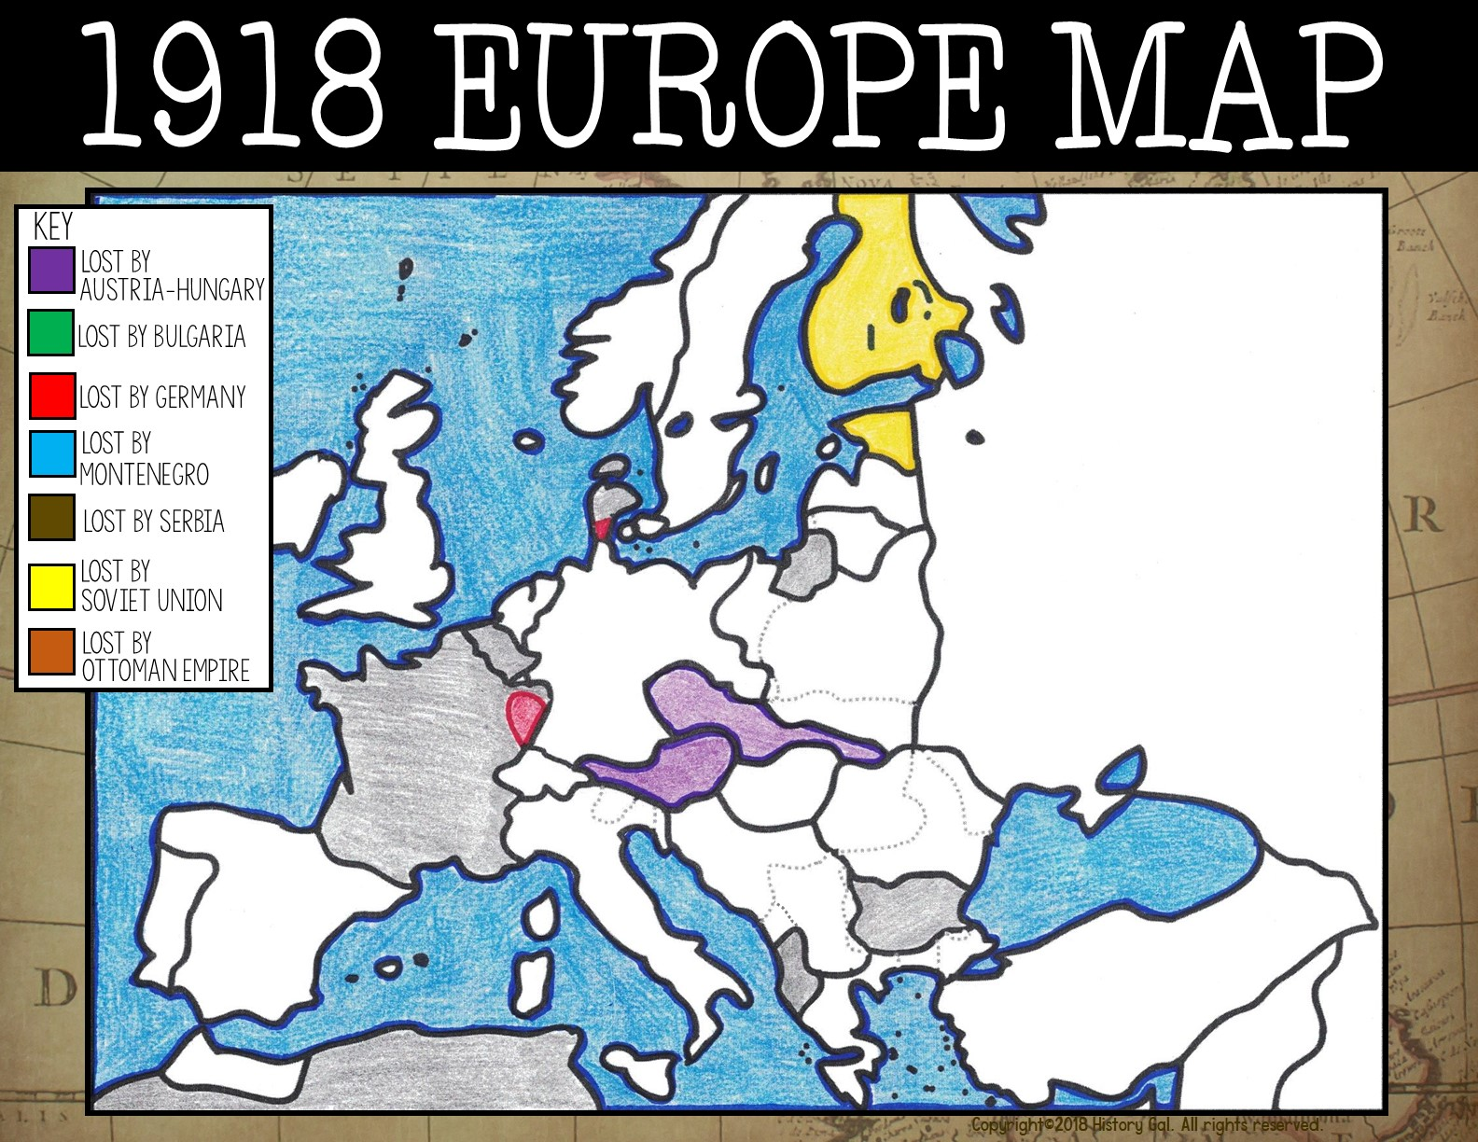
Finland
Estonia
Denmark
East Prussia
Belgium
Czech.
Austria
France
Bulgaria
French
West Africa
Albania

Slide 13
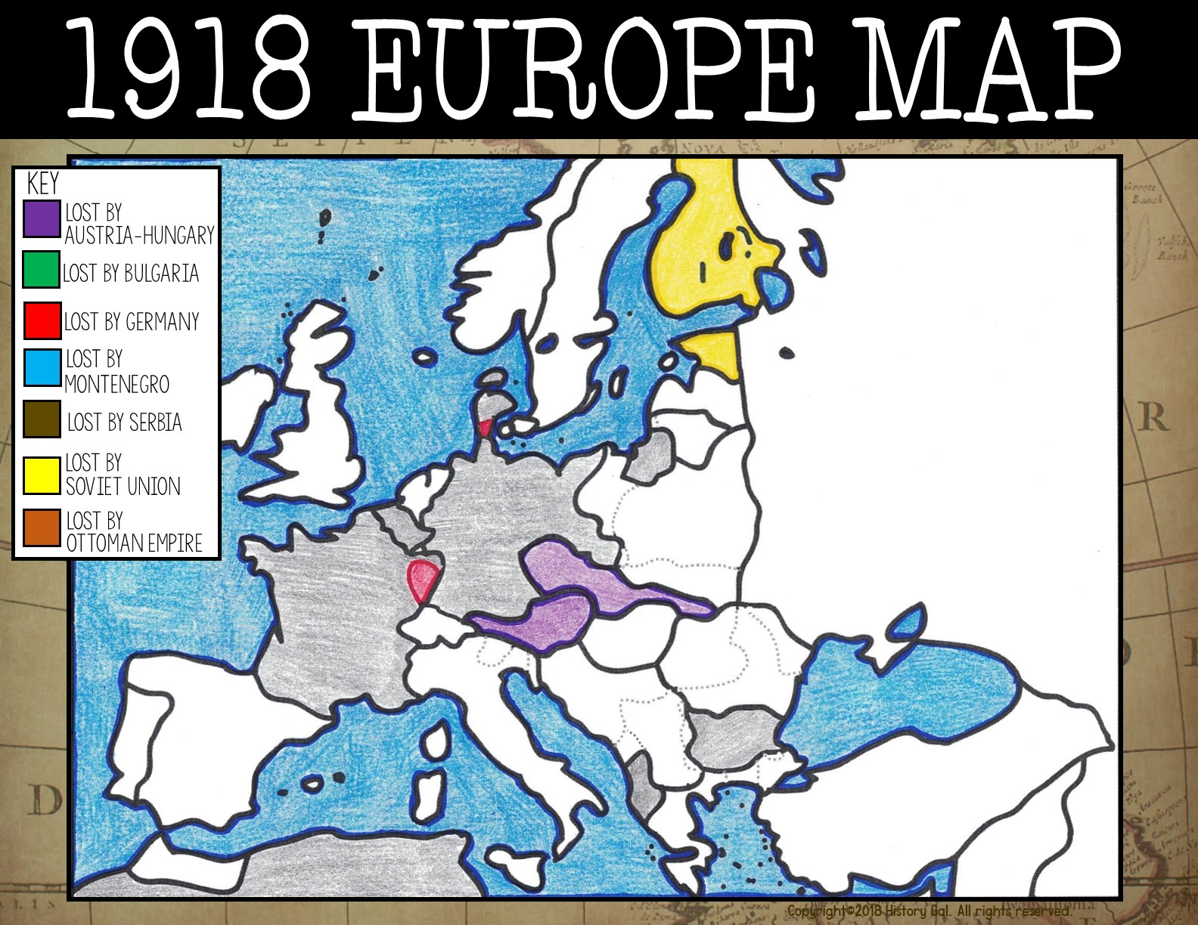
Finland
Estonia
Denmark
Germany
East Prussia
Belgium
Czech.
Austria
France
Bulgaria
French
West Africa
Albania

Slide 14
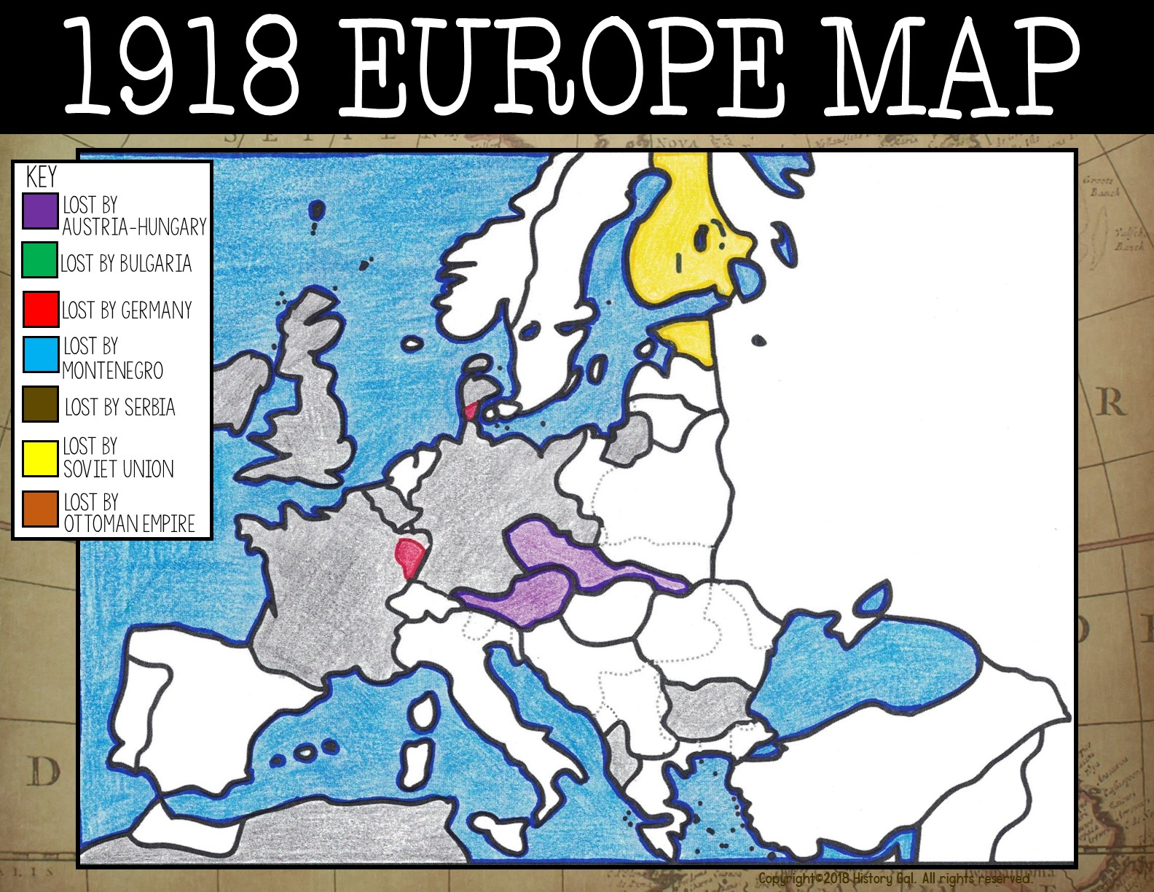
Finland
Estonia
Great Britain
Denmark
East Prussia
Belgium
Germany
Czech.
Austria
France
Bulgaria
French
West Africa
Albania

Slide 15
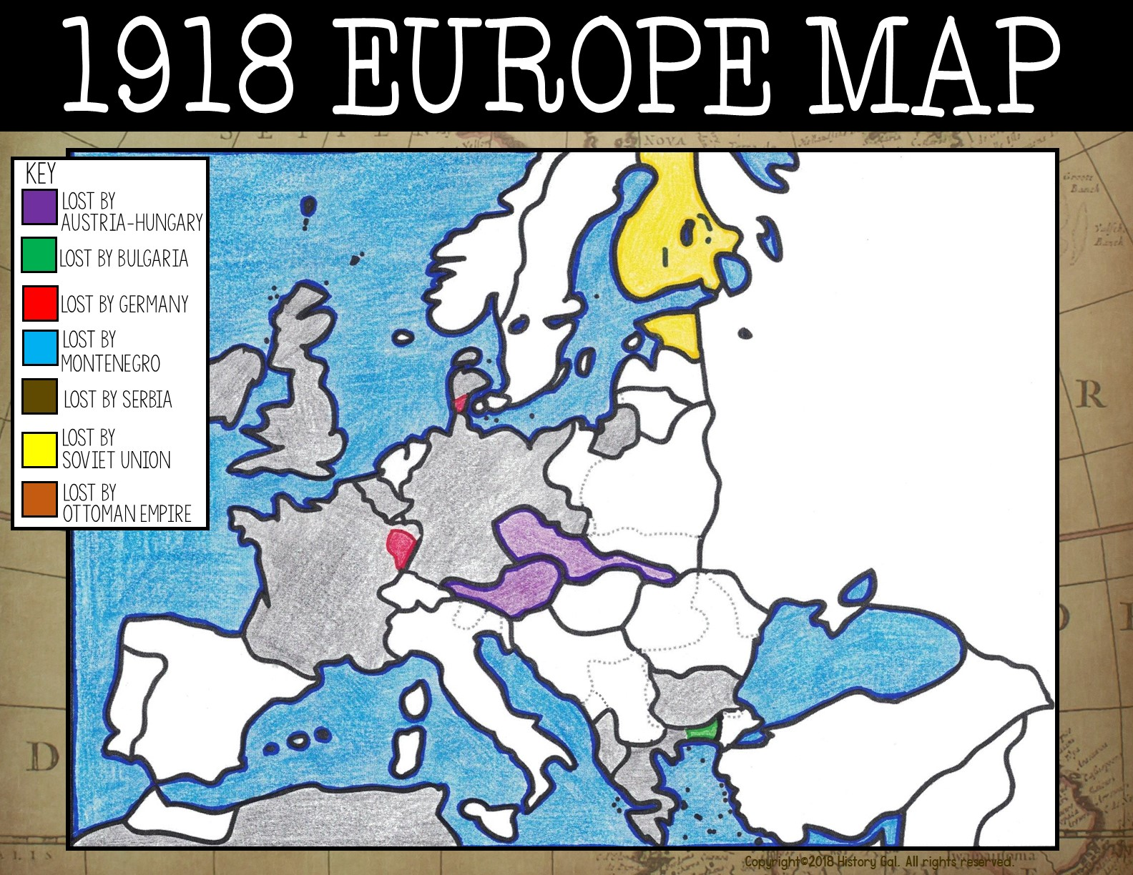
Finland
Estonia
Denmark
Great Britain
East Prussia
Belgium
Germany
Czech.
Austria
France
Bulgaria
Greece
French
West Africa
Albania

Slide 16
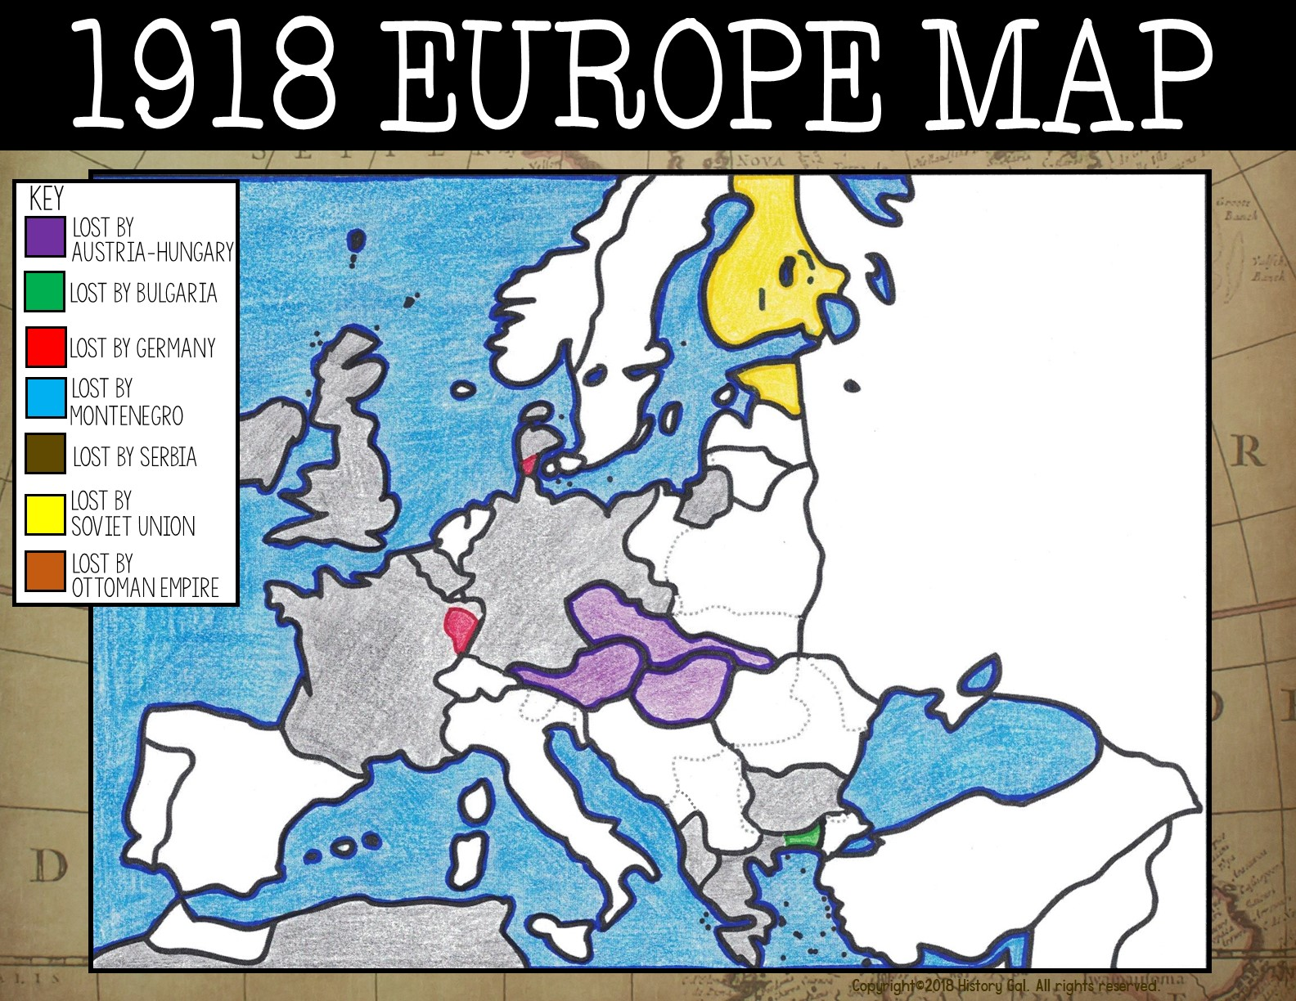
Finland
Estonia
Denmark
Great Britain
East Prussia
Belgium
Germany
Czech.
Austria
Hungary
France
Bulgaria
Greece
French
West Africa
Albania

Slide 17
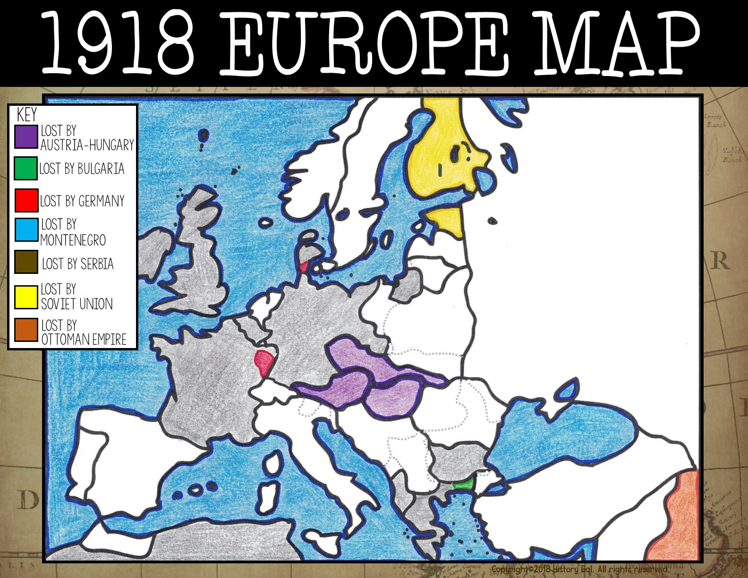
Finland
Estonia
Denmark
Great Britain
East Prussia
Belgium
Germany
Czech.
Austria
Hungary
France
Bulgaria
Greece
Iraq
French
West Africa
Albania

Slide 18
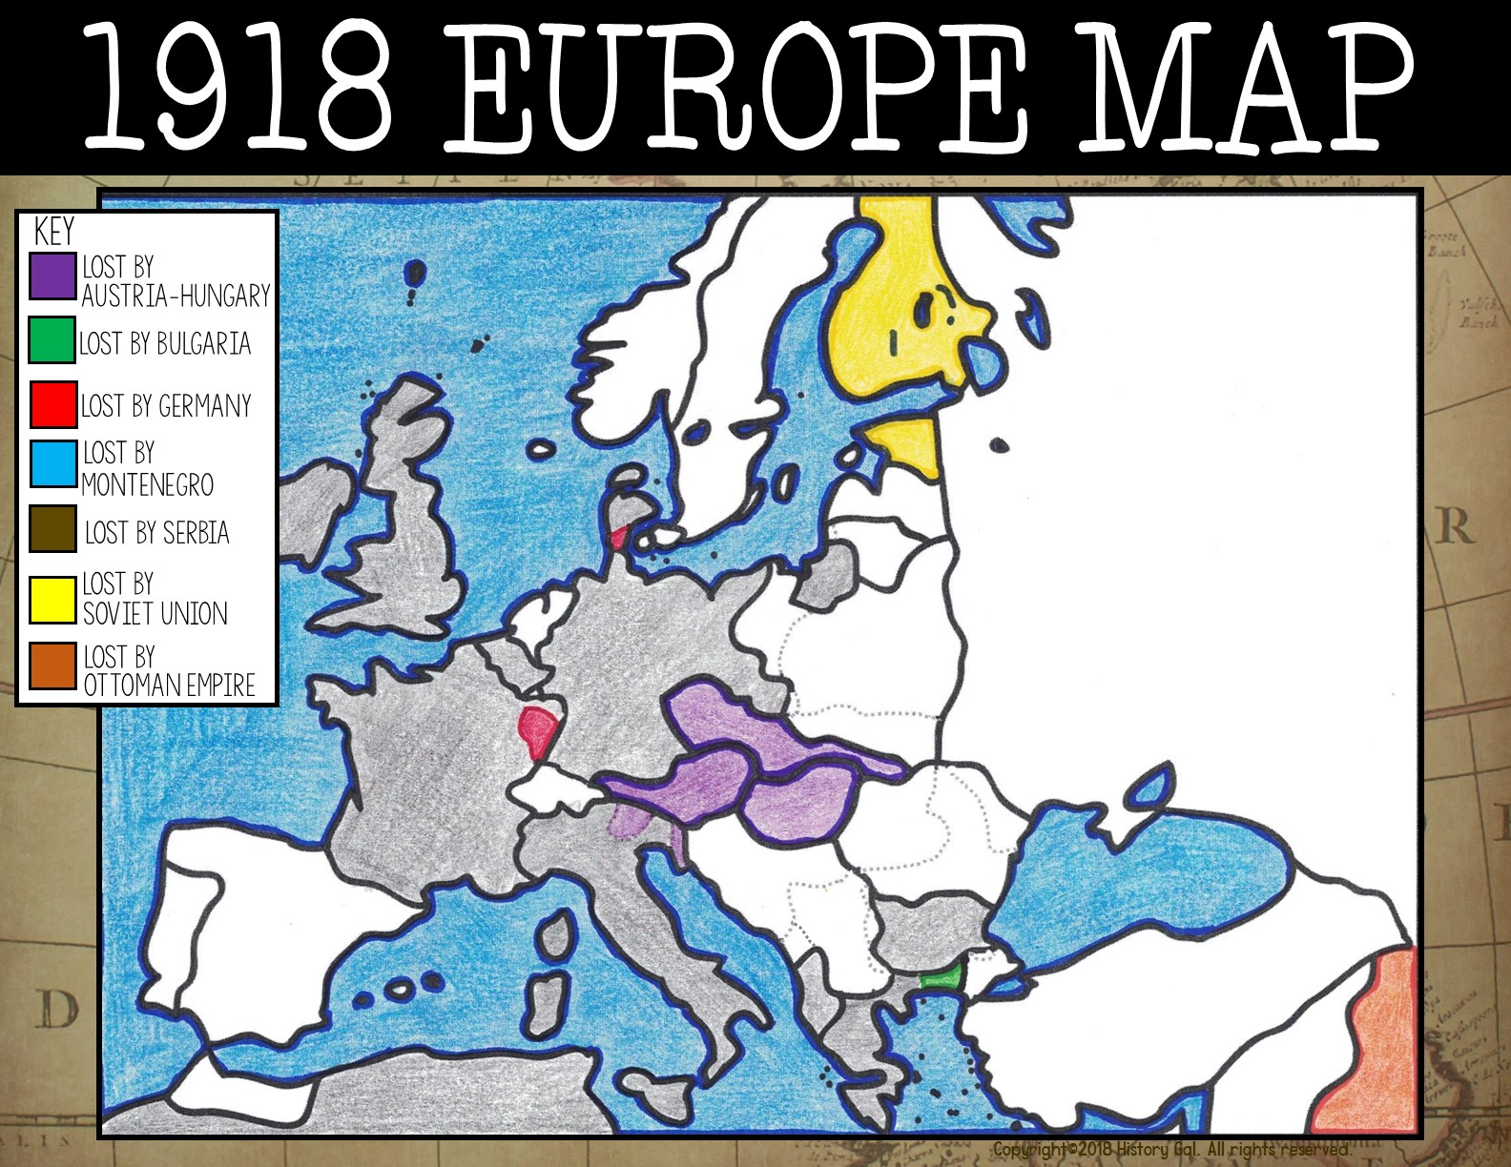
Finland
Estonia
Denmark
Great Britain
East Prussia
Belgium
Germany
Czech.
Austria
Hungary
France
Italy
Bulgaria
Greece
French
West Africa
Albania
Iraq

Slide 19
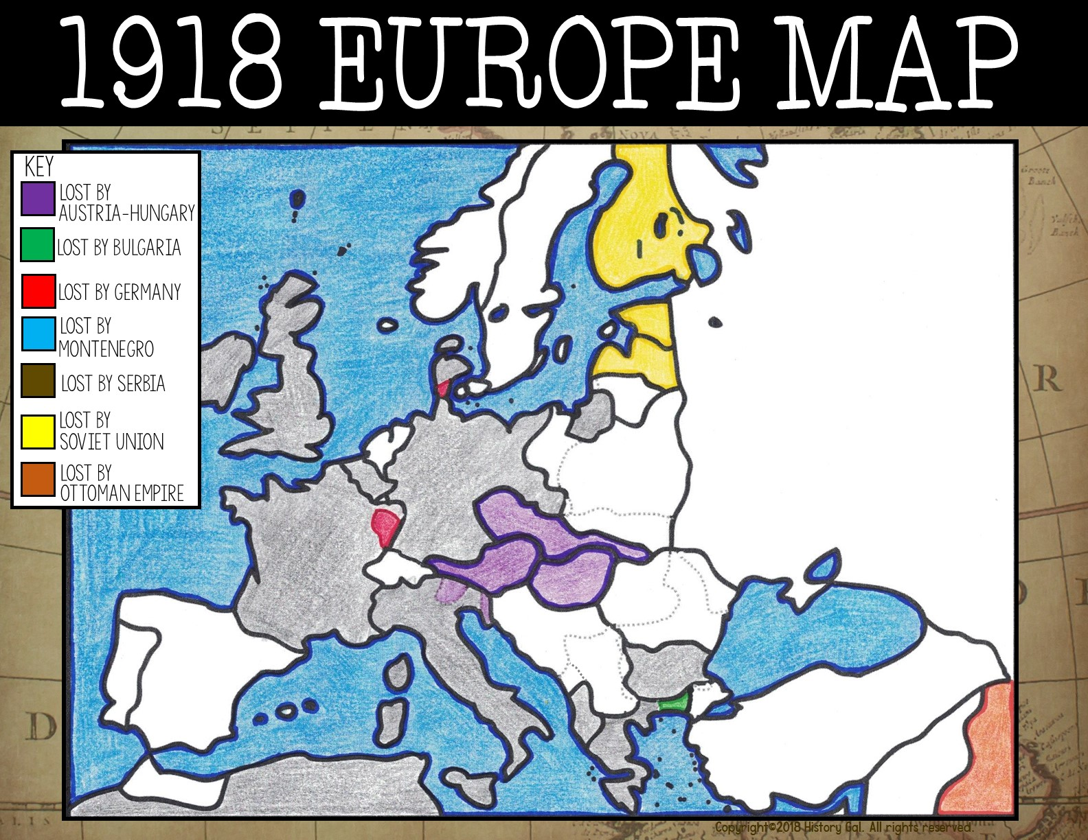
Finland
Estonia
Denmark
Latvia
Great Britain
East Prussia
Belgium
Germany
Czech.
Austria
Hungary
France
Italy
Bulgaria
Greece
French
West Africa
Albania
Iraq

Slide 20

Finland
Estonia
Denmark
Latvia
Great Britain
Lithuania
East Prussia
Belgium
Germany
Czech.
Austria
Hungary
France
Italy
Bulgaria
Greece
French
West Africa
Albania
Iraq

Slide 21
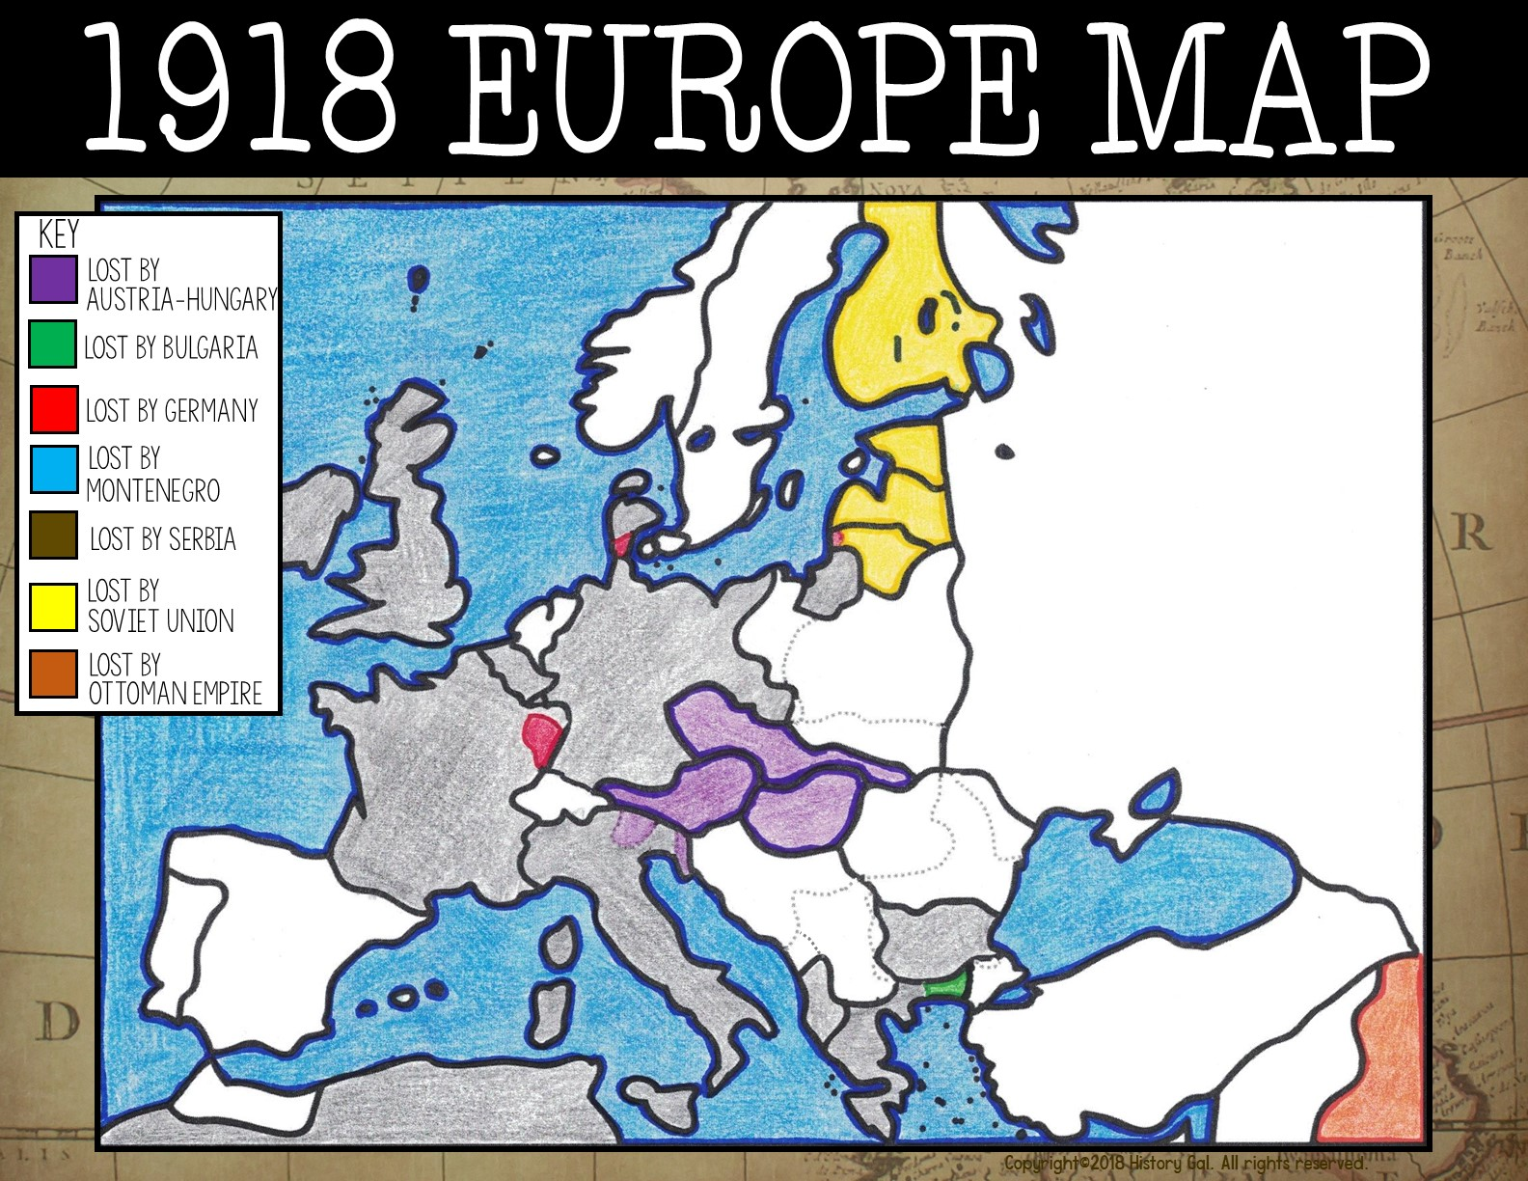
Finland
Estonia
Denmark
Latvia
Great Britain
Lithuania
East Prussia
Belgium
Germany
Luxembourg
Czech.
Austria
Hungary
France
Italy
Bulgaria
Greece
French
West Africa
Albania
Iraq

Slide 22

Netherlands
Finland
Estonia
Denmark
Latvia
Great Britain
Lithuania
Germany
East Prussia
Belgium
Lux.
Czech.
Austria
Hungary
France
Italy
Bulgaria
Greece
French
West Africa
Albania
Iraq

Slide 23
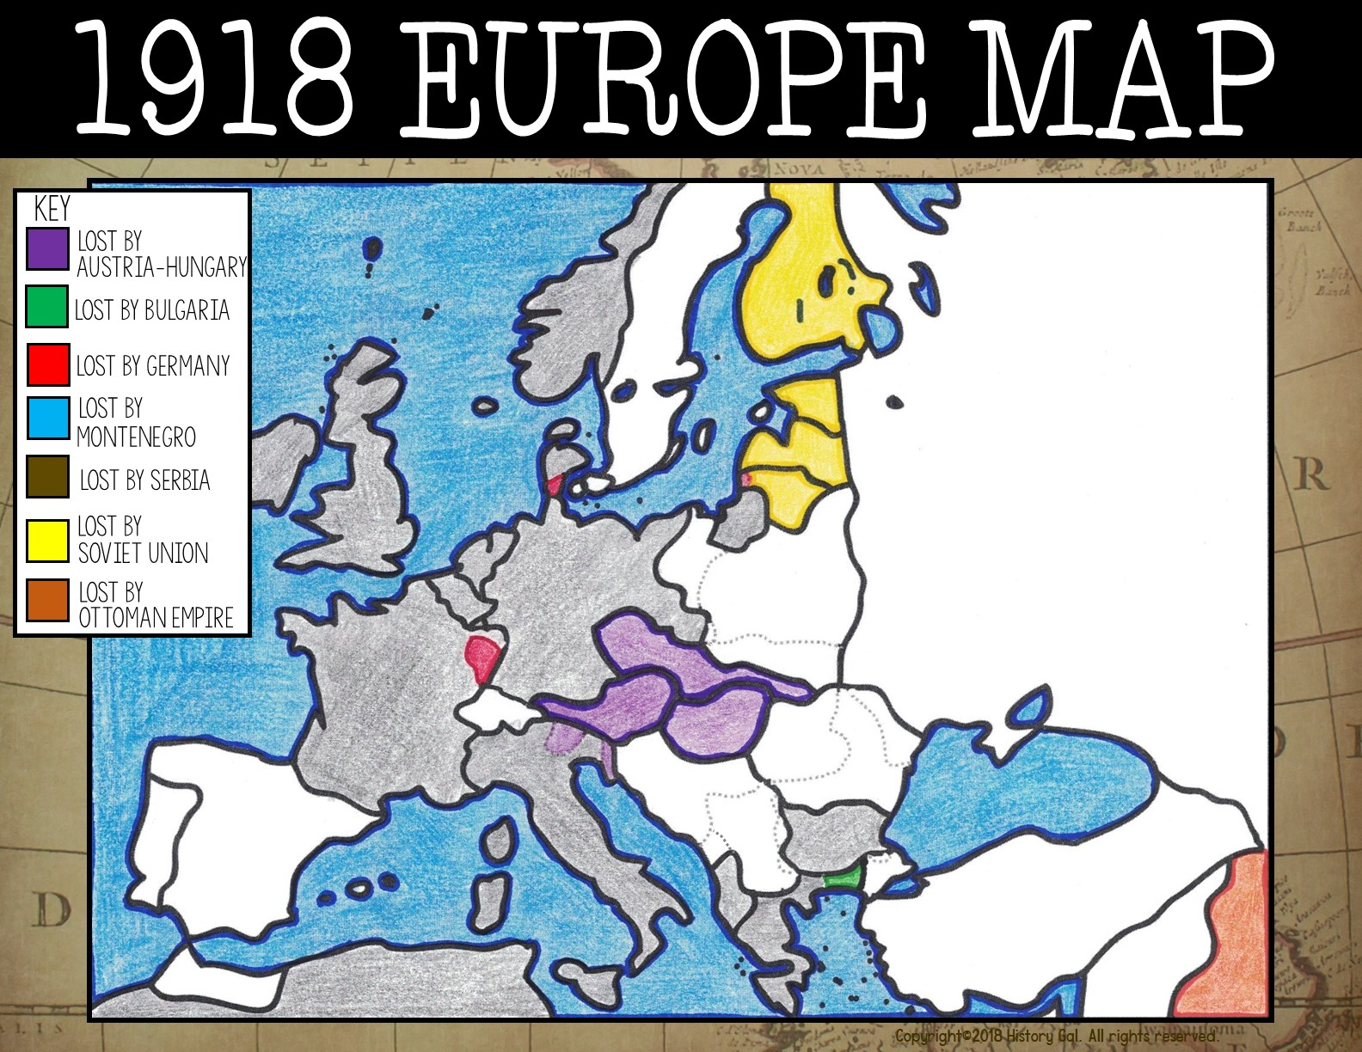
Norway
Finland
Estonia
Denmark
Latvia
Great Britain
Netherlands
Lithuania
Germany
East Prussia
Belgium
Lux.
Czech.
Austria
Hungary
France
Italy
Bulgaria
Greece
French
West Africa
Albania
Iraq

Slide 24
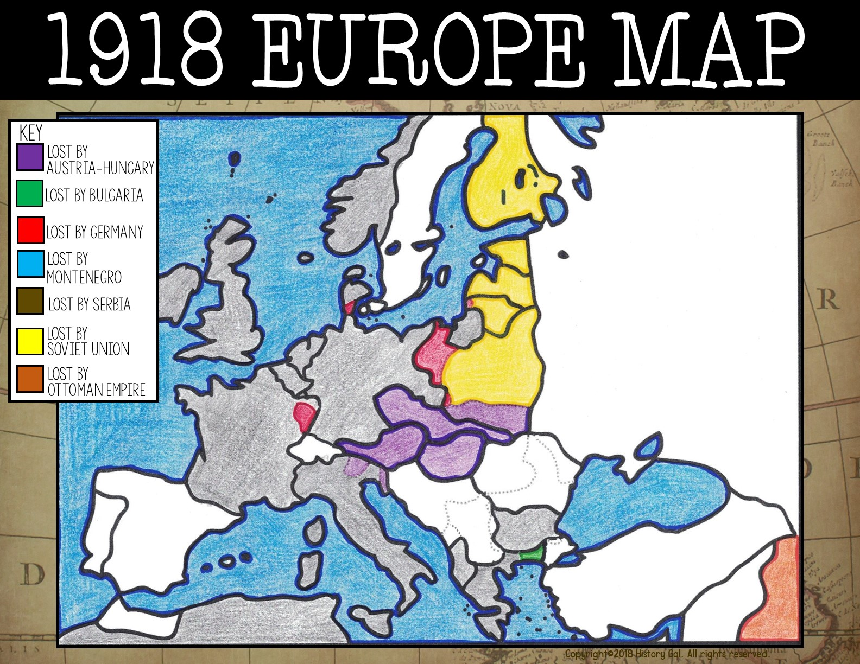
Norway
Finland
Estonia
Denmark
Latvia
Great Britain
Netherlands
Lithuania
Germany
East Prussia
Belgium
Poland
Lux.
Czech.
Austria
Hungary
France
Italy
Bulgaria
Greece
French
West Africa
Albania
Iraq

Slide 25
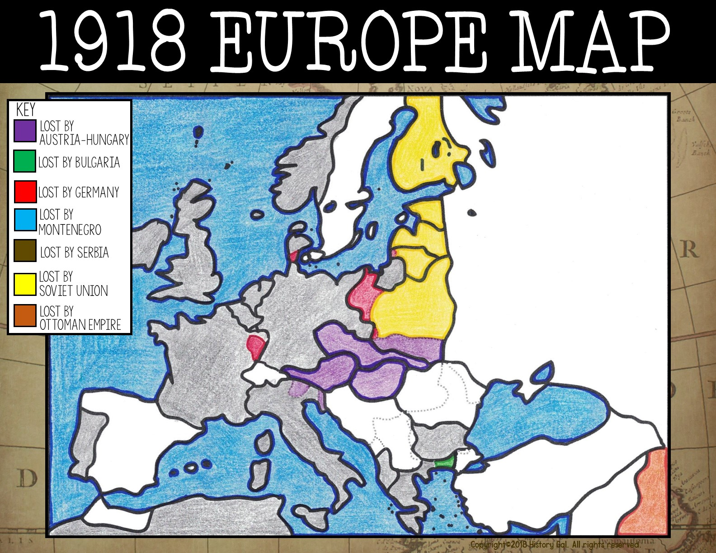
Norway
Finland
Estonia
Denmark
Latvia
Great Britain
Netherlands
Lithuania
Germany
East Prussia
Belgium
Poland
Lux.
Czech.
Portugal
Austria
France
Hungary
Italy
Bulgaria
Greece
French
West Africa
Albania
Iraq

Slide 26
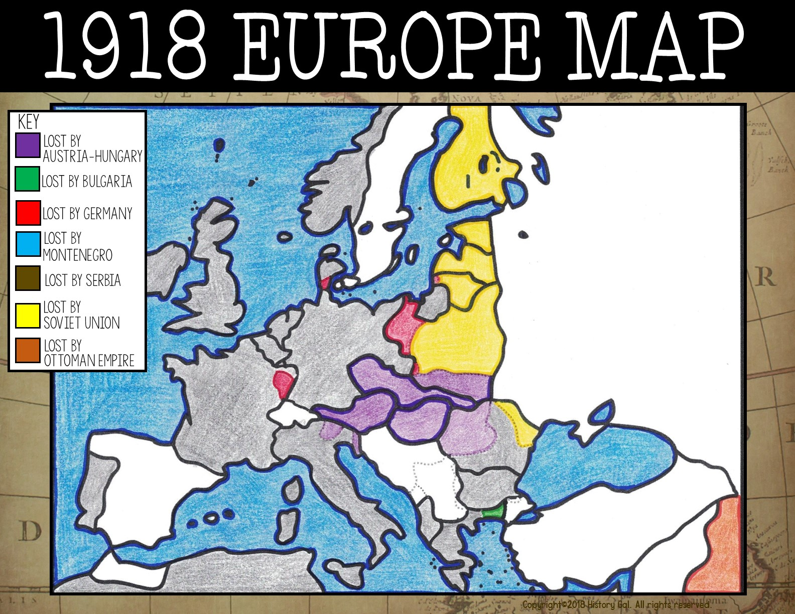
Norway
Finland
Estonia
Denmark
Latvia
Great Britain
Netherlands
Lithuania
Germany
East Prussia
Belgium
Poland
Lux.
Czech.
Romania
Austria
Hungary
France
Italy
Portugal
Bulgaria
Greece
French
West Africa
Albania
Iraq

Slide 27
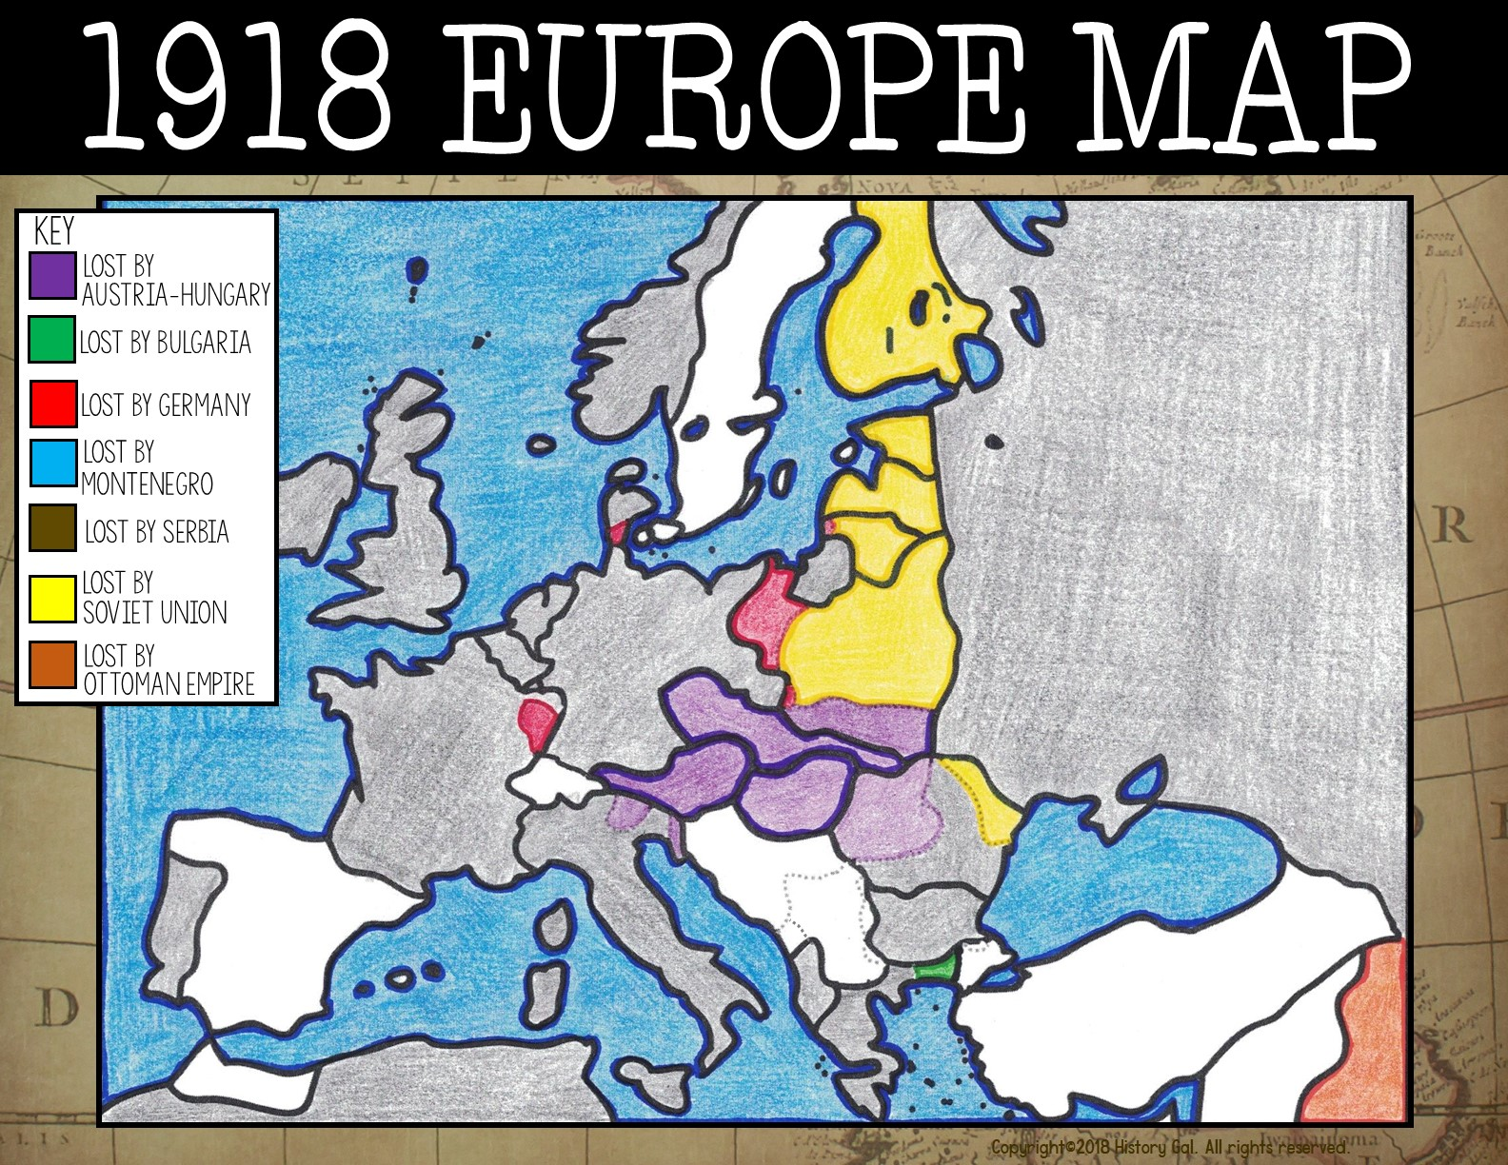
Norway
Finland
Soviet Union (USSR)
Estonia
Denmark
Latvia
Great Britain
Netherlands
Lithuania
Germany
East Prussia
Belgium
Poland
Lux.
Czech.
Austria
Hungary
France
Italy
Romania
Portugal
Bulgaria
Greece
French
West Africa
Albania
Iraq

Slide 28
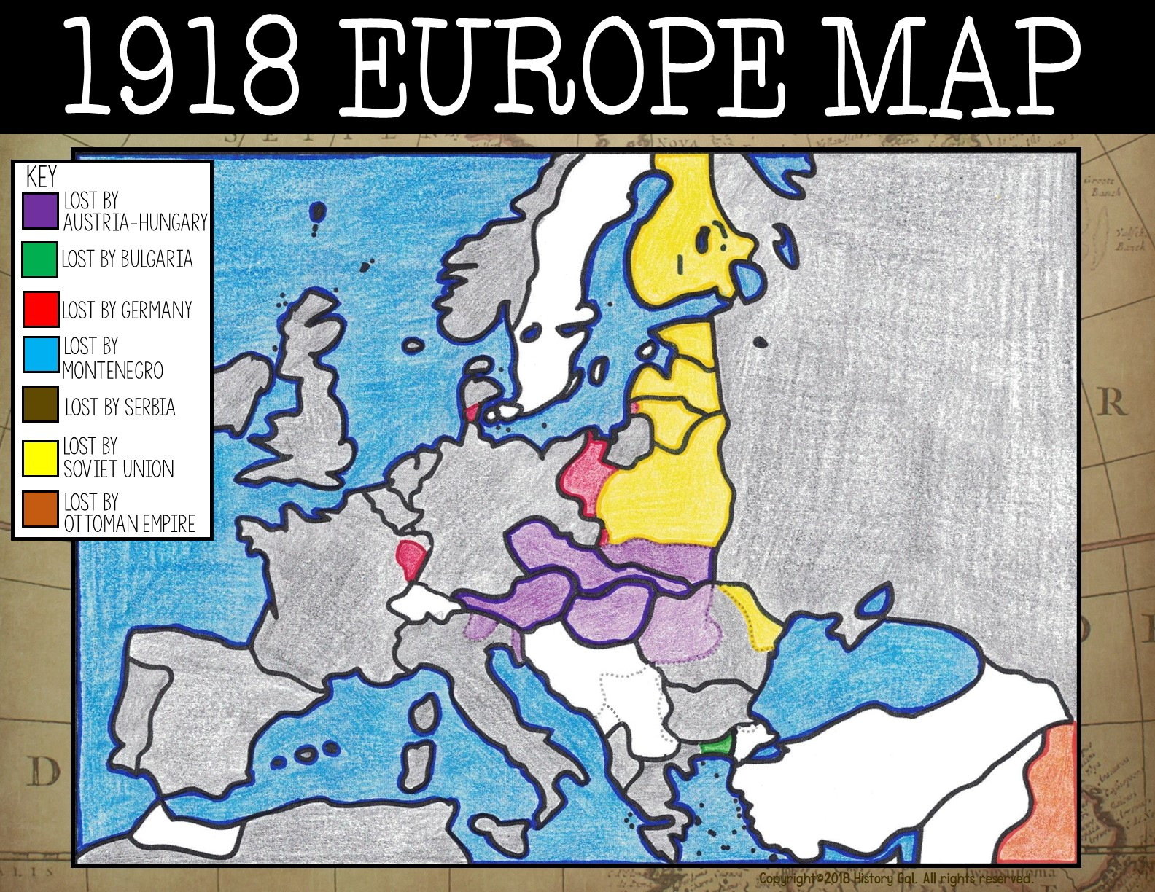
Norway
Finland
Estonia
Soviet Union (USSR)
Denmark
Latvia
Great Britain
Netherlands
Lithuania
Germany
East Prussia
Belgium
Poland
Lux.
Czech.
Austria
Hungary
France
Italy
Romania
Portugal
Spain
Bulgaria
Greece
French
West Africa
Albania
Iraq

Slide 29
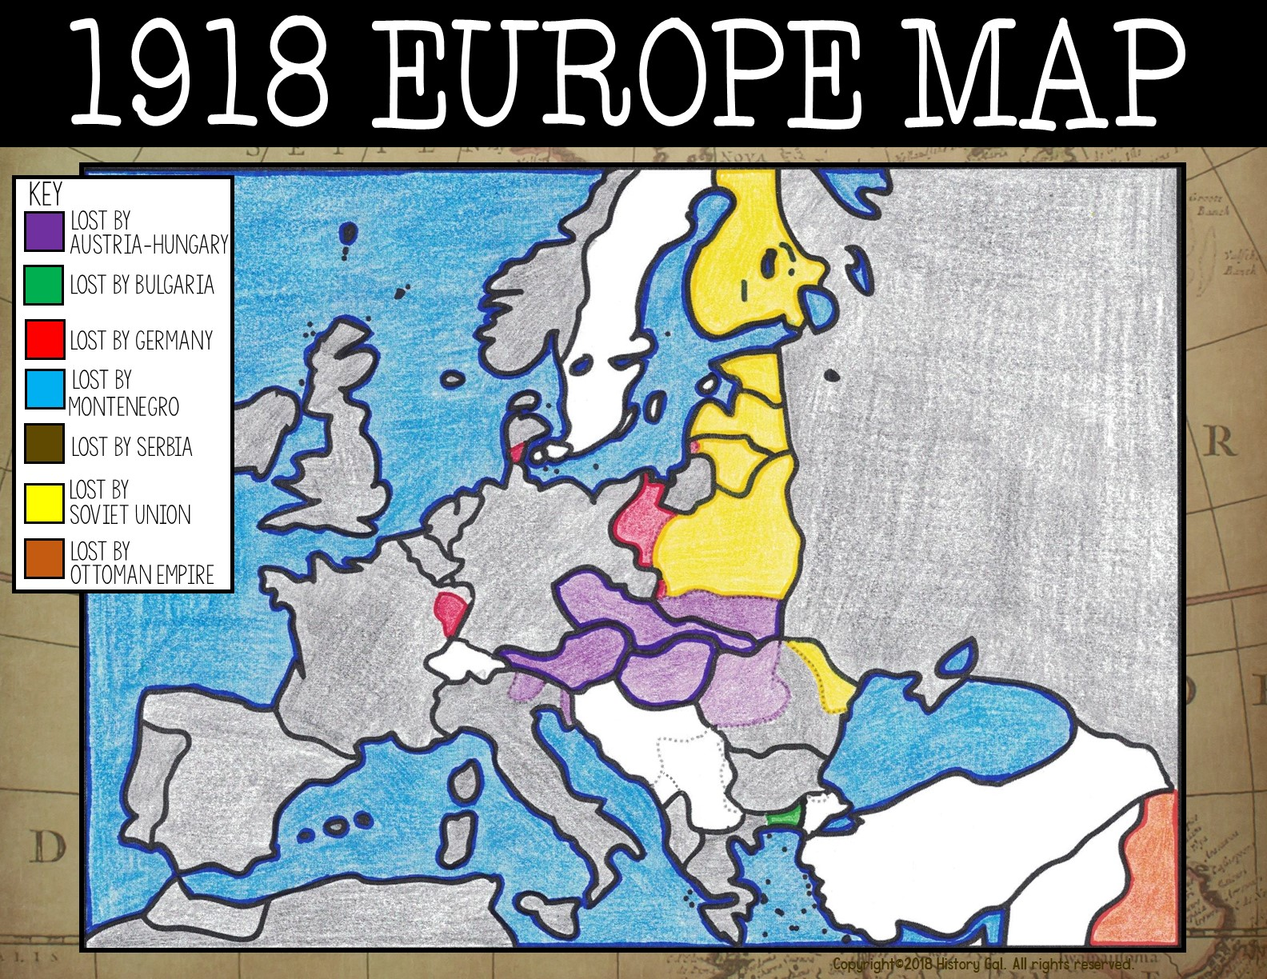
Norway
Finland
Estonia
Soviet Union (USSR)
Denmark
Latvia
Great Britain
Netherlands
Lithuania
Germany
East Prussia
Belgium
Poland
Lux.
Czech.
Austria
Hungary
France
Italy
Romania
Portugal
Spain
Bulgaria
Spanish Morocco
Greece
French
West Africa
Albania
Iraq

Slide 30
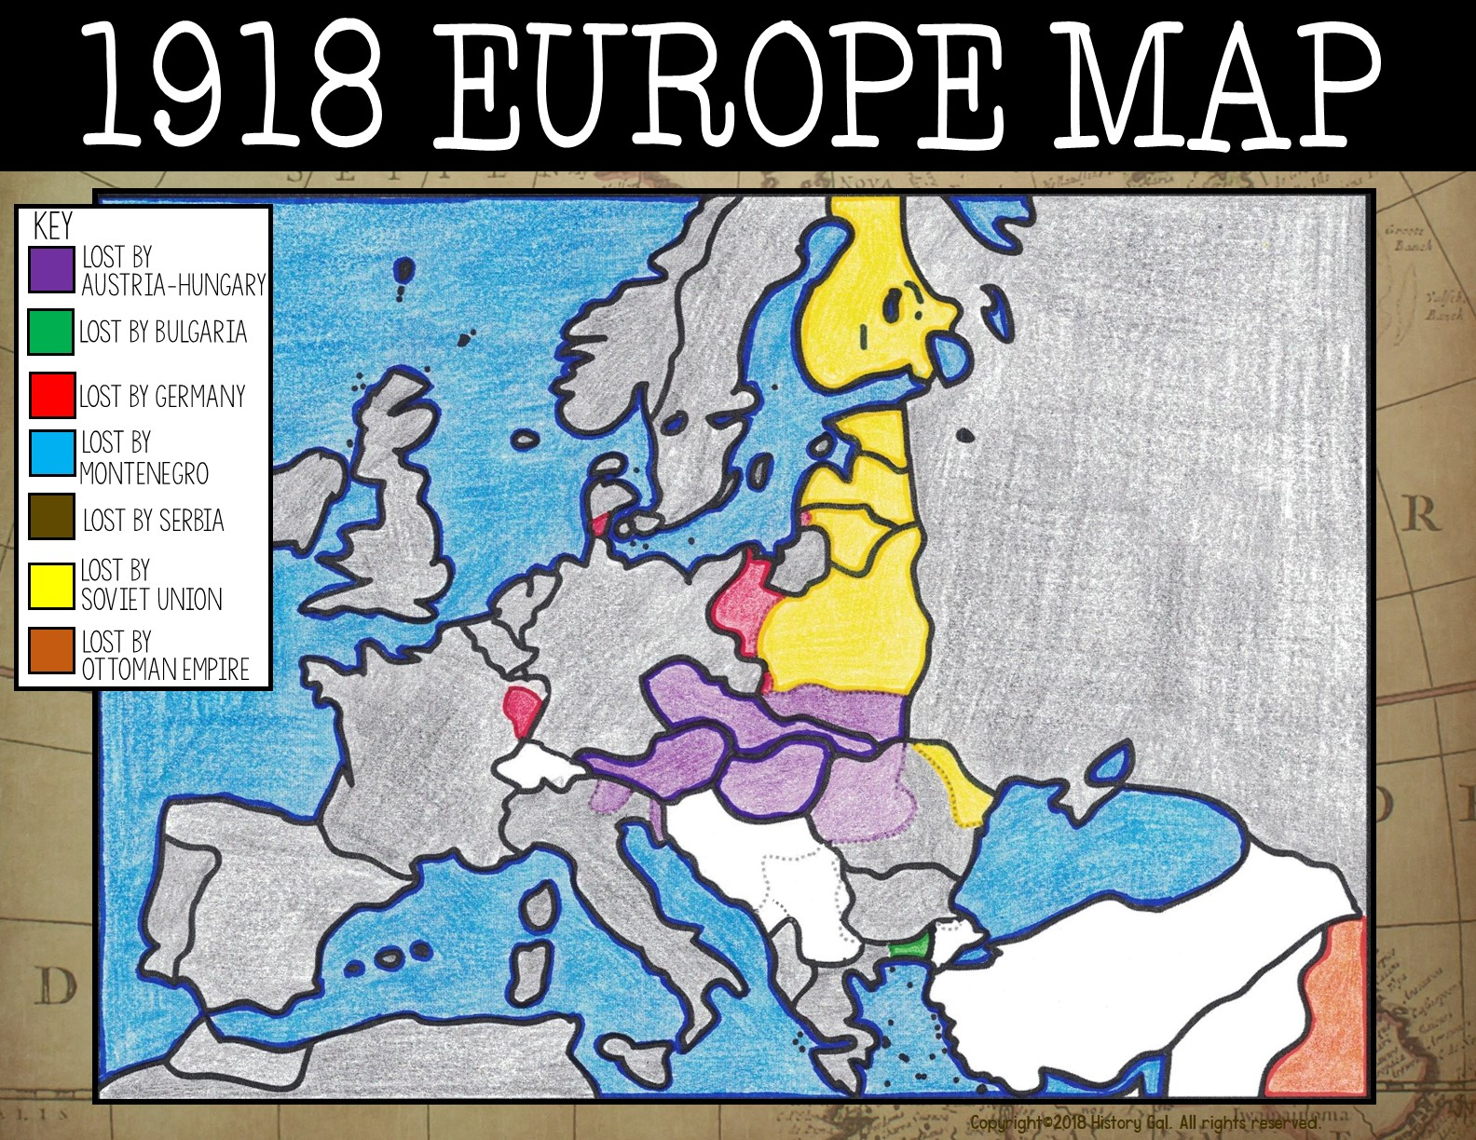
Sweden
Norway
Finland
Estonia
Soviet Union (USSR)
Denmark
Latvia
Great Britain
Netherlands
Lithuania
Germany
East Prussia
Belgium
Poland
Lux.
Czech.
Austria
Hungary
France
Italy
Romania
Portugal
Spain
Bulgaria
Spanish Morocco
Greece
French
West Africa
Albania
Iraq

Slide 31
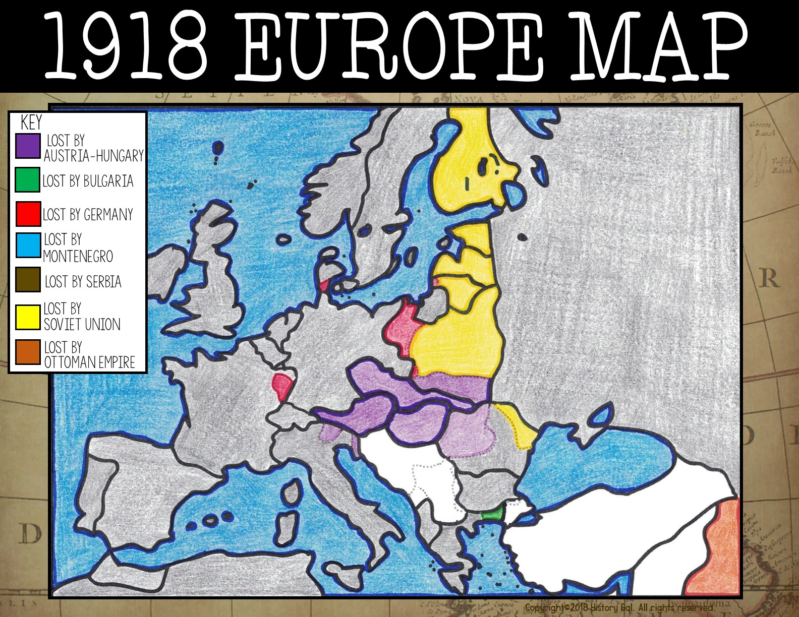
Sweden
Norway
Finland
Estonia
Soviet Union (USSR)
Denmark
Latvia
Great Britain
Netherlands
Lithuania
Germany
East Prussia
Belgium
Poland
Lux.
Switzerland
Czech.
Austria
Hungary
France
Italy
Romania
Portugal
Spain
Bulgaria
Spanish Morocco
Greece
French
West Africa
Albania
Iraq

Slide 32
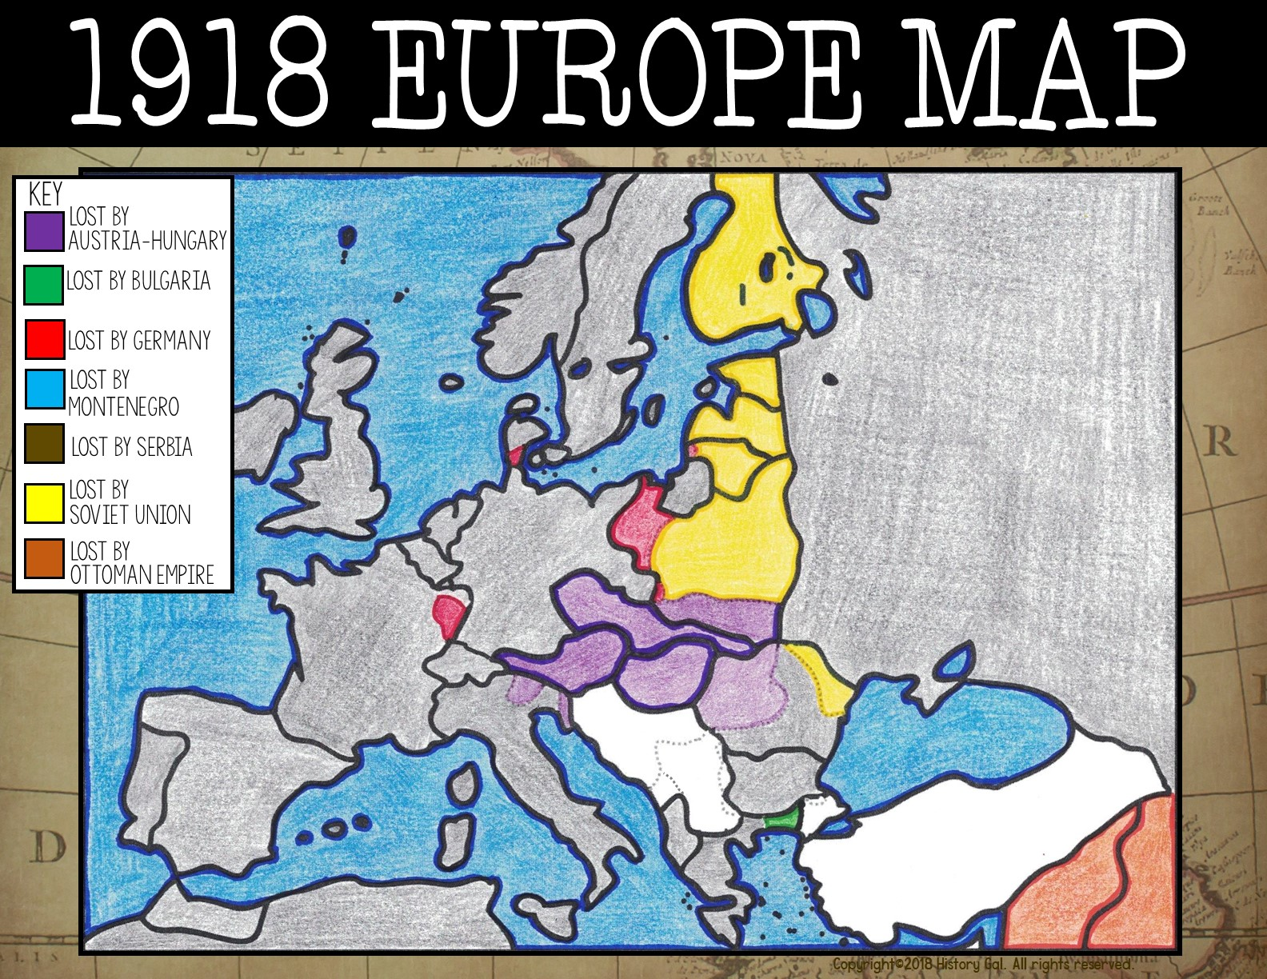
Sweden
Norway
Finland
Estonia
Soviet Union (USSR)
Denmark
Latvia
Great Britain
Netherlands
Lithuania
Germany
East Prussia
Belgium
Poland
Lux.
Czech.
Switz.
Austria
Hungary
France
Italy
Romania
Portugal
Spain
Bulgaria
Syria-Lebanon
Spanish Morocco
Greece
French
West Africa
Albania
Iraq

Slide 33
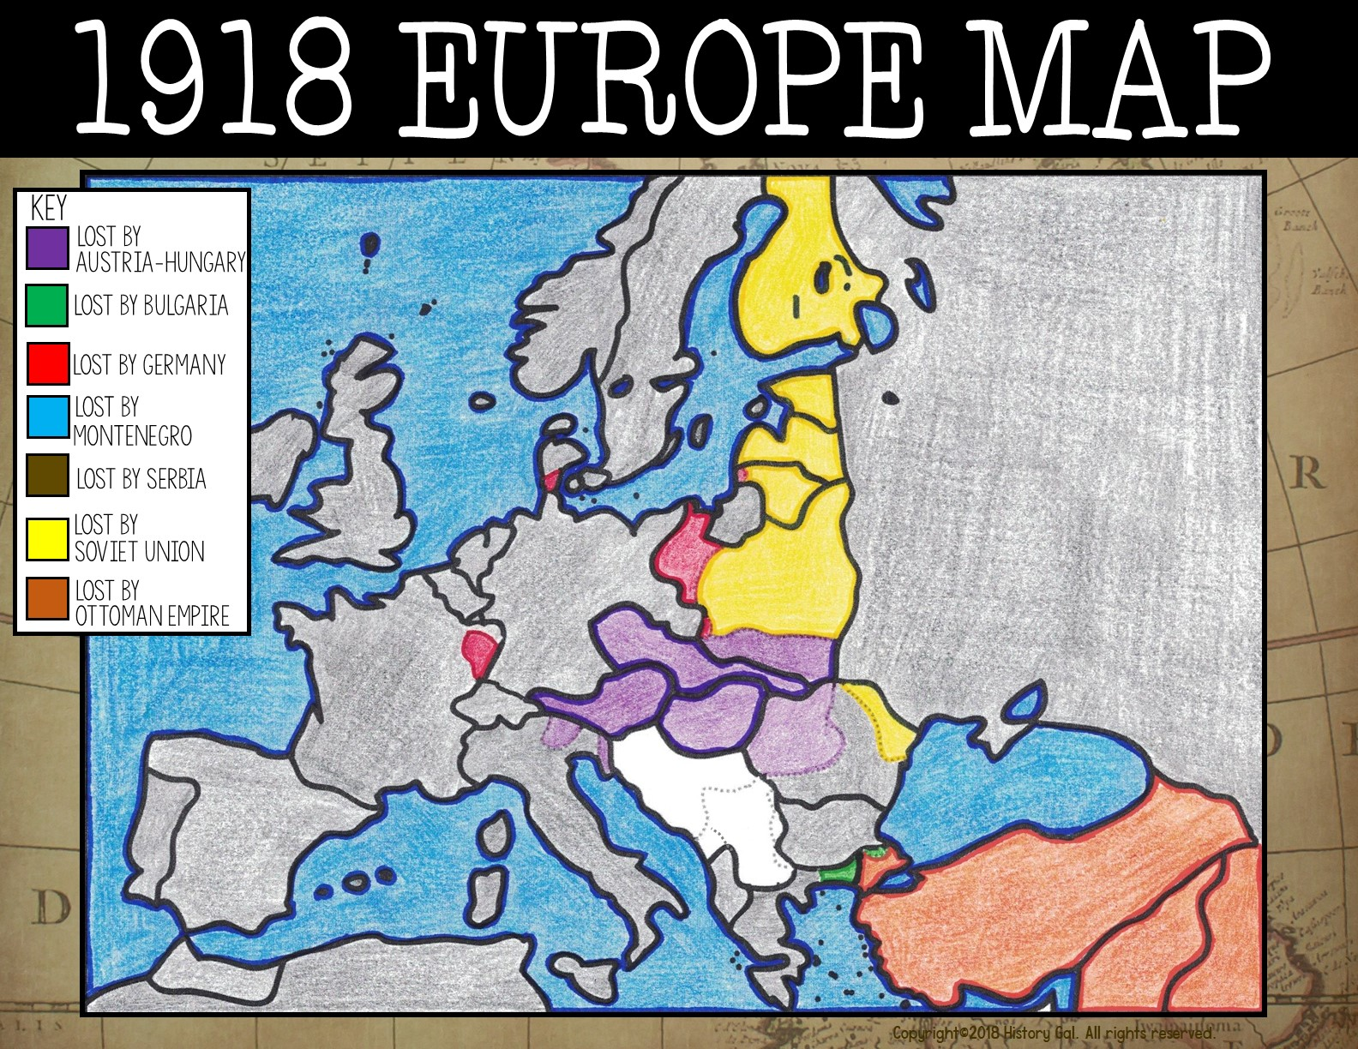
Sweden
Norway
Finland
Estonia
Soviet Union (USSR)
Denmark
Latvia
Great Britain
Netherlands
Lithuania
Germany
East Prussia
Belgium
Poland
Lux.
Czech.
Switz.
Austria
Hungary
France
Italy
Romania
Portugal
Spain
Bulgaria
Spanish Morocco
Greece
Turkey
Iraq
French
West Africa
Syria-Lebanon
Albania

Slide 34
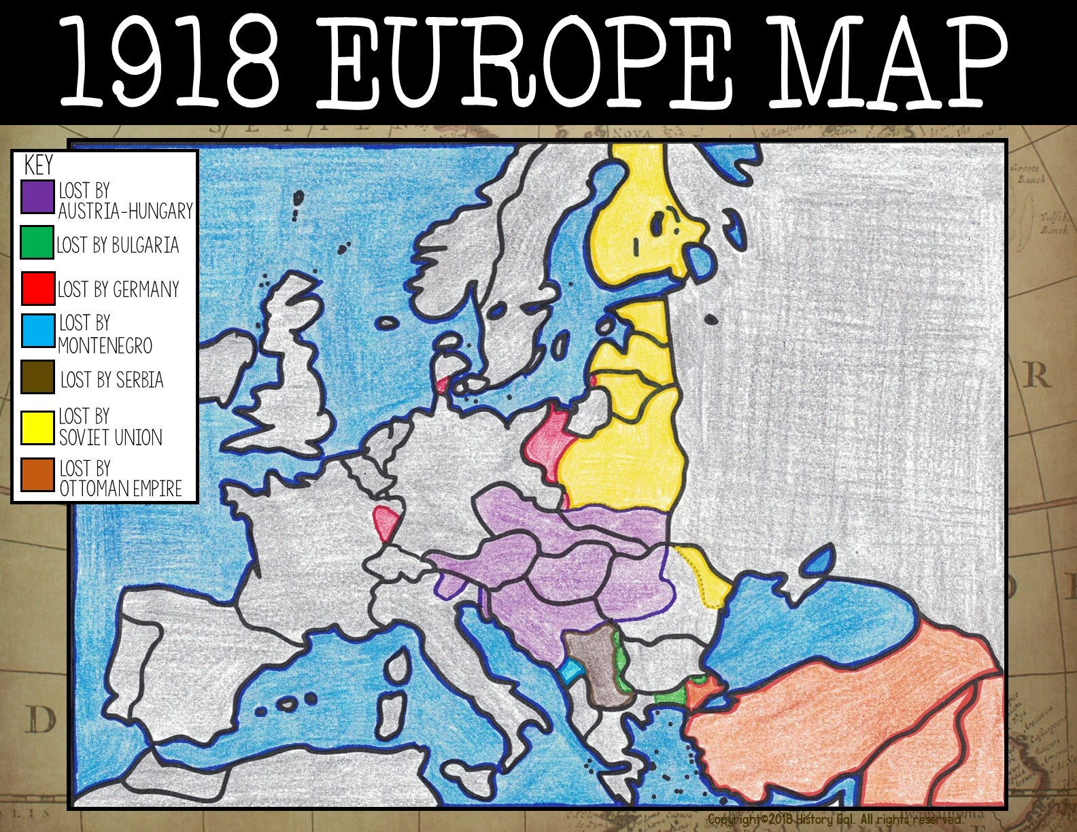
Sweden
Norway
Finland
Estonia
Soviet Union (USSR)
Denmark
Latvia
Great Britain
Netherlands
Lithuania
Germany
East Prussia
Belgium
Poland
Lux.
Czech.
Switz.
Austria
Hungary
France
Italy
Romania
Portugal
Spain
Yugoslavia
Bulgaria
Spanish Morocco
Greece
Turkey
Iraq
French
West Africa
Albania
Syria-Lebanon

Slide 35
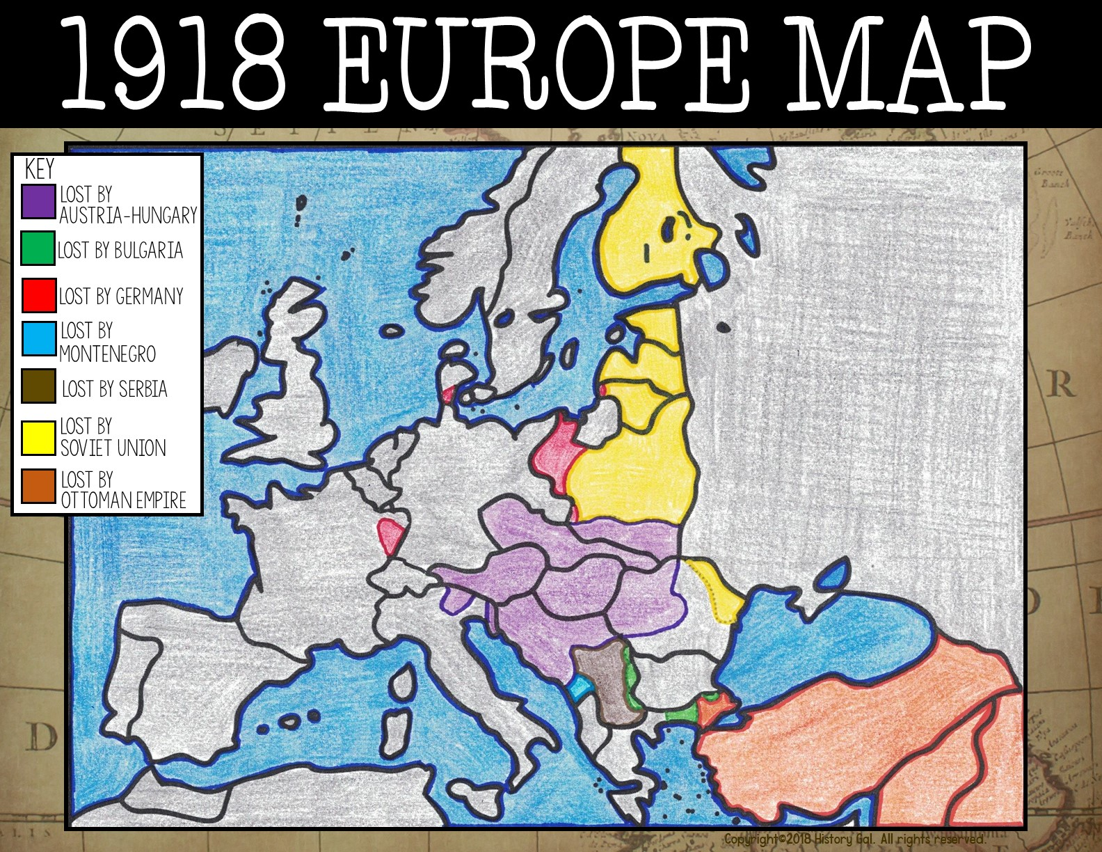
Sweden
Norway
Finland
Estonia
Soviet Union (USSR)
Denmark
Latvia
Great Britain
Netherlands
Lithuania
Germany
East Prussia
Belgium
Poland
Lux.
Czech.
Switz.
Austria
Hungary
France
Italy
Romania
Spain
Yugoslavia
Portugal
Bulgaria
Spanish Morocco
Greece
Turkey
Iraq
French
West Africa
Albania
Syria-Lebanon

