Slide 1
Welcome To Ms. Pickens’ Classroom
Curriculum Night 2017

Slide 2
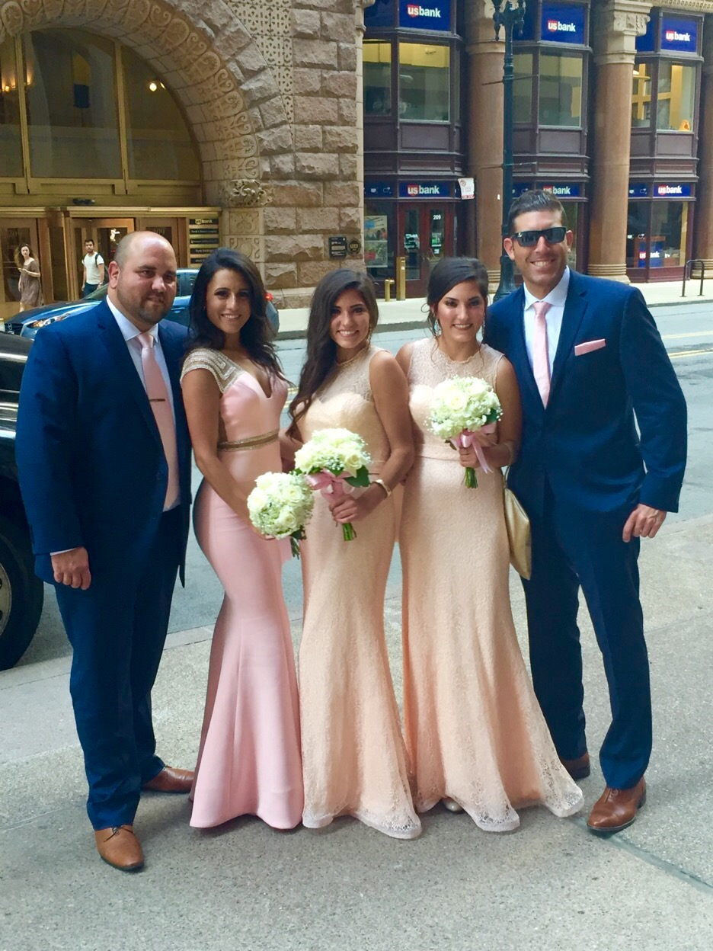
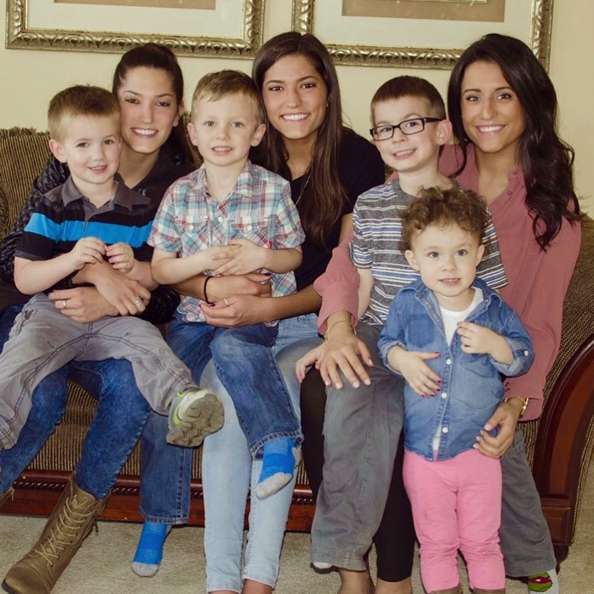
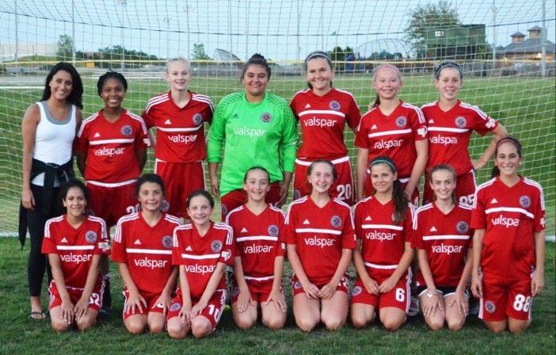
All About Me

Slide 3
School Smarts
Graduated from Carl Sandburg High School (Orland Park, IL).
Bachelor’s Degree from Lewis University in Early Childhood Education, Early Childhood Special Education, and English as a Second Language (children birth through third grade).
2nd year teacher; last year as the General Education 1st Grade Teacher at Dr. Julian Rogus School.

Slide 4
Classroom Expectations
Eyes Watching
Ears Listening
Voice Quiet
Body Still
Raise your hand
Follow Directions
Try your best

Slide 5
Homework Expectations
Homework will be sent home every Monday in the form of a packet. There will be a sheet to sign and return on the following Monday. My newsletter will also be within the packet.
You may turn in the packet earlier than Monday if it is complete.
The packets will consist of Reading and Math practice, along with skills they are working on in their IEP’s. Each child's packet will be individualized.
Homework packets will be taken as a Formative grade.

Slide 6
P.B.I.S EXPECTATIONS
BE RESPECTFUL
BE RESPONSIBLE
BE SAFE
Students can earn Eagle Tickets from any staff member. Tickets are earned for good behavior in school. Students collect Eagles Tickets and use them to get prizes from the “Eagles Nest.”

Slide 7
Grade Level Projects/Activities
Grandparent’s Day
Polar Express
Gingerbread Houses
Field Trip (TBD)
Cinco de Mayo
Chinese New Year
Field Days (End-of-the-year)
PBIS Assemblies

Slide 8
Report Cards
First Graders will receive a letter grade for each subject:
Reading
Language Arts
Math
Science
Social Studies
Specials
(Music, Art,Technology,P.E.)
Formative Assessments are 25% of your child’s grade.
Summative Assessments are 75% of your child’s grade.

Slide 9
Curriculum:
Fundations- Phonics, Sight Words, Letters, Sounds, Decoding (Reading Words), and Encoding (Writing/Spelling).
Michael Heggerty/Phonemic Awareness
Reading Milestones- Leveled Reading, Reading Skills, and Comprehension
Touch Math- Leveled Math Skills
Our Curriculum is adjusted to each child’s needs and abilities. Accommodations of lessons will be made daily. My biggest concern is your child and their needs.

Slide 10
I.E.P. Notes
Parents will receive IEP goal updates at the end of each quarter. They will be sent home with report cards.
You will receive an IEP Notification of Conference prior to each meeting.
Each student will have an Annual Review each calendar year.
Please see me for specific questions.

Slide 11
Communication
Email: apickens@summithill.org
School Phone: (815)464-2034
T.I.P. Topics:
Ms. Pickens’ Weekly Newsletter
(Found on my website weekly and also sent home every Monday with Homework Packet).
District Website:
www.summithill.org
Dr. Julian Rogus School
Teacher Pages
Ms. Ashley Pickens
Parent-Teacher Conferences
Please use the sign-up sheets to sign-up for a time to meet with me.

Slide 12
Weapons Policy
“Illinois Law requires that the school officials expel a student who is determined to have a weapon at school, or any school sponsored activity or event, which bears a reasonable relationship to school. Weapons including not only guns, buy also look alike, and any object used to cause or threaten injury. The expulsion from school must be for a period of time of not less than one year except that the Superintendent of the School Board may modify the expulsion period on a case-by –case basis. Students, who threaten to use a weapon, even in intended as a joke, will also be dealt seriously in order to maintain the safely of students and district 161 employees. All teachers are expected to explain this policy to all students on the first day of school.”

Slide 13
Thank You so much!
I look forward to a great year!

