Slide 1
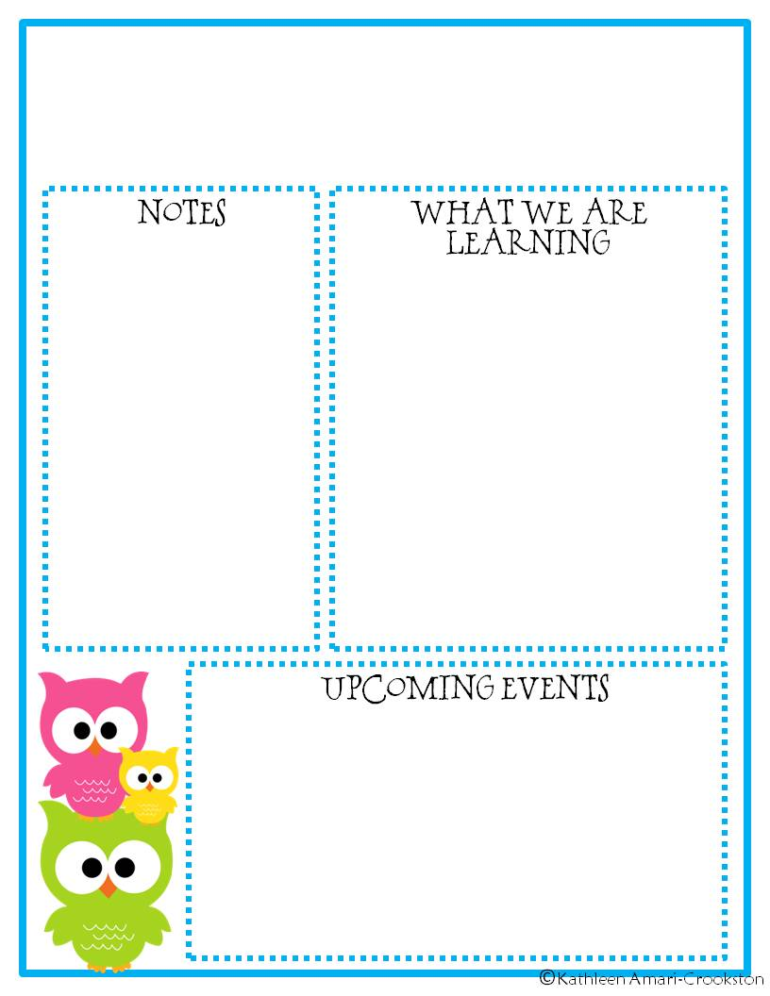
Mrs. Kane’s
Classroom News
May 28-31, 2019
What a great Field Day last Thursday! Beautiful weather, hot lunch, a water station, kickball and jump houses made for the perfect ending to our year! Students had a blast! They’re all looking forward to celebrating on Tuesday with a day all for them- 4th grade party!
If your child is receiving an award, they may dress nicely for the occasion and bring a change of clothes for the afternoon.
ELA- We will be spending our ELA block reading and learning about Illinois. We’ll end the year by reading “I Survived, the Great Chicago Fire”. We’re also writing about our summer plans!
Science- We will be doing a week long mini-unit on renewable and nonrenewable resources. Our focus is on understanding what they are and how to use them wisely.
Math- We’ll be reviewing skills learned this year by creating our own math games and playing them with partners.
May 28th- 4th Grade Party P.M.
June 6th – Last Day of School!

