Slide 1
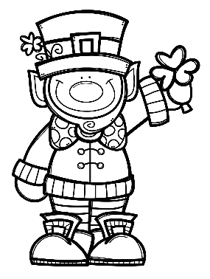
Mrs. Schimke’s Class Newsletter
February 24-28, 2020
 | What are we learning this week?
Reading | We will spend our 2nd week with “Yonder Mountain”. Our story skills are: compare/contrast, story message, homophones/homographs, and contractions. Our story summative will be Wednesday. Book Reports are due by February 25th.
Language Arts | We will review the chapter and take the Adjective and Adverb Summative on Tuesday.
Math | We will spend the week learning how to make equivalent fractions. MULTIPLICATION DRAGON CHALLENGE-we are almost there! A few students started division now!!
Social Studies & Science | Science-we will continue with our Social and Group Behavior unit. Social Studies-taking this week off to do more science.
Teacher Notes
*Remember to initial or sign the student planner each night so that I know you’ve seen the nightly homework.
*All test, quiz, and assignment dates are subject to change.
*Your child should be reading every night for our 24 Book Challenge.
Dates to Remember
2/25 Book Reports Due and
Erin’s Law Assembly
2/26 Science Assembly
2/27 Hot Lunch
2/28 Spelling Contracts Due and SHEF Bingo Night
FEBRUARY BIRTHDAYS
14-Leah
19-Mateo
22-Cooper
Weekly Specials
M-Music & PE
T-PE (Art every other week)
W-Technology & PE
Th-Music & PE
Friday-Library & PE

