Slide 1
Double Digit Multiplication
Word Problems
Read each of the following word problems.

Slide 2
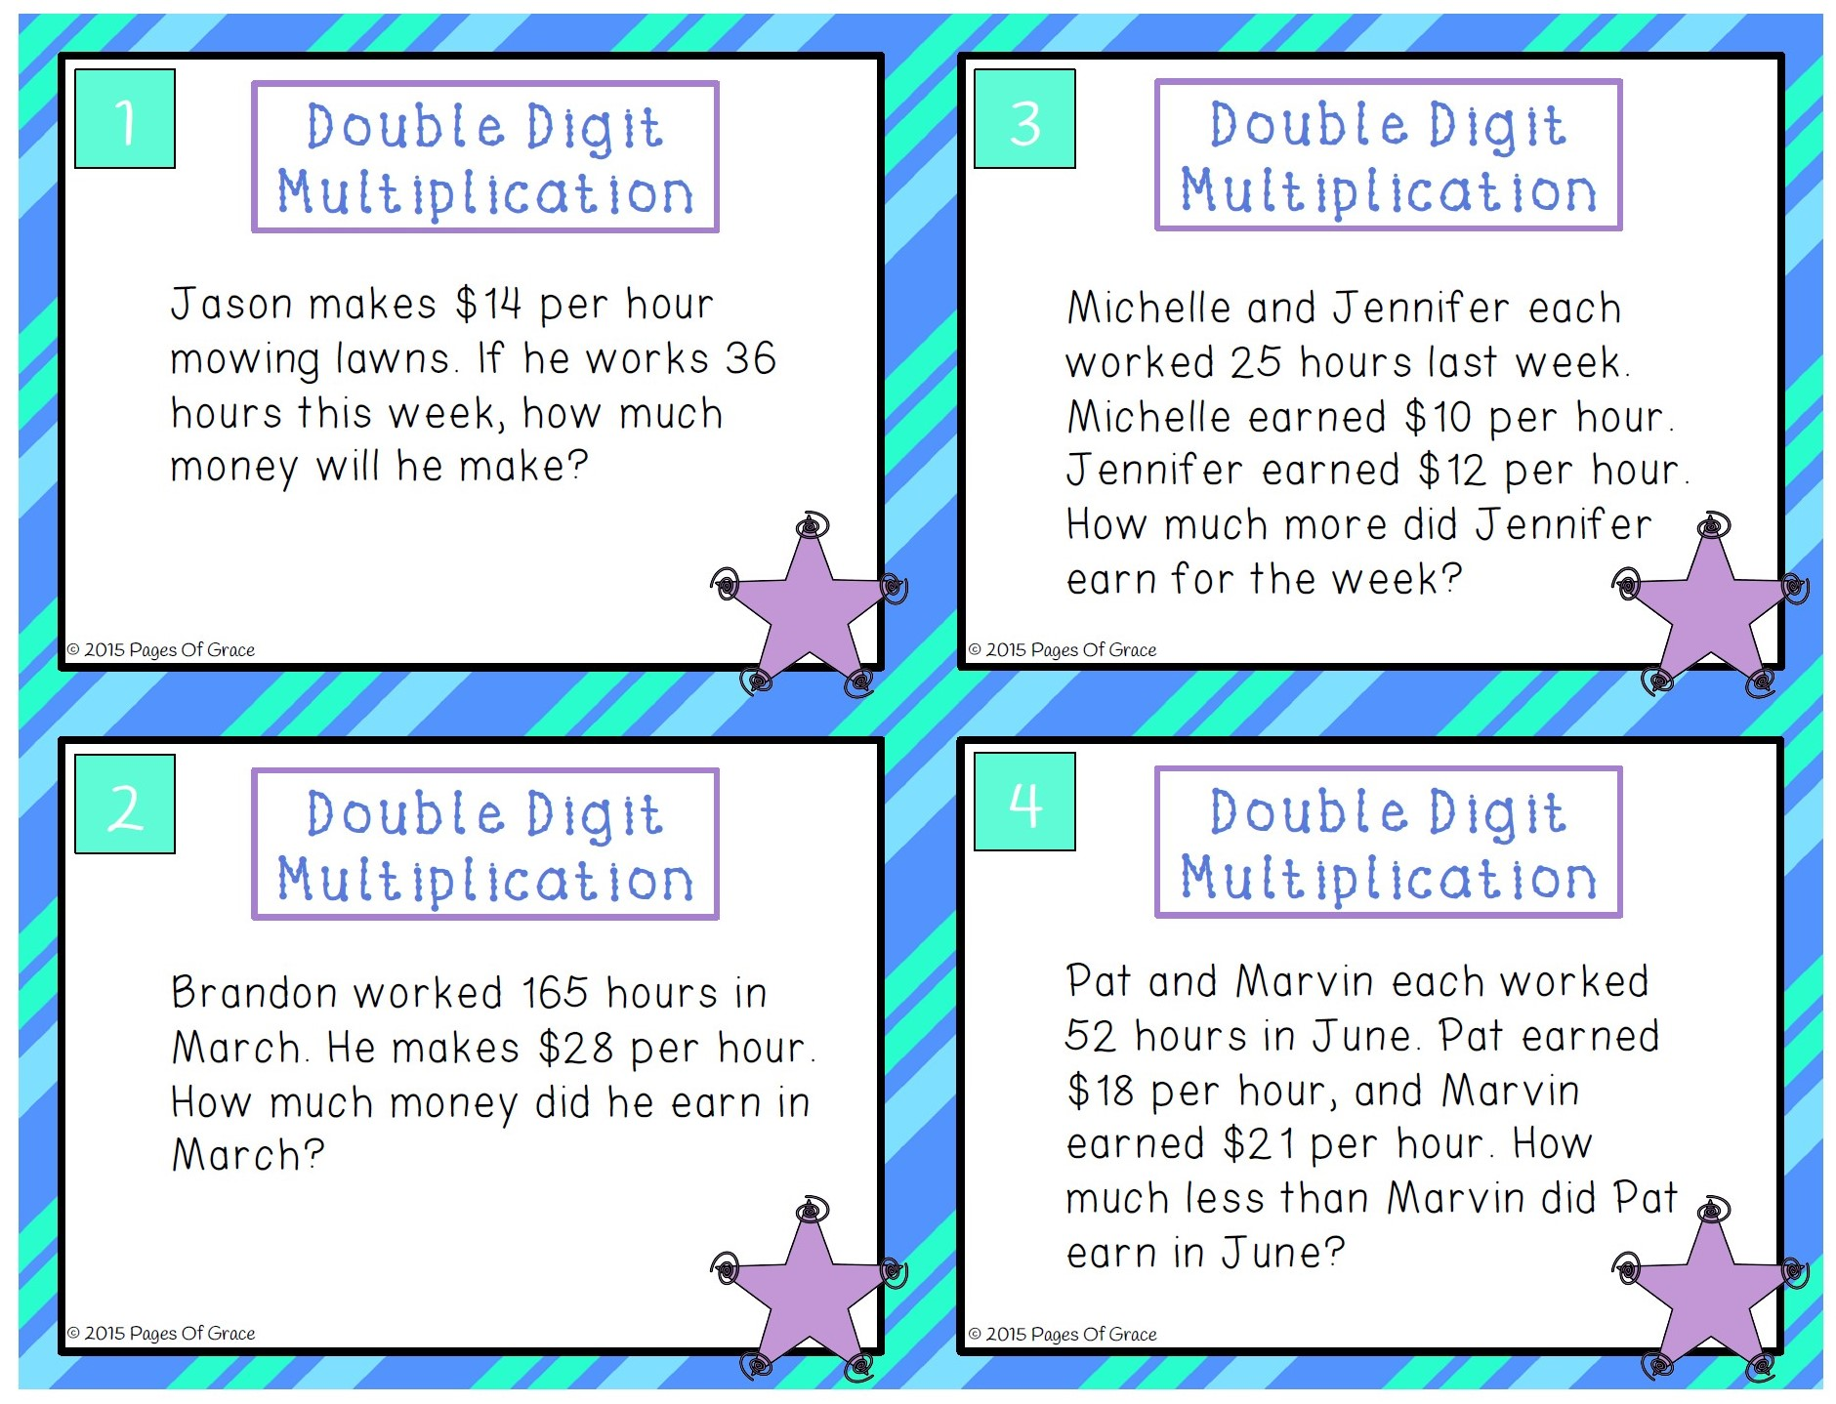

Slide 3
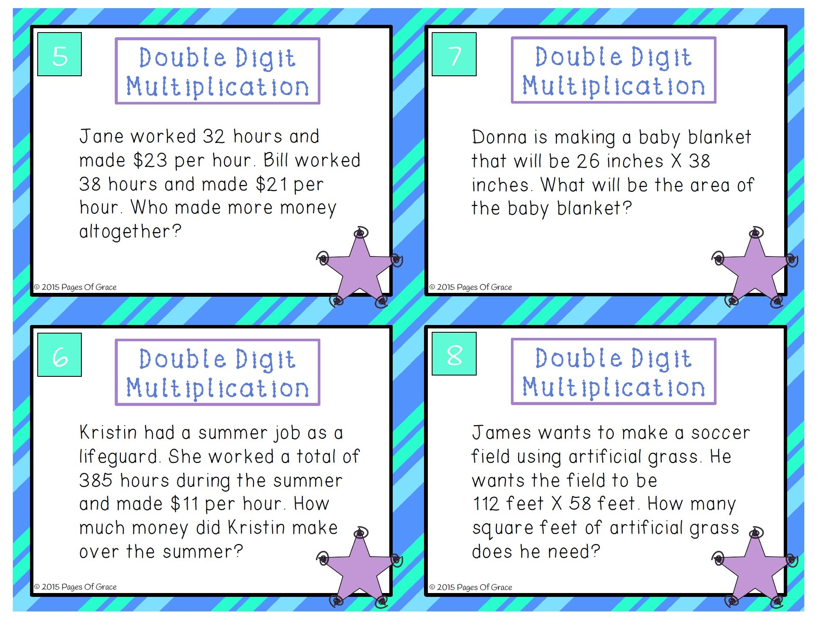

Slide 4
