Slide 1
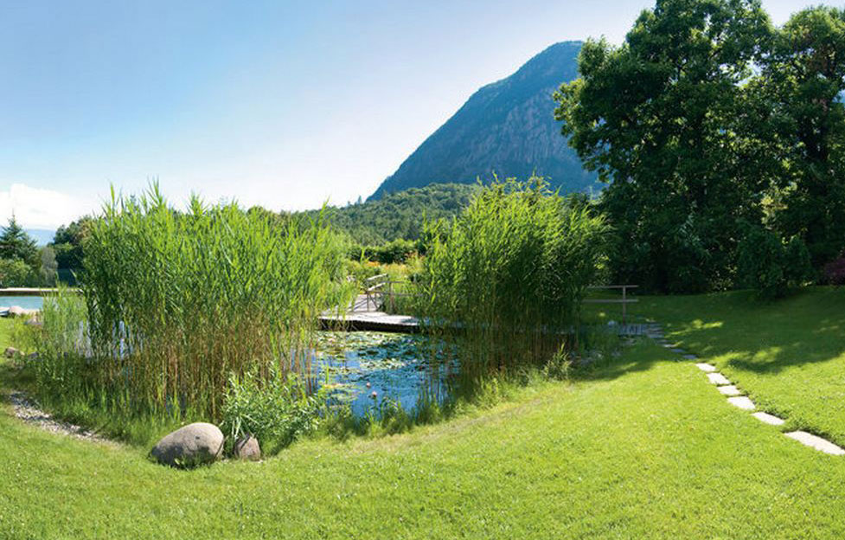
Matter and Energy in Plants
Key Terms

Slide 2
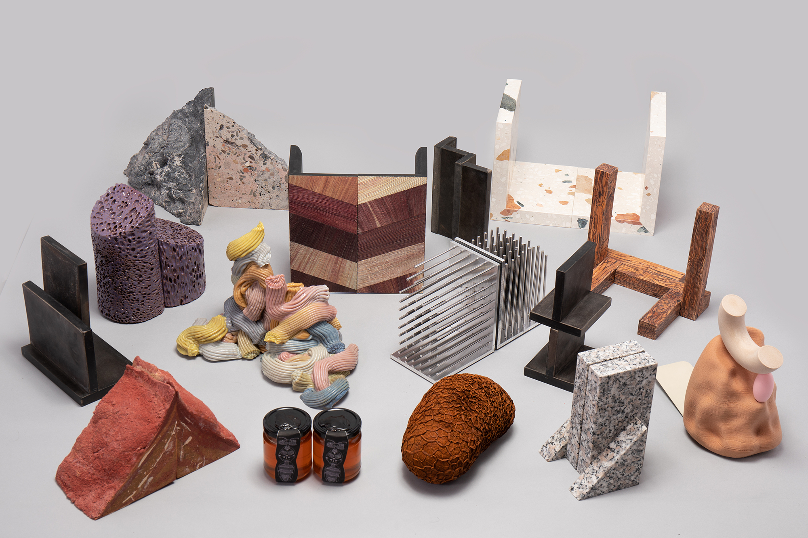
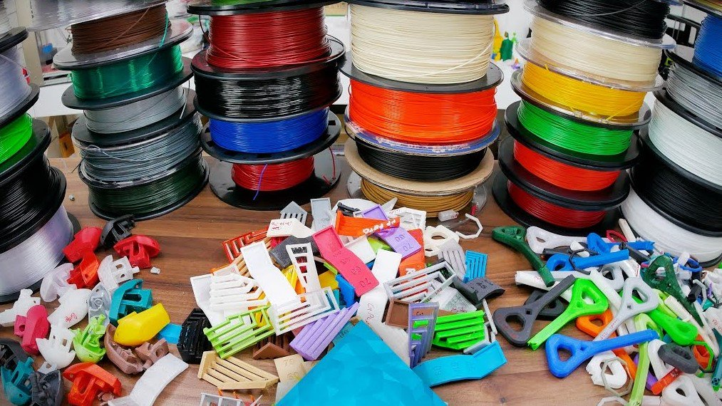
Material
The matter from which a thing can be made

Slide 3
Growth
Increase in size, abundance, or complexity

Slide 4
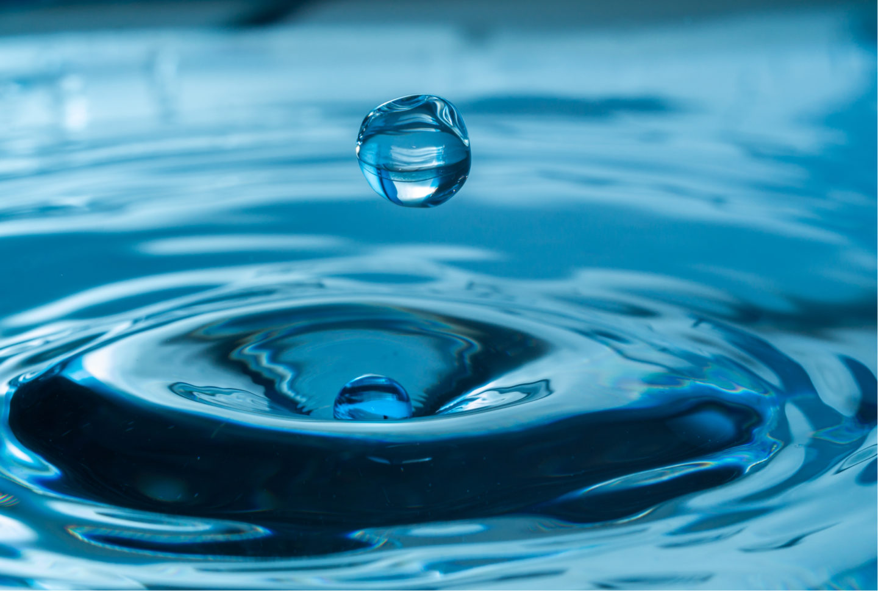
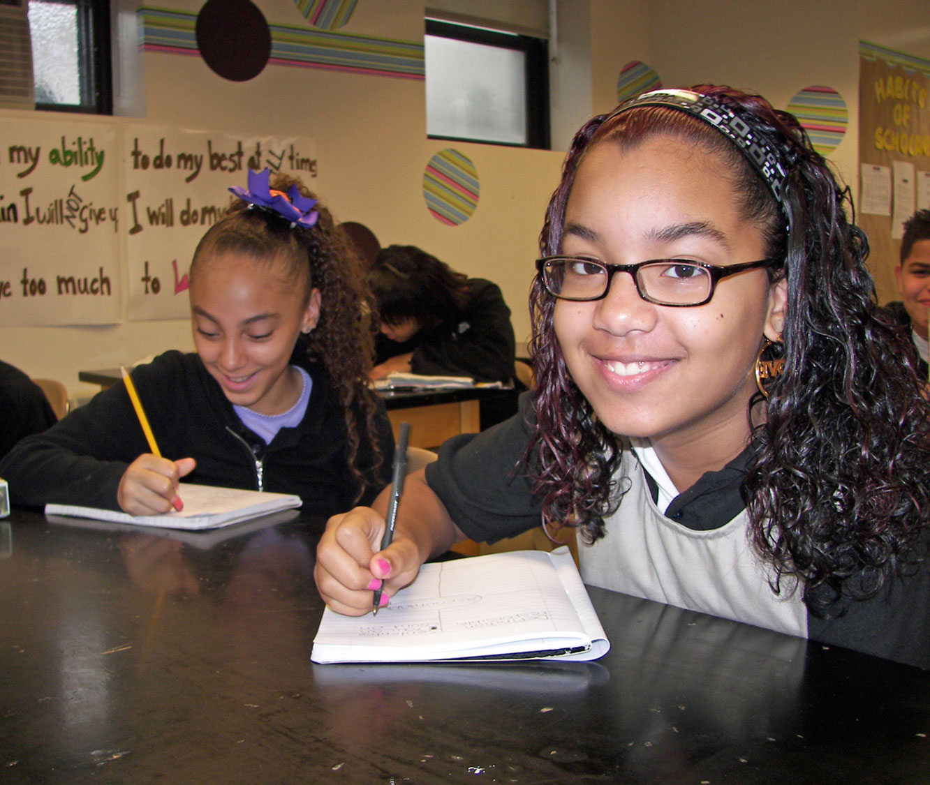
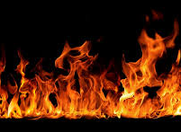
Matter
Anything that has volume and mass

Slide 5
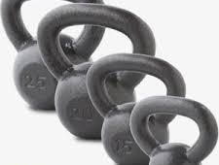
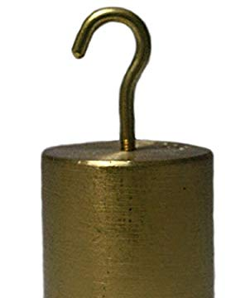
Weight
The heaviness of an object; The force of gravity on mass equals weight.

Slide 6
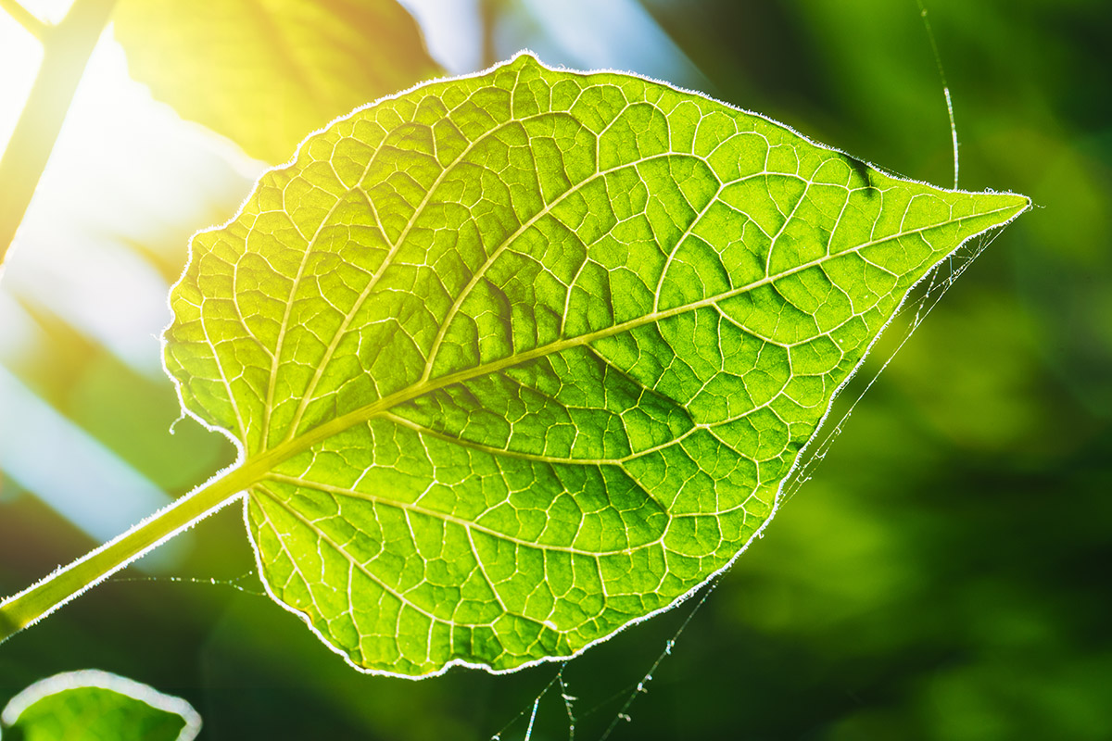
Photosynthesis
The process where plants use sunlight, water, and carbon dioxide to produce sugar and release oxygen

Slide 7
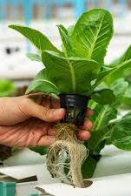
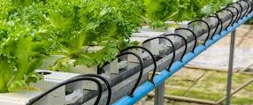
Hydroponics
a way of growing plants without soil, usually by providing a nutrient-rich water.

Slide 8
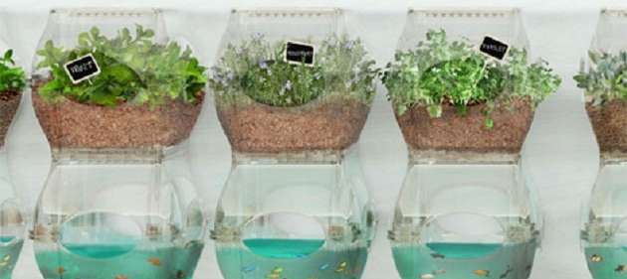
Aquaponics
Aquaponics takes hydroponics to the next level by raising fish and other aquatic organisms, such as snails, crayfish, and shrimp, in the water supply and then pumping the fish water through the hydroponics system and then back to the fish tank.

Slide 9
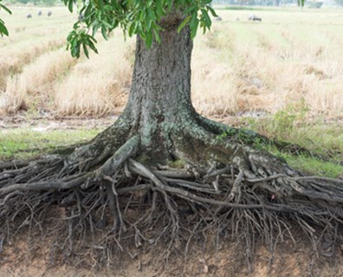
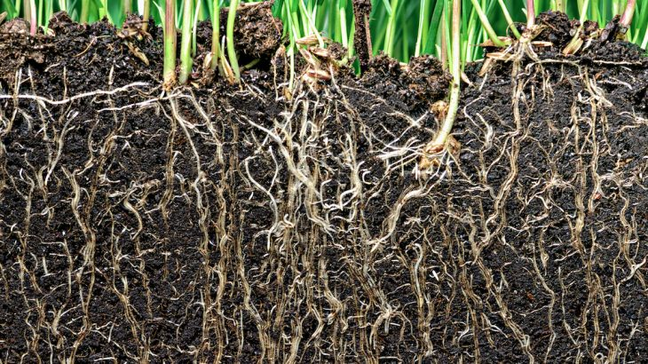
roots
the part of the plant that anchors it in the ground It absorbs water, minerals, and other nutrients from the soil.

Slide 10
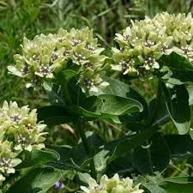
plants
A type of organism that gets its energy directly from the Sun and is unable to move from place to place on its own.

Slide 11
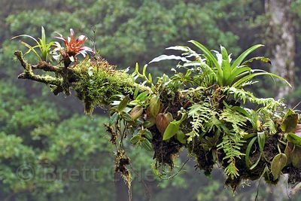
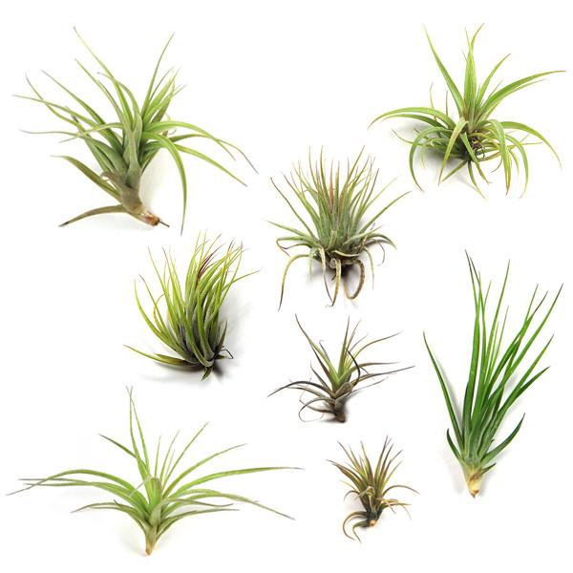
Epiphytes (air plants)
plants that grow on other plants, such as trees, and gather their nutrition from the air and rain.

Slide 12
phytoremediation
the technologies that use living plants to clean up soil, air, and water contaminated with hazardous contaminants

