Slide 1
Math Free Choice

Slide 2
Goal: Have some Math fun!
Choose one of the following math activities to do.
Share about what "Option" you did and what the outcome was on our Math Teams page so we can all give you a thumbs up!
Note: It wouldn’t let me add live links on all the slides, so you may have to copy and paste the links on some of the slides. It will tell you to copy and paste. Some slides do have working links and again, it will tell you to just click the link.

Slide 3
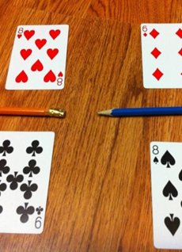
Option 1: Fraction War
You can use playing cards or click the link on the below to print fraction cards of your own.
https://s18670.pcdn.co/wp-content/uploads/2016/10/fractionwar.pdf?sfvrsn=0
Set it up as shown in the picture. Multiply your fractions like normal. To keep it simple, you can have the smaller card value as the numerator.
Whoever gets the highest value as an answer wins all the cards.
Who is going to win the most cards?
Tell us you did "Option 1" and your results on our Math Teams page so we can give you a thumbs up!

Slide 4
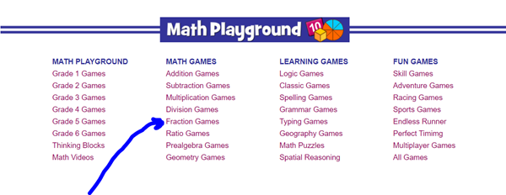
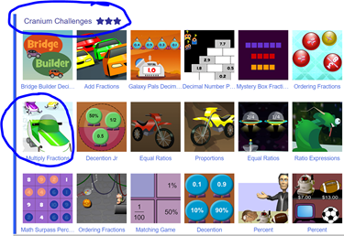
Option 2: Cranium Challenge
Copy and paste this link into your address bar on Google. www.mathplayground.com
Go to the bottom of the page and click on Fraction Games.
Go down to “Cranium Challenges” and click on “Multiply Fractions”.
Play the game. What place did you take?
Tell us you did "Option 2" and your results on our Math Teams page so we can give you a thumbs up!

Slide 5
Option 3: Fraction Hundredaire
Click on the link below to play the game.
http://www.math-play.com/Multiplying-Fractions-Millionaire/Multiplying-Fractions-Millionaire-Game_html5.html
How much money did you earn?
Tell us you did "Option 3" and your results on our Math Teams page so we can give you a thumbs up!

Slide 6
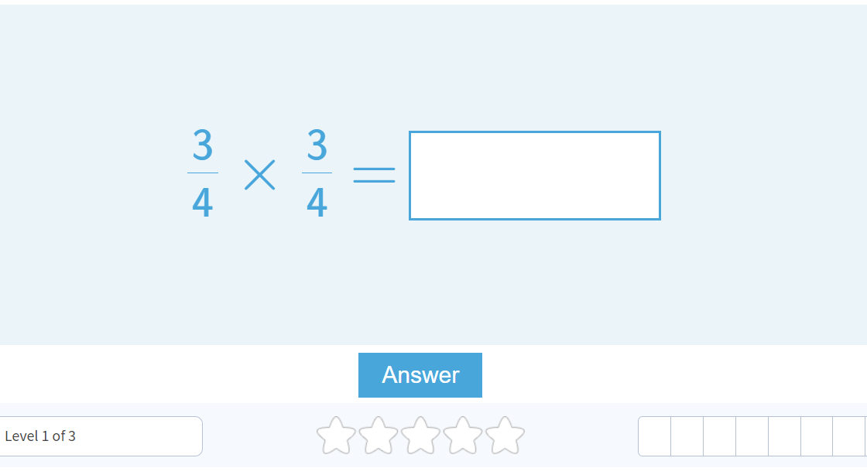
Option 4: Multiply Fractions Game
Click on the link below to play a game of multiplying fractions.
https://www.mathgames.com/skill/5.84-multiply-fractions
How did you do?
Tell us you did "Option 4" and your results on our Math Teams page so we can give you a thumbs up!

Slide 7
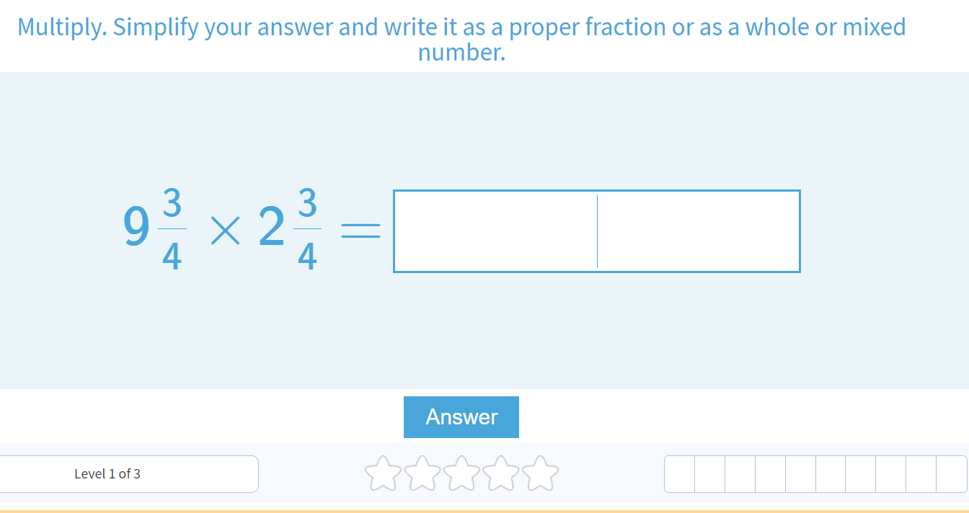
Option 5: Multiply Mixed Numbers
Click on the link below to play a game of multiplying fractions.
https://www.mathgames.com/skill/5.84-multiply-fractions
How did you do?
Tell us you did "Option 5" and your results on our Math Teams page so we can give you a thumbs up!

Slide 8
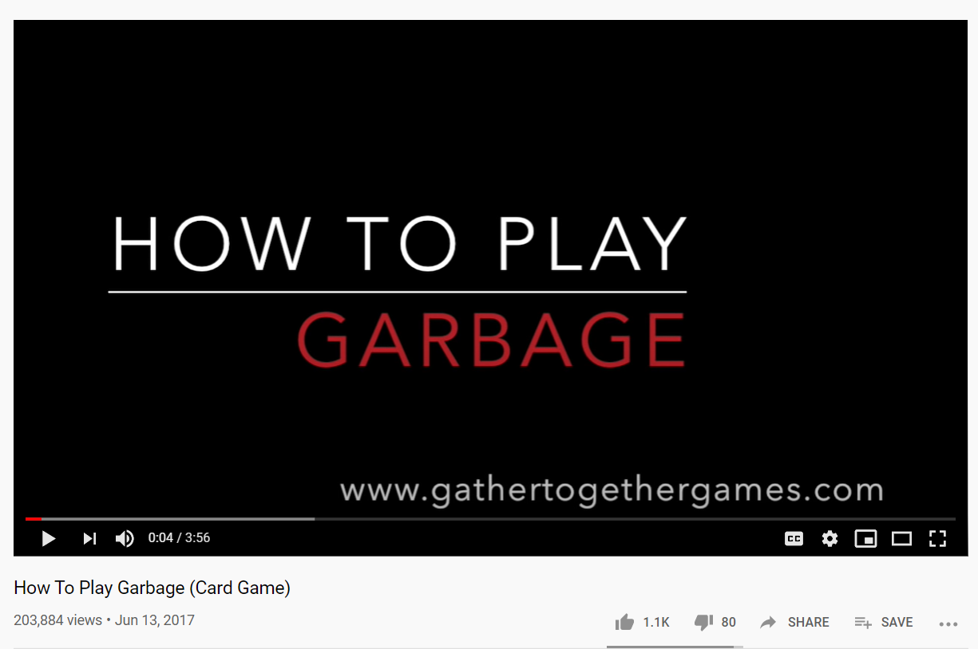
Option 6: Garbage (with cards)
Watch the tutorial video provided in the link below.
“How to Play Garbage” (Card Game) on YouTube
https://youtu.be/tKWvR-43Ukc
Who ended up winning?
Tell us you did "Option 6" and your results on our Math Teams page so we can give you a thumbs up!

