Slide 1
Create a Sundail
Science – Week of April 27- May 1

Slide 2
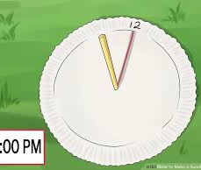
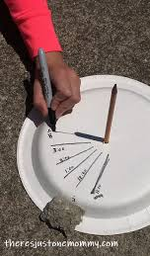
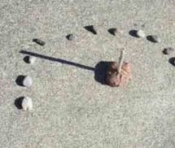
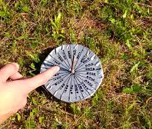
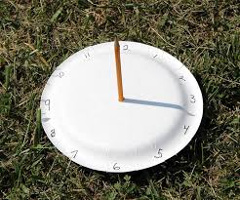

Slide 3
Make Your Sundial
Create a sundial. It can be as simple as a paper plate and pencil or you can be more creative.
Copy and paste these links for some ideas or research some ideas of your own.
https://www.youtube.com/watch?v=CQViTzK0AsA
https://www.wikihow.com/Make-a-Sundial
http://www.ichild.co.uk/documents/activities/pdf/Make_a_Sundial.pdf

Slide 4
Record Your Observations
Take your sundial outside. Do this early in the day (I suggest 8 or 9 am).
Make a mark to show where the shadow is on your sundial when you start and what time you started.
Observe your sundial every hour and make markings for the shadow and time of day. Try to do this for 5 hours or more.
Put a picture of your sundial in Teams.
Write a few sentences explaining your observations.

