Slide 1
_________ _________’s Family Tree

Slide 2
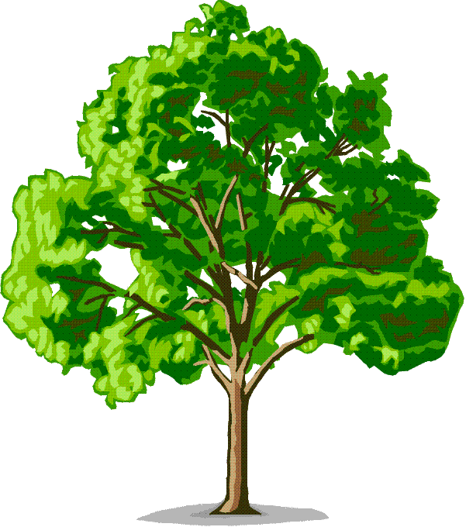
Name
Great Grandfather
Name
Great Grandfather
Name
Great Grandfather
Name
Great Grandfather
Name
Great Grandmother
Name
Great Grandmother
Name
Great Grandmother
Name
Great Grandmother
Name
Grandmother
Name
Grandfather
Name
Grandmother
Name
Grandfather
Name
Father
Name
Mother
Name
Me

