Slide 1
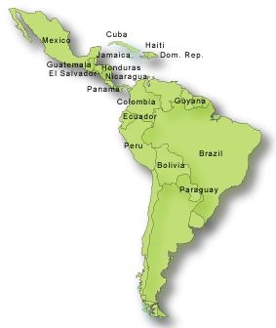
Latin American Policies
Chapter 7 Section 4 Notes

Slide 2
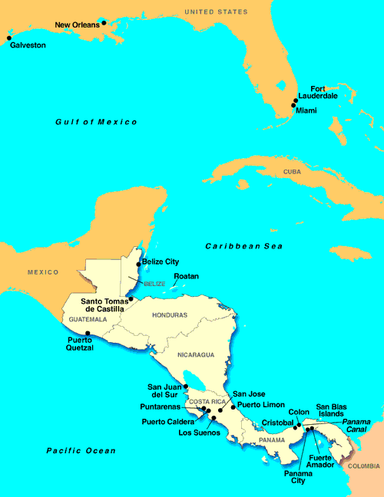
PANAMA
Europeans and Americans wanted to build a canal across Central America

Slide 3
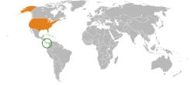
This would make travel between the Atlantic and Pacific Ocean shorter and less dangerous.

Slide 4
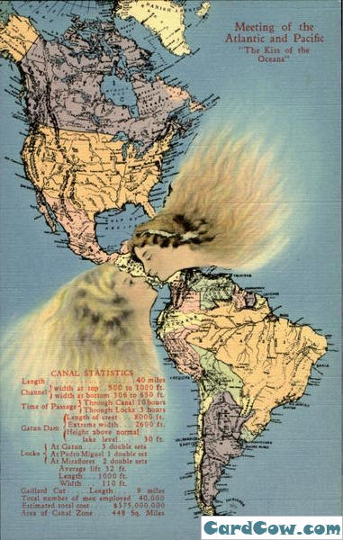
After acquiring new territories in the Pacific region, the goal of building a canal became more important to the U.S.

Slide 5
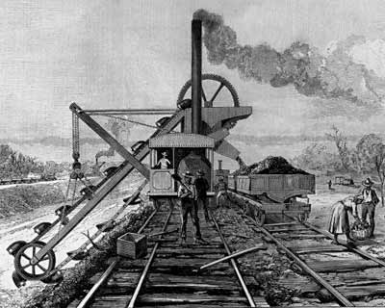
  The French were the first to try and build the canal in Panama, which was then part of Columbia
    They were unsuccessful
    The U.S. paid the French 40 million for their lease in Panama

Slide 6
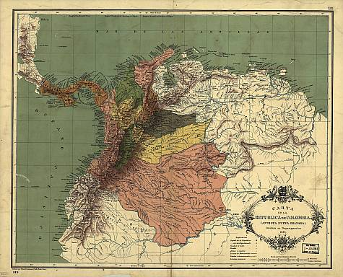
The Columbian government opposed the deal and rejected a treaty with the U.S.

Slide 7
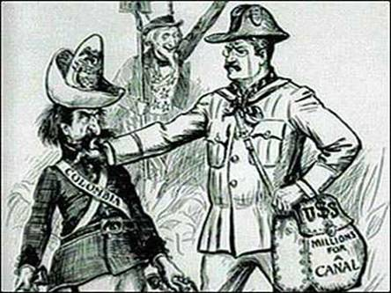
The U.S. and President Roosevelt supported a Panamanian revolt against the Columbians.

Slide 8
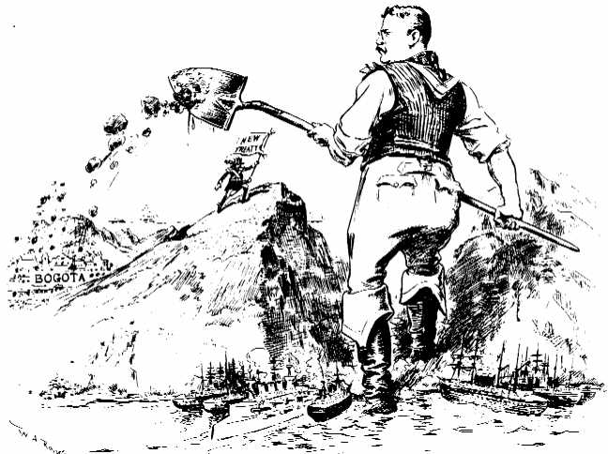

Slide 9
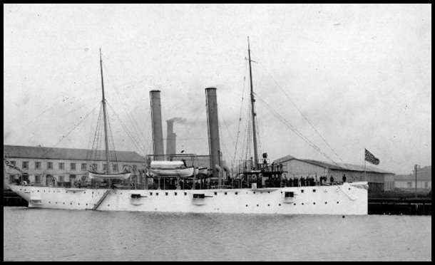
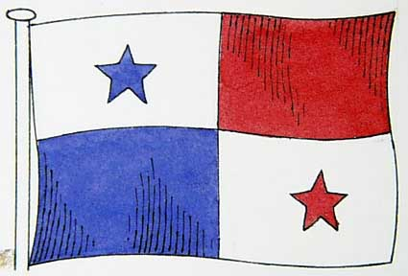
Roosevelt sent the warship U.S.S. Nashville to Panama.
The Panamanians revolted and declared their independence from Columbia
The U.S. prevented the Columbians from stopping the revolt.
The U.S. recognized Panama’s independence and signed a treaty with Panama for a ten mile strip of land.

Slide 10
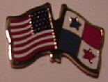
The 2 countries agreed the U.S. could lease the land for 99 years in exchange for 10 million dollars and a yearly rent of $250,000.

Slide 11
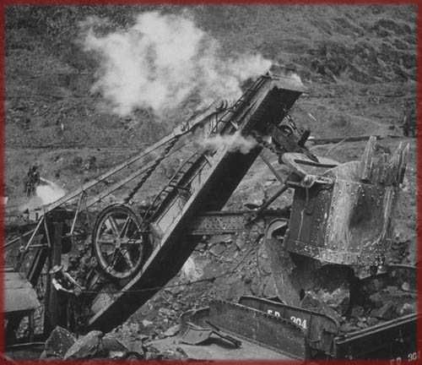
Building the Canal

Slide 12
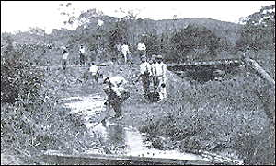
Before the U.S. began digging, they first had to get rid of what kept the French from being successful

Slide 13
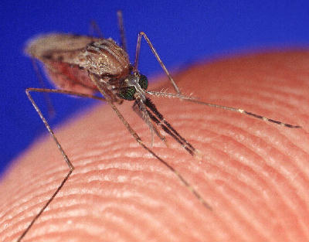
Mosquitoes

Slide 14
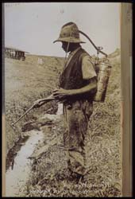
Drained swamps, sprayed insecticides, spread oil on standing bodies of water, and cut grassy marshes.

Slide 15
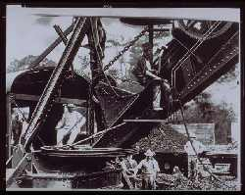
Building the canal was an enormous job.
  It was considered the greatest engineering challenges of the time

Slide 16
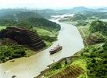
It took thousands of workers 8 years to carve a path through the thick jungles and mountains

Slide 17
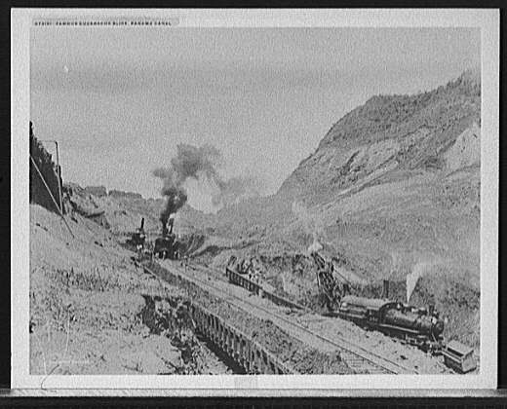

Slide 18
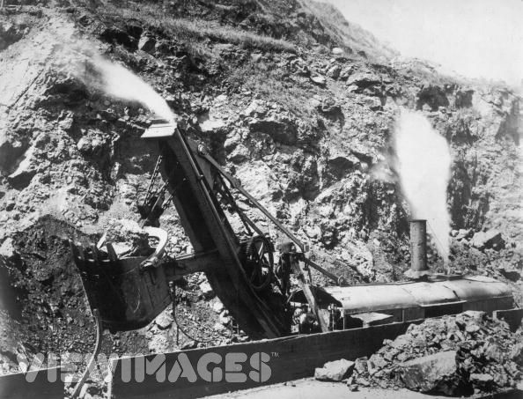

Slide 19
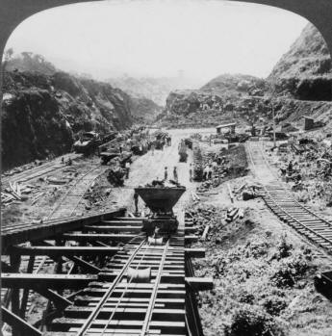

Slide 20
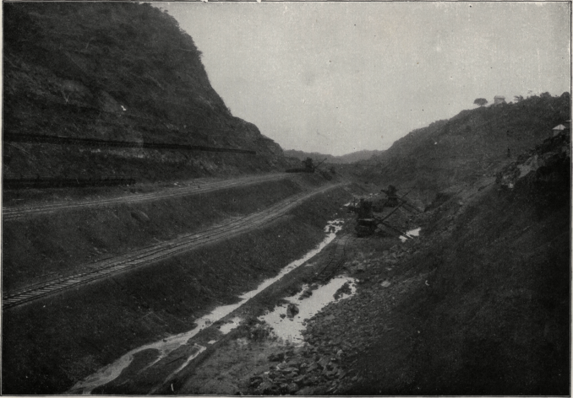

Slide 21
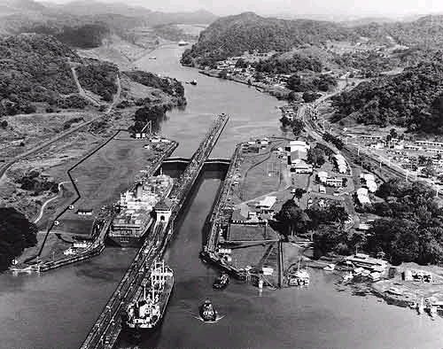

Slide 22
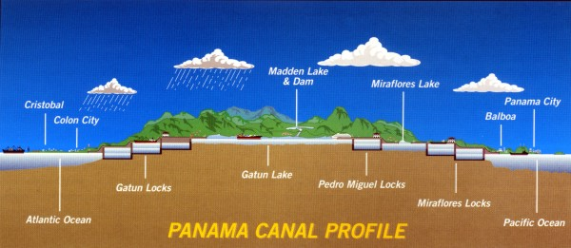

Slide 23
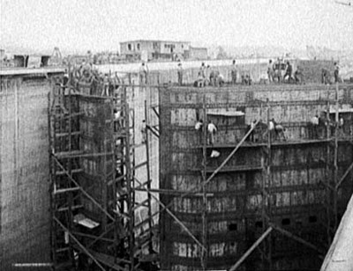

Slide 24
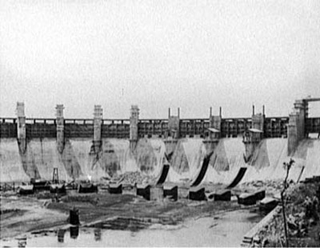

Slide 25
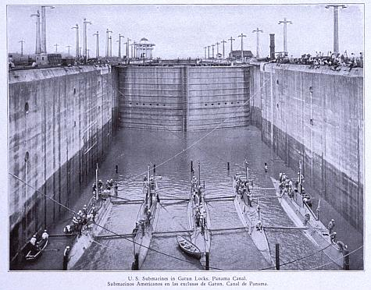

Slide 26
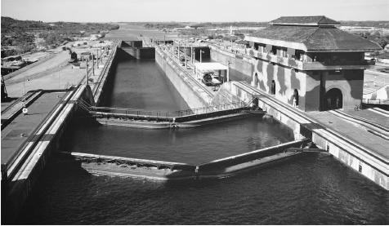

Slide 27
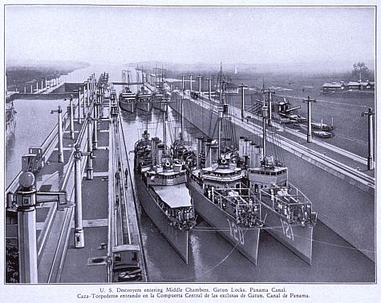

Slide 28
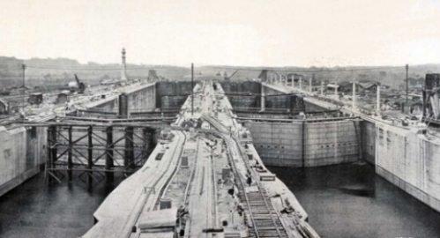

Slide 29
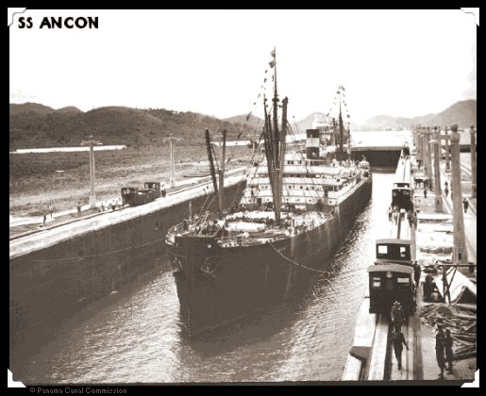
It opened in 1914
  The Ancon, a cargo ship, was the first vessel to travel through the canal.

Slide 30
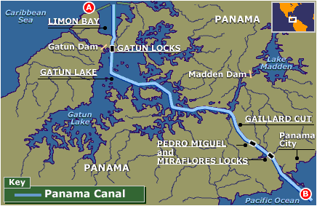
Results of the Panama Canal

Slide 31
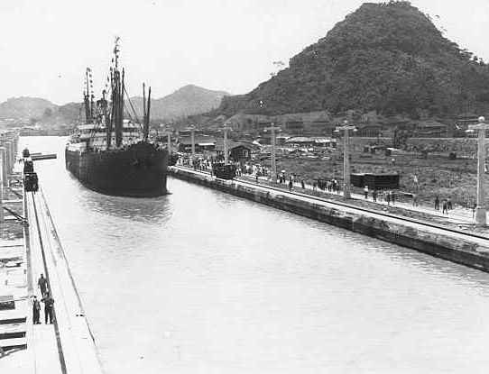
Results of the Panama Canal
The canal took 7,000 miles off the trip from New York to San Francisco.
Shipping costs drastically dropped
Americans became a strong presence in Latin America.

Slide 32
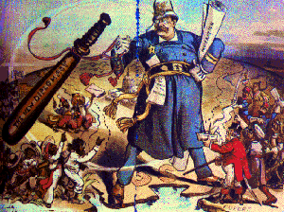
Policing the Western Hemisphere

Slide 33
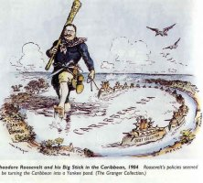
Roosevelt believed America should serve as an international police force to protect other countries from disorder and lawlessness, or anarchy

Slide 34
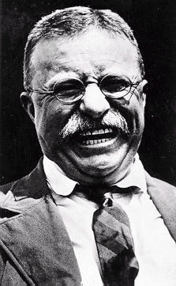
In 1904 Roosevelt added the Roosevelt Corollary to the Monroe Doctrine.
  The Roosevelt Corollary claimed the United States to become involved in Latin America whenever nations were unstable.
    He was worried Europeans would start to become involve in Latin American affairs

Slide 35
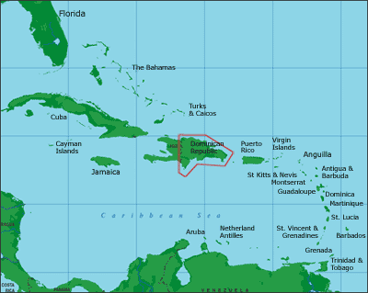
In 1903 revolutionaries overthrew the government of the Dominican Republic
    The U.S. took control of the Dominican’s finances from 1905 until about 1935 under the terms of the Roosevelt Corollary
In 1906 the U.S. prevented a revolution in Cuba by applying the Roosevelt Corollary

Slide 36
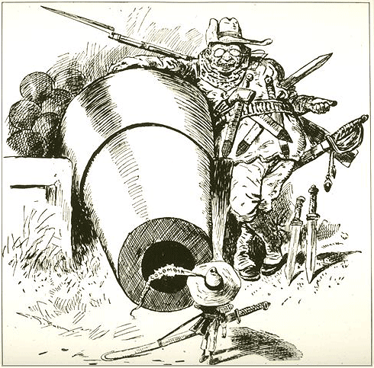
Anti-United States feelings increased and Latin Americans wanted the U.S. to stop interfering in their affairs.

Slide 37
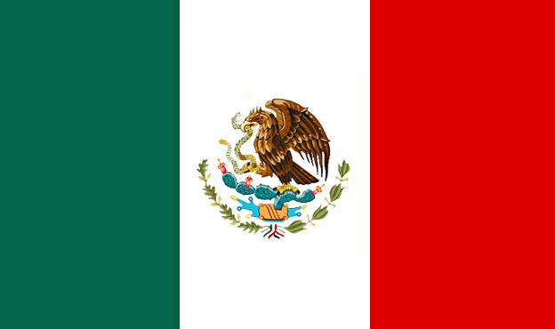
Relations in Mexico

Slide 38
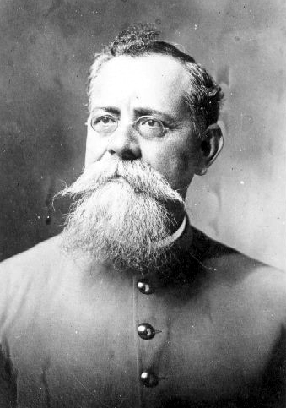
  Civil War broke out in Mexico
    The U.S. supported Venustiano Carranza and gave him and his followers weapons to win the war

Slide 39
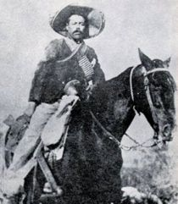
Francisco “Poncho” Villa led a revolt against Carranza

Slide 40
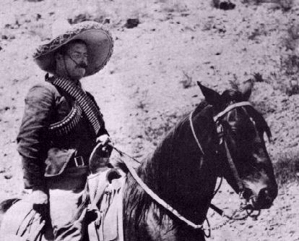
Villa shot 16 Americans in 1916 because the U.S. supported Carranza

Slide 41
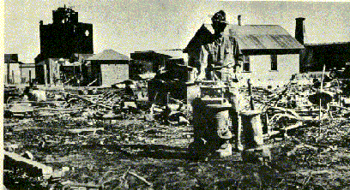
He and his followers set fires in New Mexico, killing 18 more Americans

Slide 42
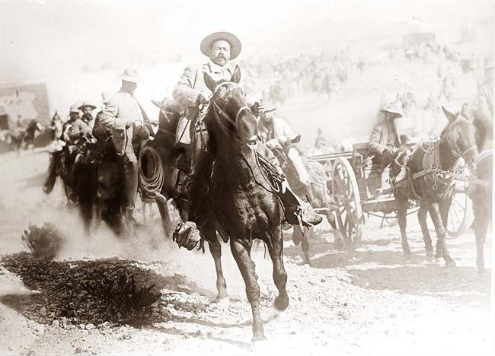
The Mexican people supported “Poncho” Villa

Slide 43
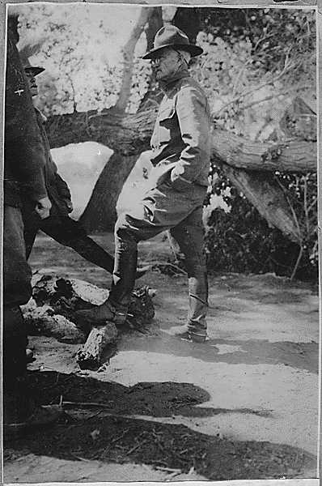
General John J. Pershing and American troops searched for a year to find Villa and his men in Mexico.

Slide 44
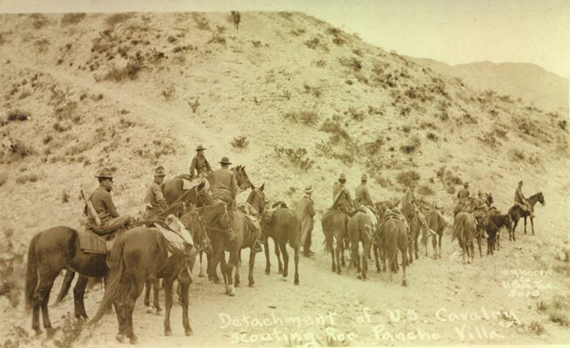
He was not successful

Slide 45
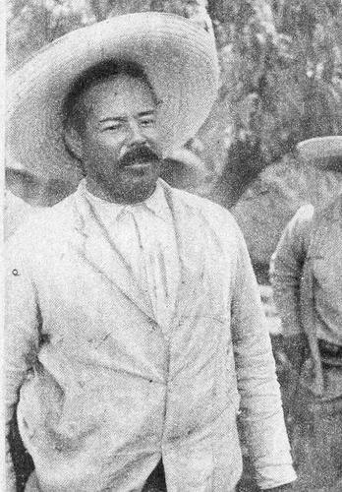
Mexican resentment toward Americans resulted.

