Slide 1
Chapter 10.2
FDR
and
The New Deal

Slide 2
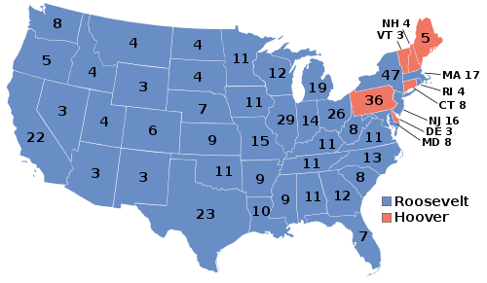
FDR Takes Charge
Franklin D. Roosevelt won the election of 1932 in a landslide victory.
  It was clear that Americans wanted a change from Hoover

Slide 3
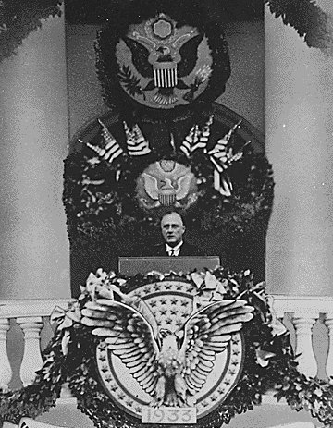
FDR Takes Charge
In his inaugural speech, FDR stated that his main goal was to get people back to work and save the troubled economy.

Slide 4
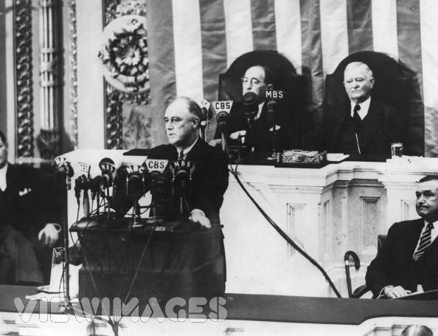
FDR Takes Charge
Emergency Banking Relief Act
  Immediately after becoming president, FDR closed all U.S. banks for four days.
  He and Congress met for a special session, where they created a system so that banks could reopen and once again be successful.

Slide 5
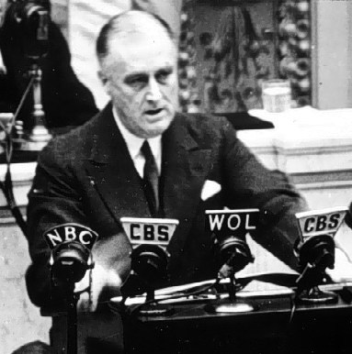
FDR Takes Charge
  Roosevelt assured Americans over the radio that their money would again be safe in American banks.
    The next day, bank deposits outnumbered withdrawals for the first time in months.
    The Emergency Banking Relief Act ended the banking crisis in America.

Slide 6
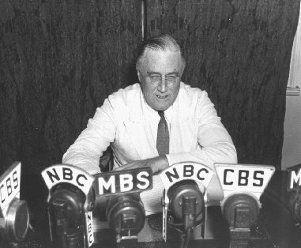
FDR Takes Charge
Fireside Chats
  FDR continued his talks over public radio, they became known as the Fireside Chats.
  These chats connected Americans to what FDR was trying to do to get the country back on track.
    This gained their confidence and trust.

Slide 7
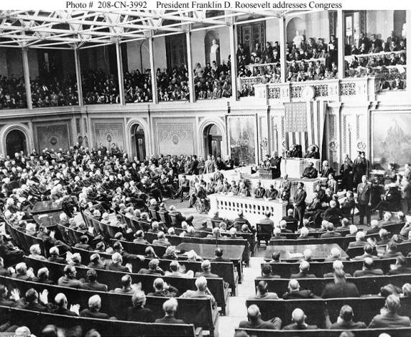
FDR Takes Charge
Hundred Days
  Roosevelt kept Congress in a special session for almost 3 months to help him solve America’s problems.
  Roosevelt gave Congress 15 proposals to fix the nation’s problems.
    Congress passed all 15 of them. They didn’t have to pass any!

Slide 8
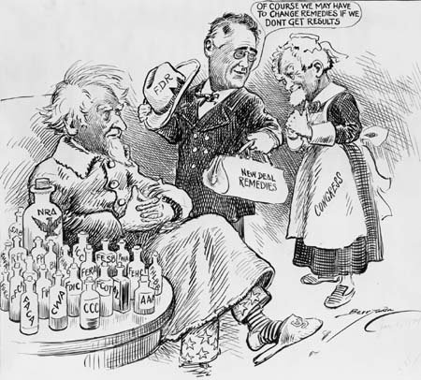
FDR Takes Charge
New Deal
  The laws passed during the Hundred Days became known as the New Deal.

Slide 9
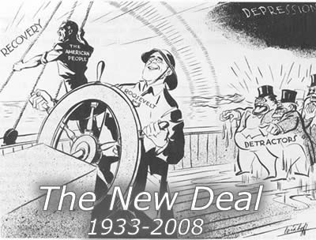
FDR Takes Charge
The New Deal created solutions to fix banking, the stock market, industry, agriculture, public works, relief for the poor, and conservation of resources.

Slide 10

FDR Takes Charge
CCC (Civilian Conservation Corps)
    Put millions of young men to work.
    They planted trees, built dams, and improved national parks.

Slide 11
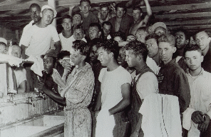
CCC

Slide 12
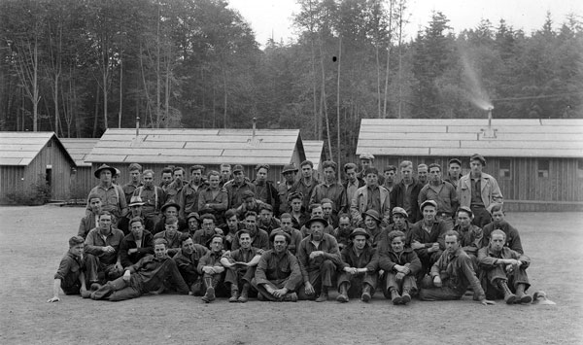
CCC

Slide 13
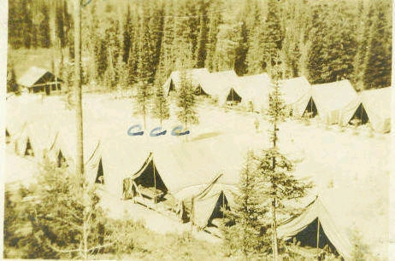
CCC

Slide 14
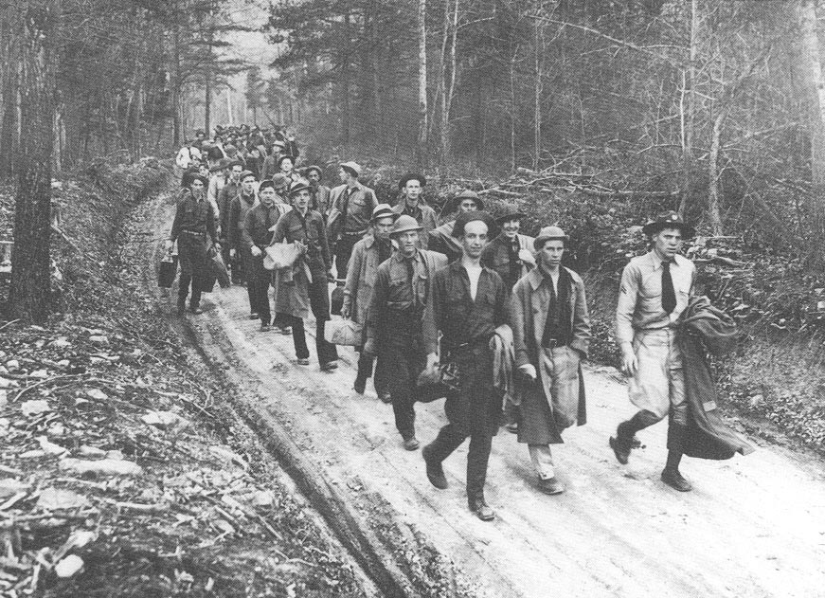
CCC

Slide 15
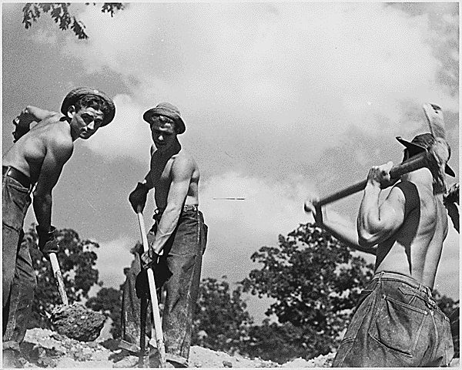
CCC

Slide 16
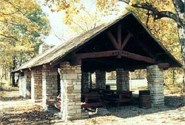
Channahon, IL

Slide 17
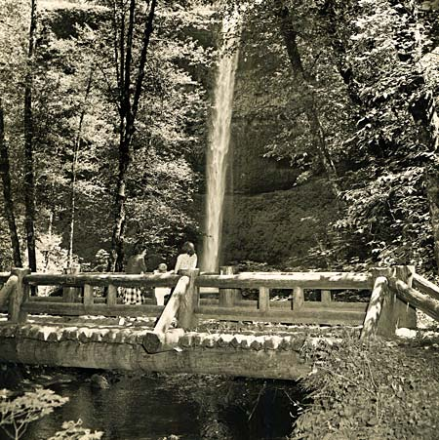
Starved Rock Bridge

Slide 18
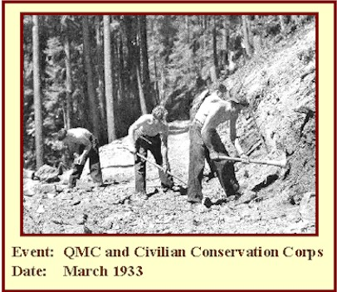
CCC

Slide 19
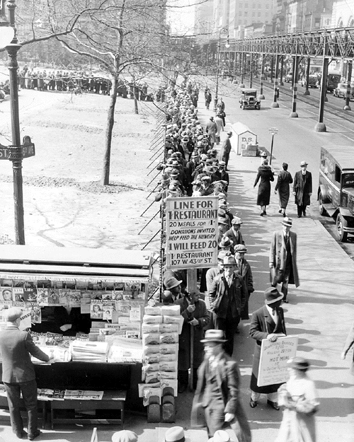
FDR Takes Charge
FERA (Federal Emergency Relief Administration)
  Gave money to the states to help needy people.

Slide 20
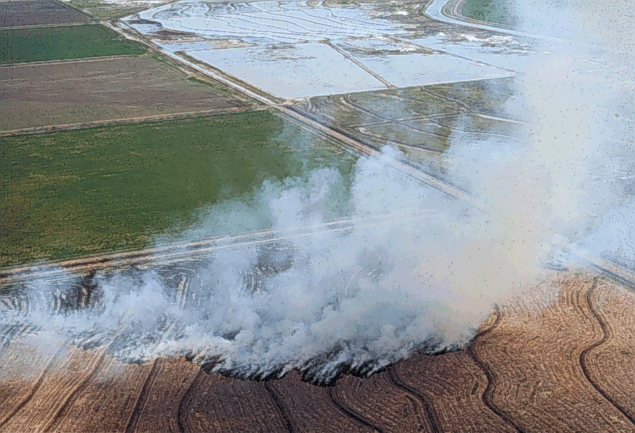
FDR Takes Charge
AAA (Agricultural Adjustment Act)
  Paid farmers to destroy some of their produce or leave some of their land unfarmed.
  The plan was to raise farm prices quickly and control production so prices could stay up.
  The Supreme Court ruled the AAA was unconstitutional.

Slide 21
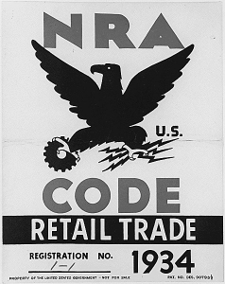
FDR Takes Charge
NRA (National Recovery Administration)
      Encouraged businesses to regulate themselves by setting a minimum wage and to stop child labor.

Slide 22
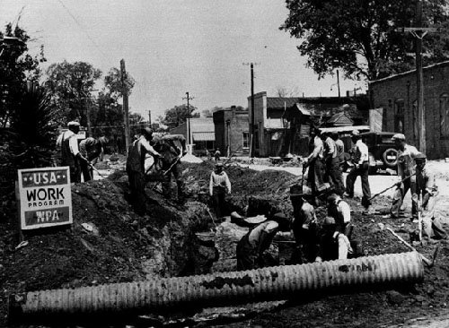
FDR Takes Charge
PWA (Public Works Administration)
    Created large public works projects that needed many workers.
    Gave people jobs working on roads, shipyards, hospitals, schools, and libraries.

Slide 23
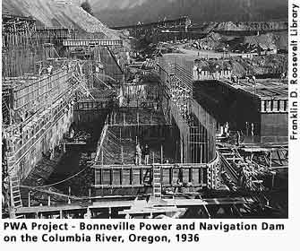
PWA

Slide 24
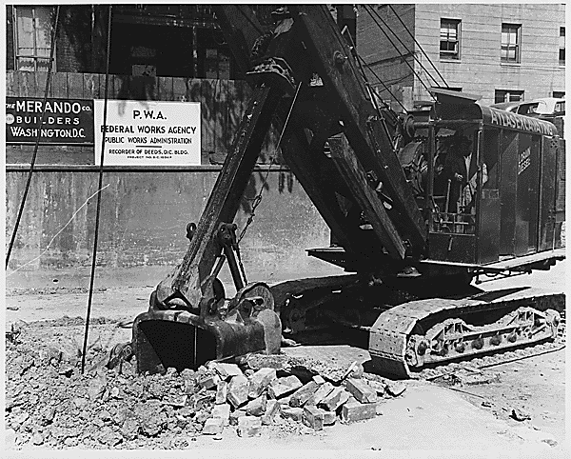
PWA

Slide 25

FDR Takes Charge
FDIC (Federal Deposit Insurance Corporation)
    Created to protect bank deposits.
    Guaranteed that money deposited in a FDIC insured bank would be available if the bank failed.

Slide 26
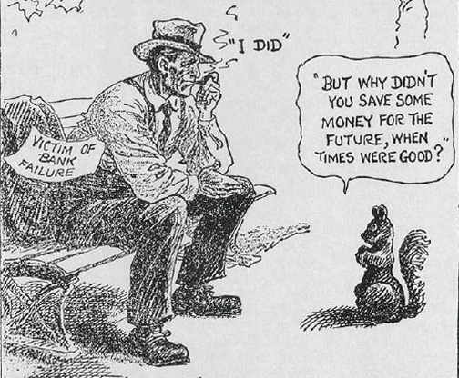

Slide 27

FDR Takes Charge
SEC (Securities and Exchange Commission)
      Created to monitor and punish dishonest stockbrokers.

Slide 28
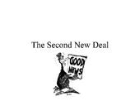
The Second New Deal
  The economic situation improved a small amount by the mid-1930’s
  FDR took more steps to improve the economy by creating the Second New Deal.

Slide 29
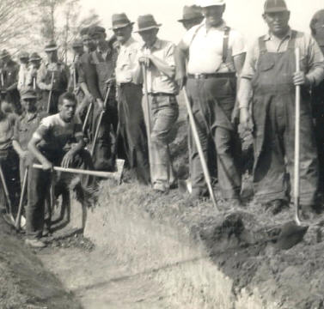
WPA (Works Progress Administration):
  Built and fixed airports, public buildings, bridges, and roads.
  Employed 2 million people

Slide 30
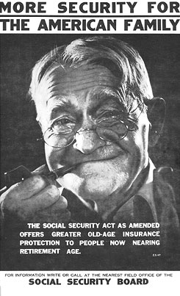
Social Security Act
  Created a tax on workers and employers
  That money provided monthly pensions for retired people.
  It supported others in need of aid.
    It was the start of the American welfare system.

Slide 31
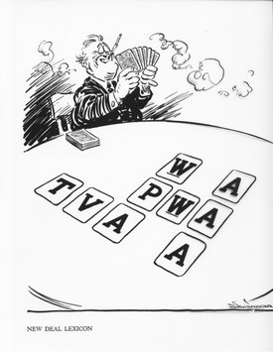
FDR Takes Charge
All of these New Deal programs did not end the Depression, but they did improve conditions and provide hope that times would get better.

Slide 32
New Deal Bumper Sticker
Create a bumper sticker that is meant to persuade the American people to trust in one of the New Deal programs.
  You get to pick the program
  Include the abbreviation and the full name
  You must include a colored, catchy drawing
  You must include 3 bulleted facts about the program
    Find info in your notes and/or textbook (Section2)
  BE CREATIVE!
    There is paper and colored pencils for your use
    Neatness counts

