Slide 1
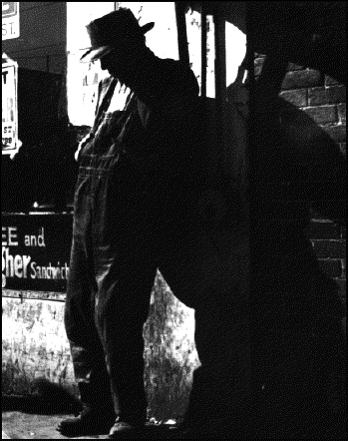
Chapter 10.3
Life During the Great Depression

Slide 2
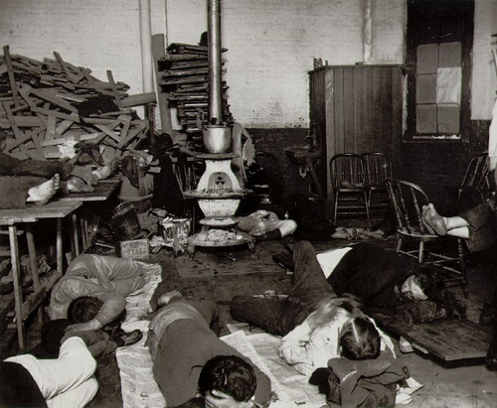
Hard times in America
Not all Americans lost their jobs, but most people did have to learn to live with less.
  Some families moved in with relatives to save money.

Slide 3
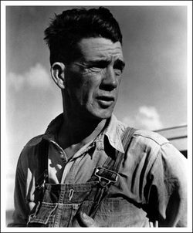
Hard times in America
Some families fell apart
  Almost 2 million men left their families
  Most wandered to warm areas such as California or Florida

Slide 4
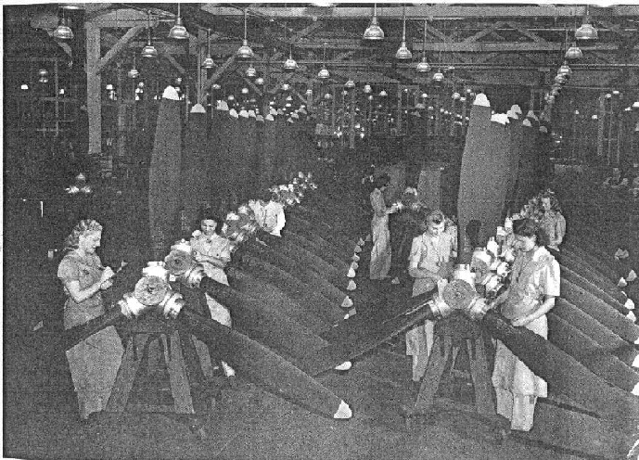
Women and the Great Depression
Many women entered the workplace
  They were paid less then men.
  Many families survived on the women’s income

Slide 5
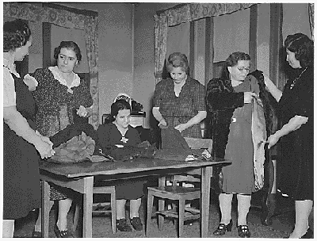
Women and the Great Depression
Some women started their own businesses in the home
  Sewing damaged clothes, canning vegetables, and baking bread.

Slide 6
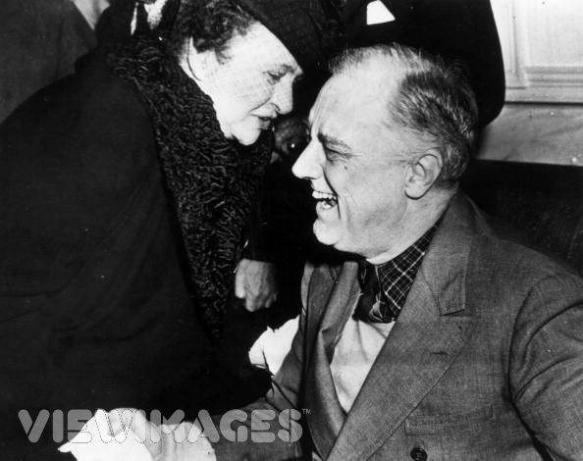
Women and the Great Depression
Many women entered politics
Frances Perkins was the first woman to ever serve on a president’s cabinet

Slide 7
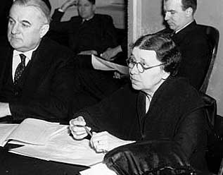
Women and the Great Depression
More than 100 women received federal government jobs
Hattie Caraway became the first woman elected to the U.S. Senate. (Arkansas)

Slide 8
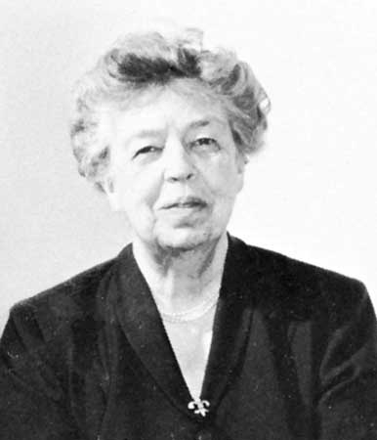
Women and the Great Depression
First Lady Eleanor Roosevelt went on trips for her husband, campaigned for women and minorities, and wrote a daily newspaper column.

Slide 9
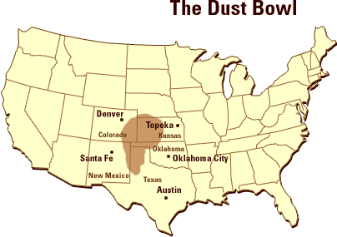
The Dust Bowl
Many settlers moved to the Southern Great Plains to start farms.
  The area of western Kansas, western Oklahoma, northern Texas, eastern Colorado, and eastern New Mexico.

Slide 10
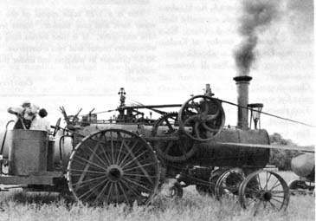
New farming methods allowed for millions of acres of sod to be cleared for farming

Slide 11
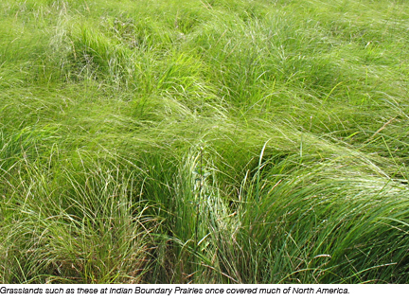
This area was mostly grasslands before settlers arrived
  The roots of the grass, or sod, were the only thing holding the soil down keeping it from blowing away.

Slide 12
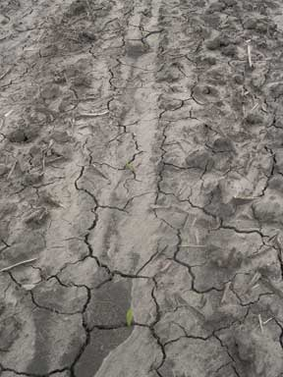
The Southern Plains were hit by a severe drought that lasted for years.
  The crops died and the bare soil dried out.

Slide 13
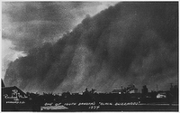
Strong prairie winds whipped the dry soil into the air forming giant black clouds

Slide 14
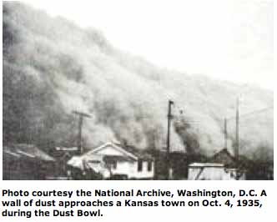

Slide 15
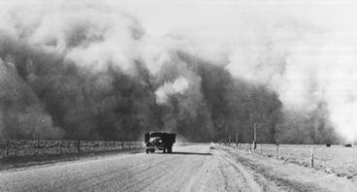

Slide 16
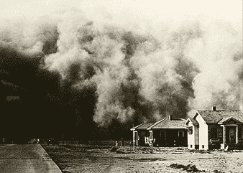

Slide 17
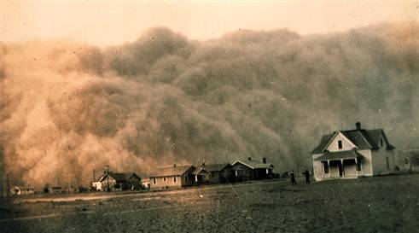

Slide 18
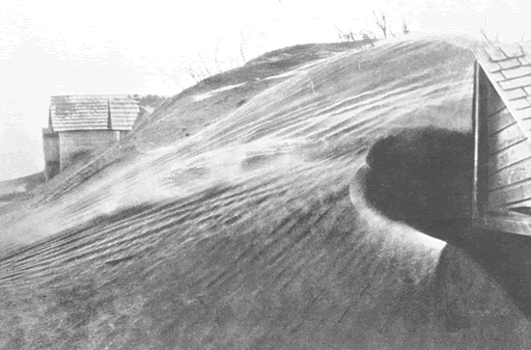
The clouds of airborne soil buried farms and houses
The areas affected by the dust storms became known as the Dust Bowl.

Slide 19
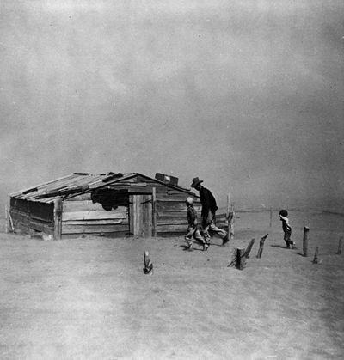

Slide 20
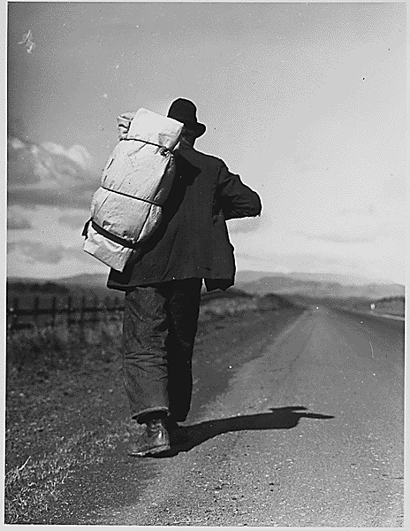
Farmers and people affected by the Dust Bowl lost their homes and farms.
  Many moved to California and became migrant workers.

Slide 21
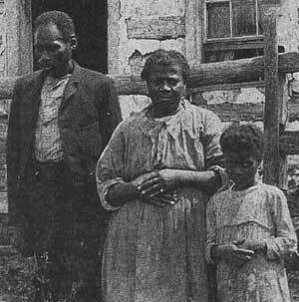
Minorities
Minority groups especially suffered during the Great Depression.

Slide 22
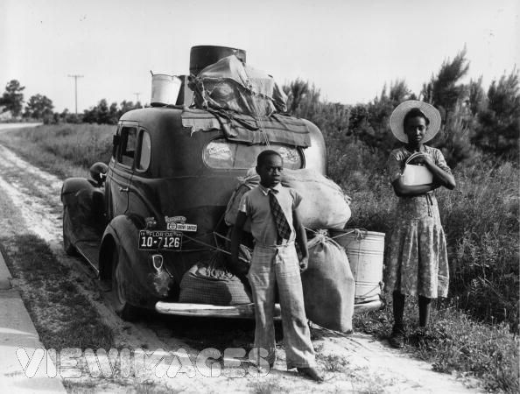
African Americans
Jobs held by African Americans were given to white people who lost their jobs.
Many African Americans moved North hoping to find work, but were unsuccessful

Slide 23
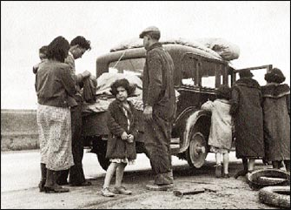
Hispanic Americans
The U.S. government encouraged Mexican immigrants to return to Mexico.
  They were given one-way train tickets to Mexico
  Groups of Mexican immigrants were collected and shipped back to Mexico.

Slide 24
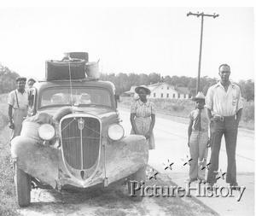
Positives for minorities during the Great Depression

Slide 25
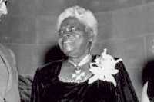
FDR appointed many African Americans to federal positions.
FDR also created a group of African Americans to advise him on African American affairs.

Slide 26
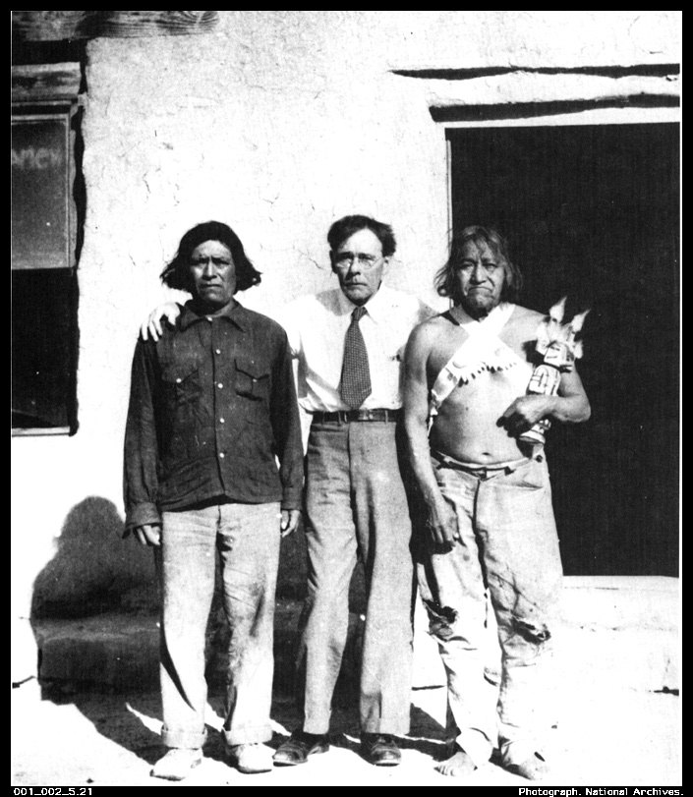
Native Americans
FDR created the Indian New Deal
  Stopped the sale of Indian reservation lands.
  Provided jobs for thousands of Native Americans in the CCC
  New schools were built on reservations
  New land was added to existing reservations

Slide 27
Great Depression Art
Draw a picture of children who may have lived during the Great Depression.
  Draw the picture as if it were to be on the cover of the Chicago Tribune in 1932.
    Your picture must include:
      More than one child
      Background
      Everything must be colored
      A two sentence caption below the picture.

Slide 28
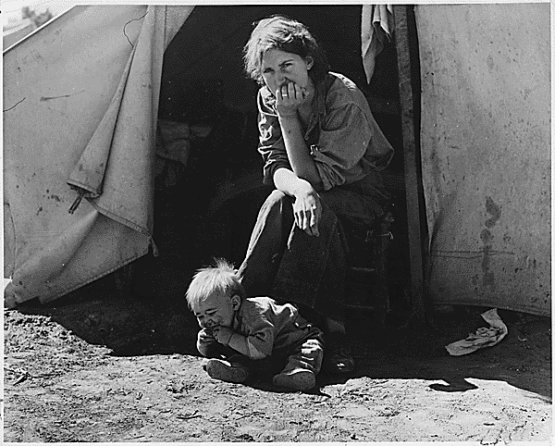
Example
Mother watches over her son as he plays in the dirt outside of their tent home. His clothes fit now, but she wonders what she will do as he continues to grow.

