Slide 1
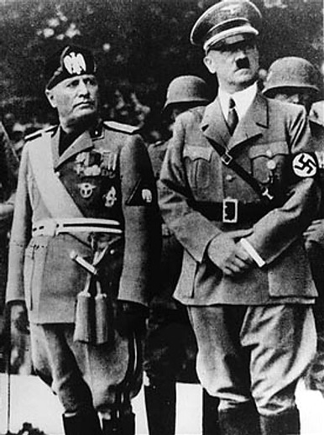
Chapter 11 Section 1
The Road to War: The Rise Of Dictators

Slide 2
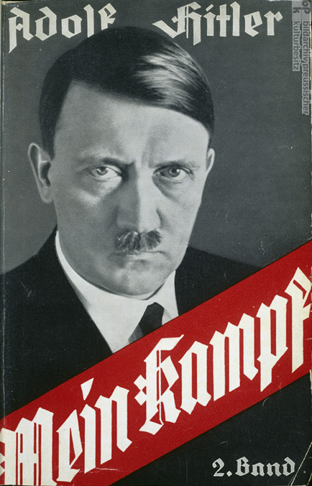
Adolf Hitler
  Adolf Hitler
    Became popular in Germany during the late 1920’s
      Published his political beliefs in a book called Mein Kampf (My Struggle).

Slide 3
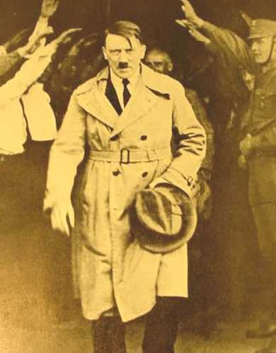
Adolf Hitler
Took advantage of the anger and suffering of the citizens in Germany.
  Angry over the terms of the Treaty of Versailles
    Germany had to give up some of it’s territory
    Forced Germany to pay back large sums of money for the damages it caused during WWI.

Slide 4
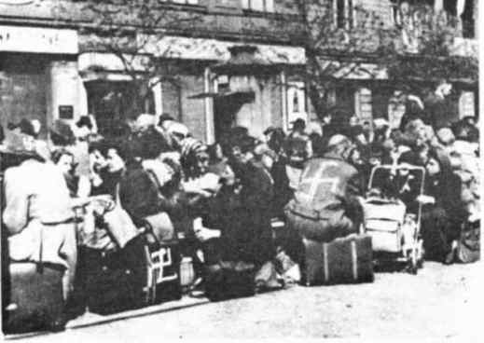
Adolf Hitler
Worldwide depression of the 1930’s
  Millions out of work
  Economy close to collapse

Slide 5
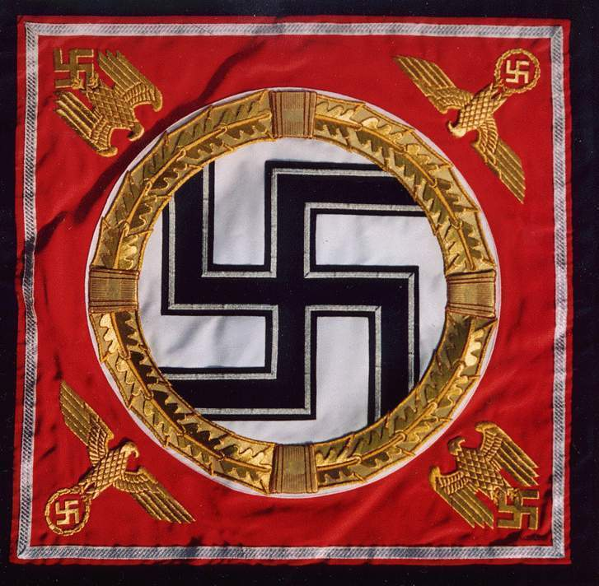
Adolf Hitler
Hitler comes to power
  Becomes the chairman of the National Socialist German Workers’ Party (Nazi Party)

Slide 6
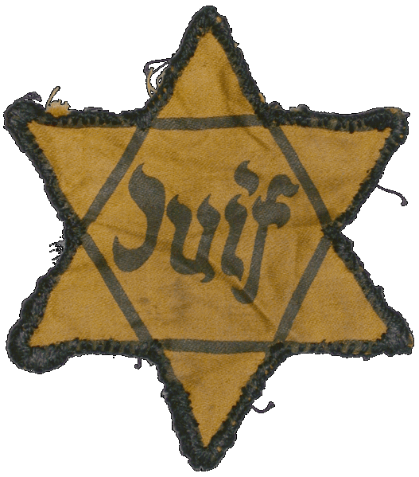
Adolf Hitler
Nazis’ were extremely racist and believed Germans were better than all other people.
Nazis’ blamed Jews for Germany’s problems.
  Anti-Semitism: Extreme hatred of Jews
  Led to imprisonment and murder of many German Jews.

Slide 7
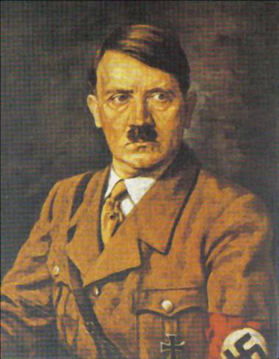
Adolf Hitler
Becomes the chancellor of Germany in 1933.
  Ends democracy
  Formed a totalitarian government
    A single party and its leader suppress any opposing views and controls peoples’ lives.

Slide 8
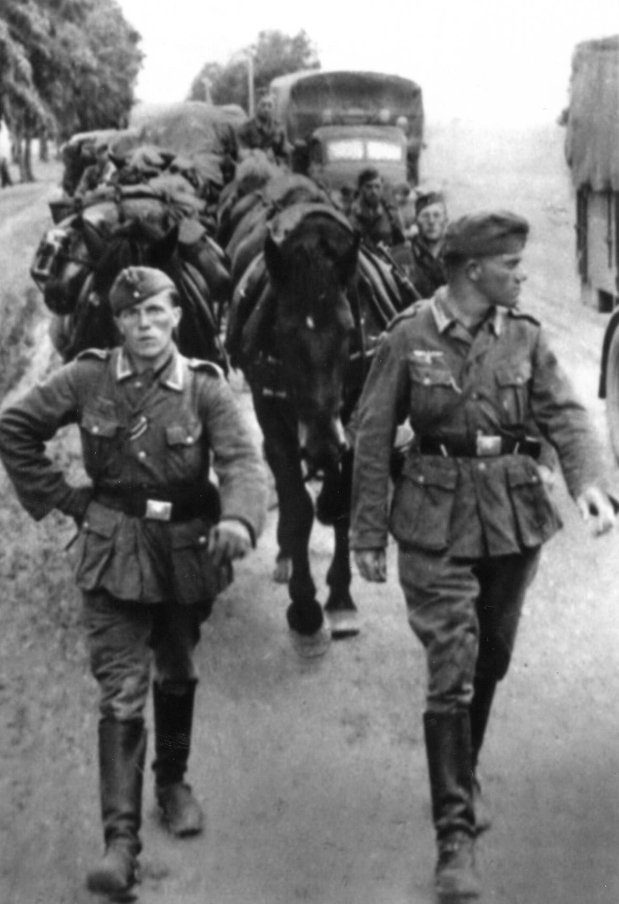
Adolf Hitler
Builds up Germany’s strength
  Ignored the Treaty of Versailles and built up it’s military.
    Declared Germany’s right to expand its territory.
    Formed an alliance with Italy and Mussolini in 1936

Slide 9
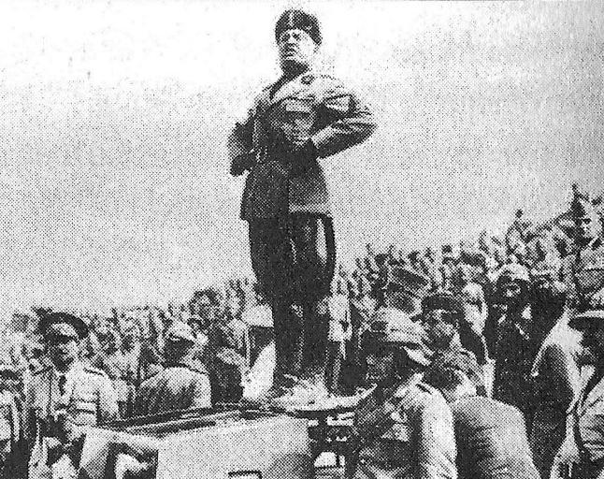
Benito Mussolini

Slide 10
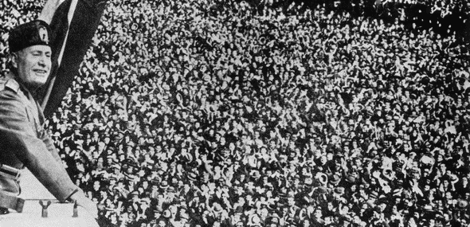
Benito Mussolini
Became popular in Italy after WWI
  Took advantage of the anger and suffering of the citizens in Italy
      Angry that Italy had not won enough in the Treaty of Versailles.
      Worldwide depression of the 1930’s

Slide 11
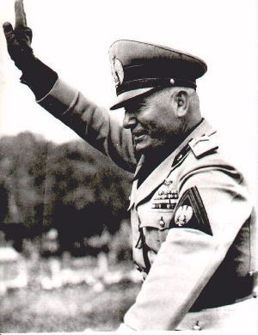
Benito Mussolini
Popularized fascism
  Fascism: A one-party system of government led by a dictator who supports extreme nationalism and racism.

Slide 12
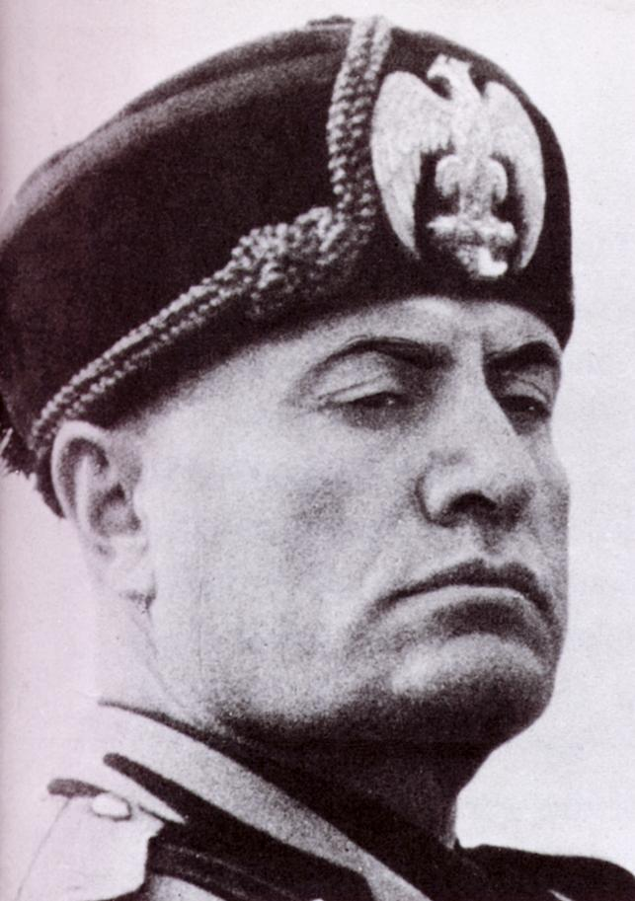
Benito Mussolini
Became the country’s leader. Known as Il Duce (The Leader)
His Fascist party forced the king of Italy to declare him the leader of the Italian government in 1922

Slide 13
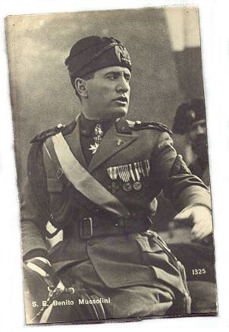
Benito Mussolini
He banned all political parties except the Fascist Party
Ended democratic rule in Italy
Ended freedom of the press
Ended all civil liberties

Slide 14
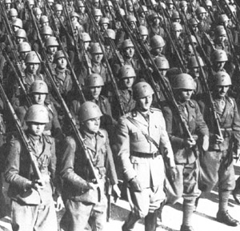
Benito Mussolini
Built up the military
  Wanted Italy to regain the power it had during the ancient Roman times.

Slide 15
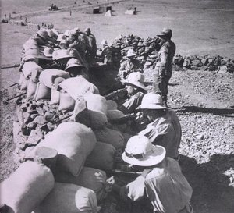
Benito Mussolini
Decided to attack and annex other countries into Italy
  Invaded and annexed Ethiopia

Slide 16
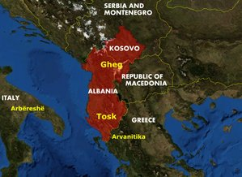
Benito Mussolini
Invaded and annexed Albania

Slide 17

Japan

Slide 18
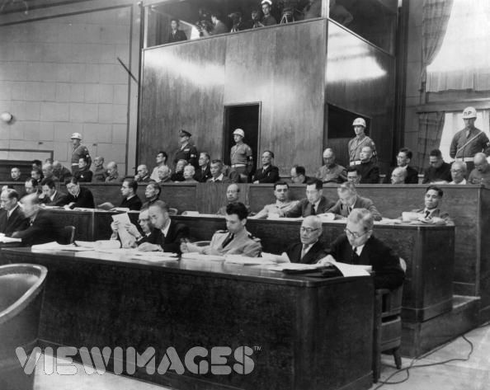
Japan
Military leaders come to power in Japan
  Leaders believe expanding Japan’s power in Asia would solve its economic problems.

Slide 19
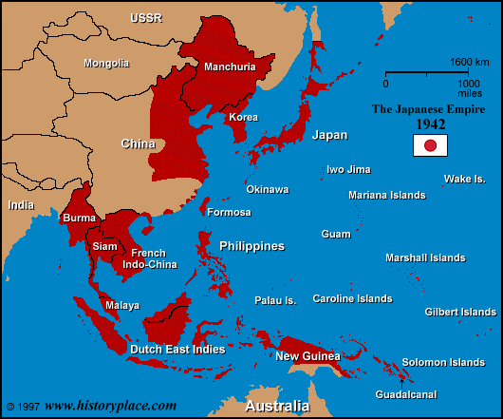
Japan
Japan attacks Manchuria (Northeast China) in 1931
Japan attacks various regions in China until it controlled most of the country by 1937

Slide 20
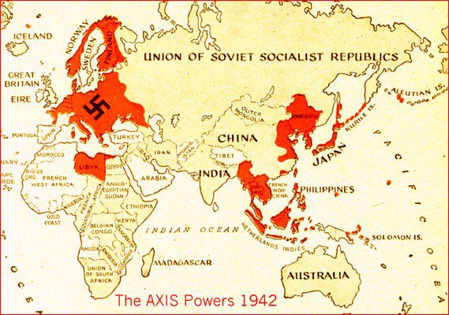
Japan
Leaders form an alliance with Germany and Italy in 1940.
  Known as the “Axis”

Slide 21
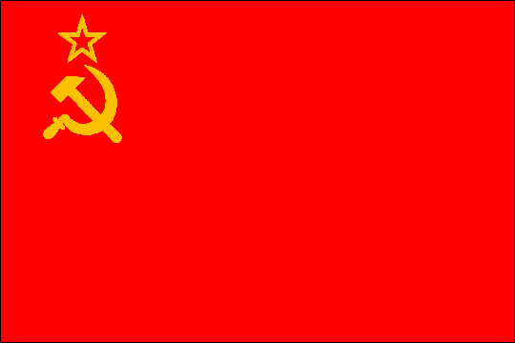
Soviet Union

Slide 22
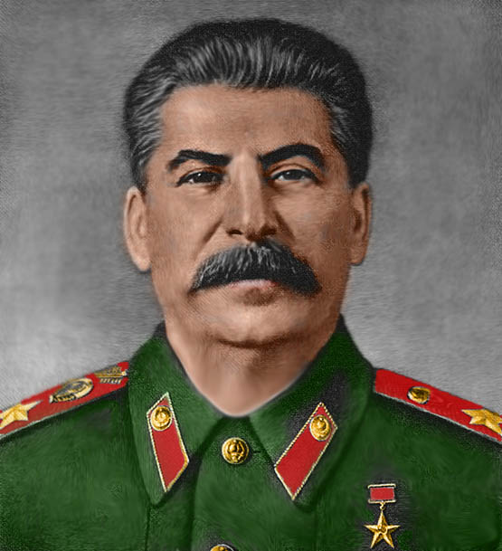
Soviet Union
Joseph Stalin
  Leader of Communist Soviet Union (Russia) in the late 1920’s
    Used force to demand the complete obedience of the people
    Had his opponents and their supporters killed.

Slide 23
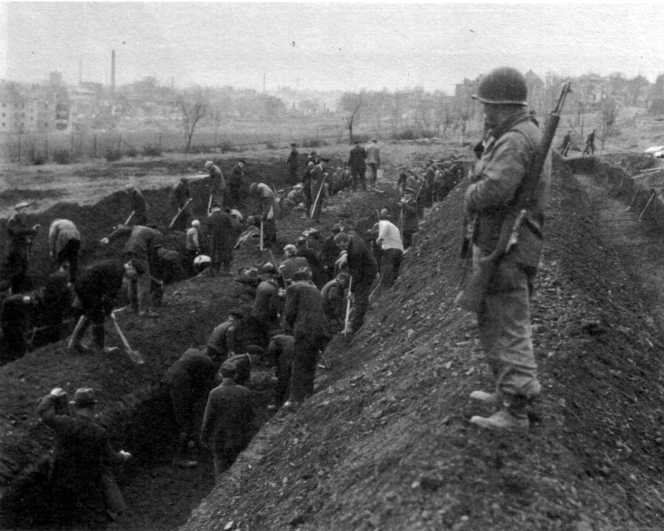
Soviet Union
Sent millions of Russians to labor camps.

Slide 24
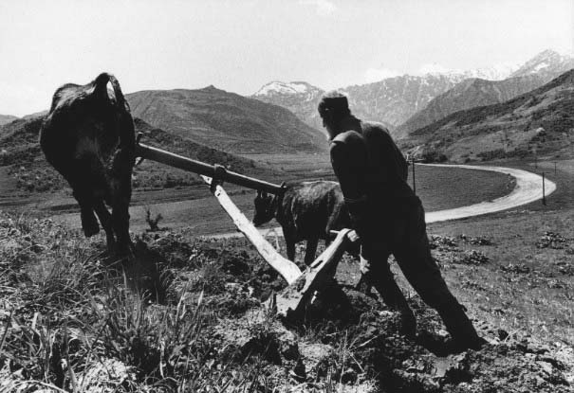
Soviet Union
Reorganized the economy of the Soviet Union by forcing millions to work on farms owned by the government.

Slide 25
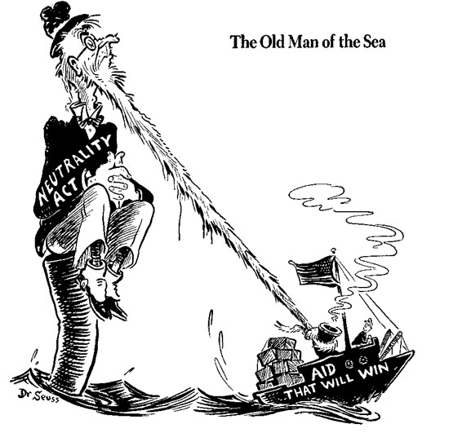
United States

Slide 26
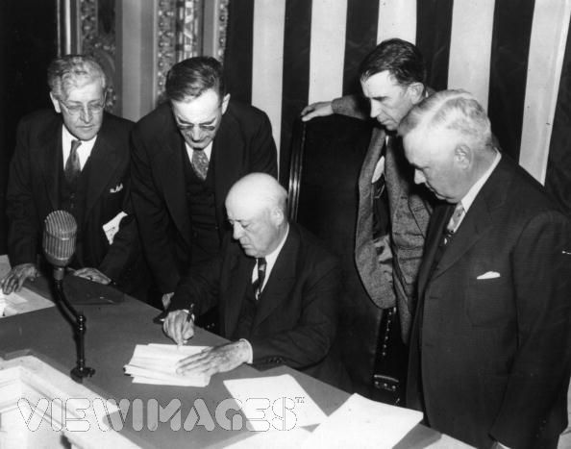
United States
Most Americans wanted to stay out of international conflicts.
  Congress passed a series of Neutrality Acts between 1935 and 1937

Slide 27
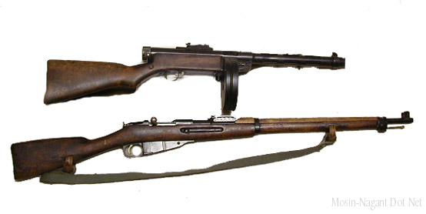
United States
Banned the sale of weapons to nations at war.

Slide 28
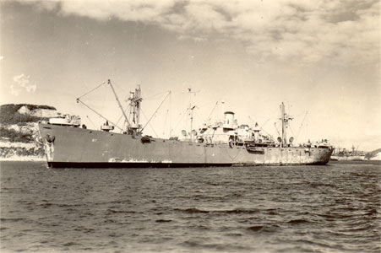
United States
Allowed trade only with countries that could pay cash and transport the goods in their own ships.

Slide 29
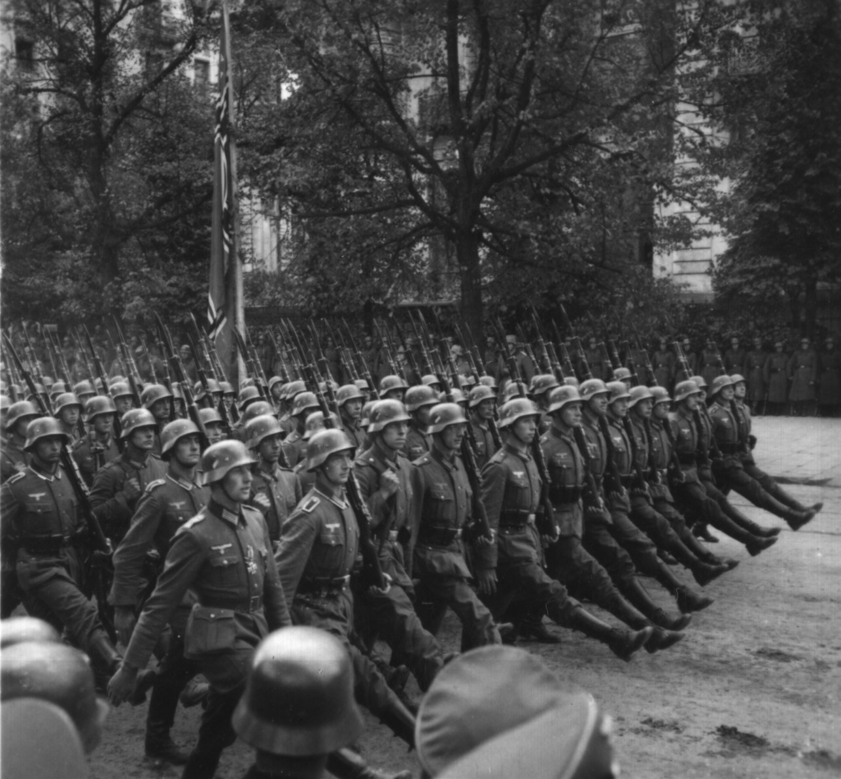
Germany On The March

Slide 30
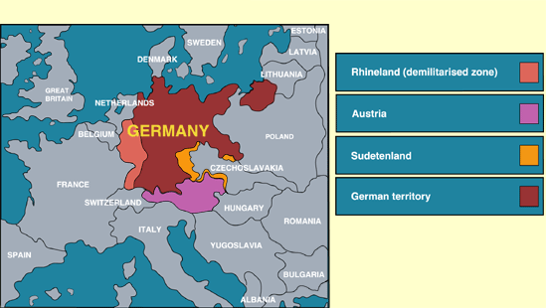
Rhineland
Rhineland
  Hitler ordered his troops into the Rhineland, a German Territory west of the Rhine River
  It is on the border of France.

Slide 31
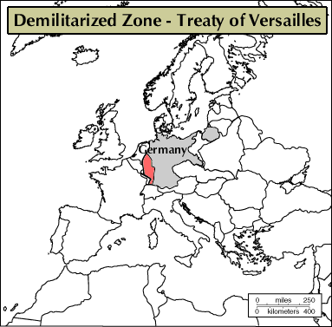
Rhineland
The Rhineland was declared a neutral zone in the Treaty of Versailles.
    France and Great Britain complained but did nothing to stop Germany.

Slide 32
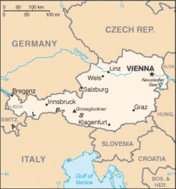
Austria

Slide 33
Austria
Hitler marched troops into and annexed Austria.
There was no battle, in fact, the Nazi’s were cheered as they entered Austria.

Slide 34
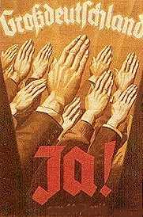
Austria
Austria is a German speaking country. Most were in favor of unification of the Germanic peoples.

Slide 35
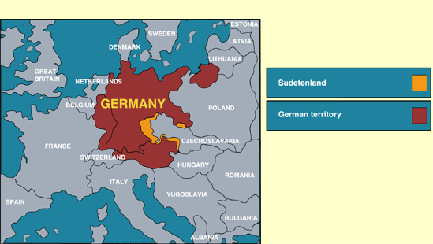
Sudetenland

Slide 36
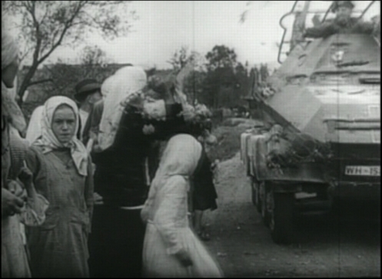
Sudetenland
The Sudetenland is a German-speaking area of Czechoslovakia
Hitler advanced troops to the Sudetenland and threatened to annex it.
  Hitler falsely claimed the people of the Sudetenland were being mistreated.

Slide 37
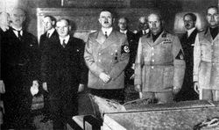
Sudetenland
In an attempt to avoid war in the region, Britain and France called European leaders together at the Munich Conference to find a peaceful resolution.

Slide 38
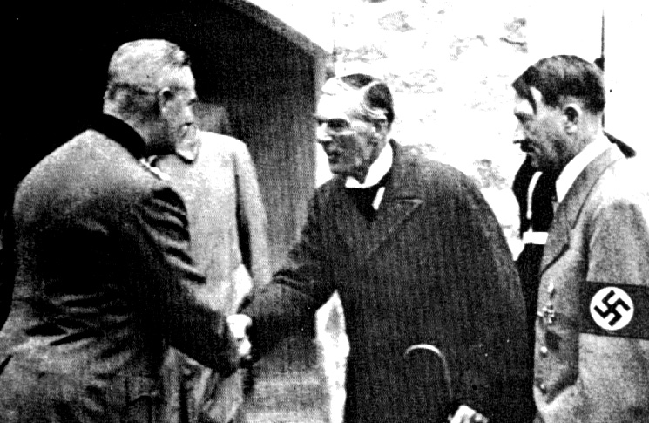
Sudetenland
Britain and France agreed to let Germany have the Sudetenland as long as Germany promised not to invade and take over any more countries.

Slide 39
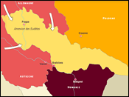
Sudetenland
Germany broke their promise by taking control of the rest of Czechoslovakia by force in 1939

Slide 40
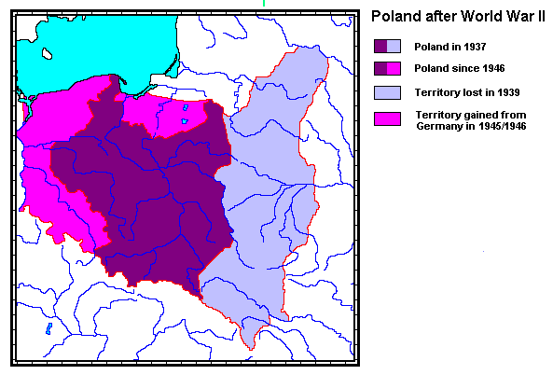
Poland

Slide 41
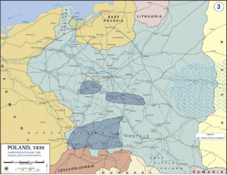
Poland
Hitler wanted to invade Poland, but was afraid Stalin would try to stop him since Poland shares a border with the Soviet Union.

Slide 42
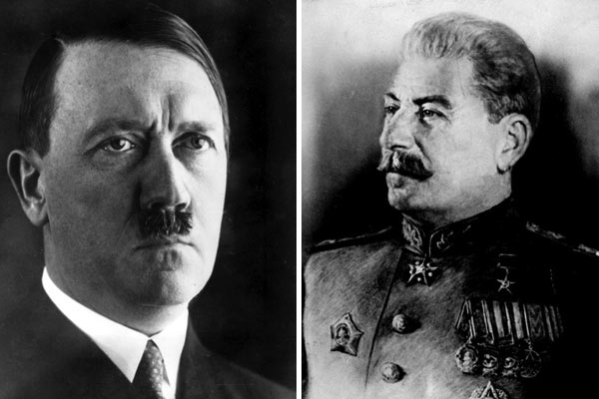
Poland
Hitler and Stalin, bitter enemies, signed the Soviet-German Non-Aggression Pact in 1939.
  The two countries promised not to attack each other’s land

Slide 43
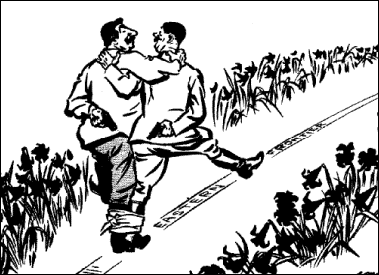

Slide 44
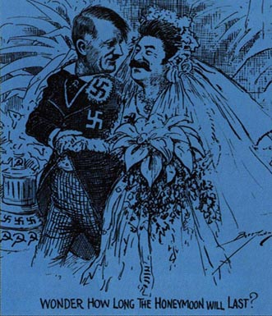

Slide 45
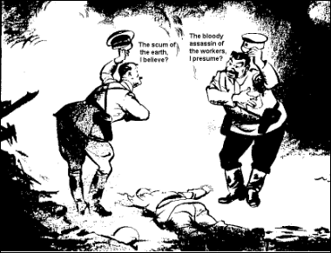

Slide 46
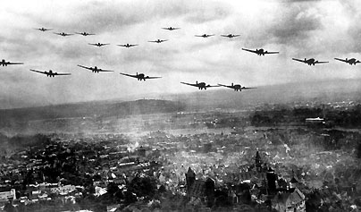
Poland
Hitler was now able to attack Poland without fear of retaliation from the Soviets.
  European leaders were shocked by the Nazi-Soviet agreement

Slide 47
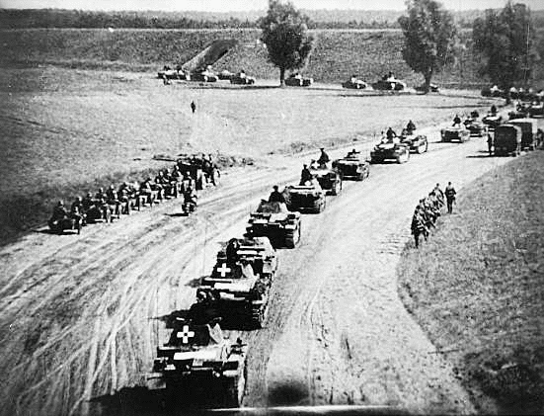
Blitzkrieg
Germany invades Poland

Slide 48
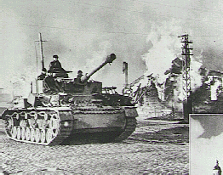
Blitzkrieg

Slide 49
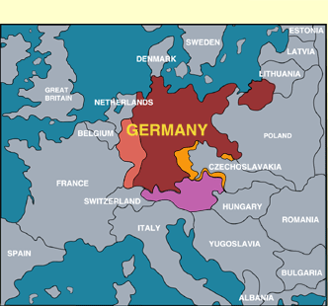
Place the name of the areas annexed by Germany before the start of WWII. Next, number the areas in the order in which they became annexed by Germany. #1 being first and #5 being last.

Slide 50
