Slide 1
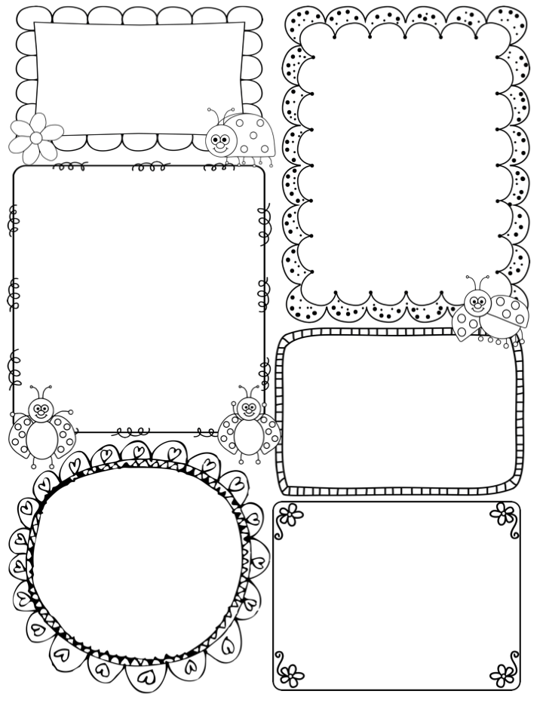
The Harris
Harold
January 15, 2020
Our Future Goals
Math – We will practice multiplying by 10 & 3 and learn about the communitive property.
Science– We will continue to explore food chains & food webs
Writing - We are going to write about what we would do with 10 snow days and practice stretching our sentences.
A look at last week:
Last week we reviewed arrays and repeated addition. Everyone did a great job remember their multiplication strategies after break . We reviewed nouns, verbs and sentences. We briefly began learning about food chains & food webs.
Important Dates
January 16th – treat day
January 17th – half day
January 20th- No School
January 24th – report cards
February 14th – half day
February 17th – no school
Mystery Words
URGENT & CONTAGIOUS
See if your family can use them throughout the week
Last week we got into the routine of being back at school. This week is off to a great start. I missed them all over break and hope everyone was able to relax and stayed healthy.

