Slide 1
Welcome to
1st Grade!
Mrs. Balta
“Why can’t you see I’m a kid?” said the kid.
“Why try to make me like you?
Why are you hurt when I don’t want to cuddle?
Why do you sigh when I splash through a puddle?
Why do you scream when I do what I did?
I’m a kid!”
-Shel Silverstein

Slide 2
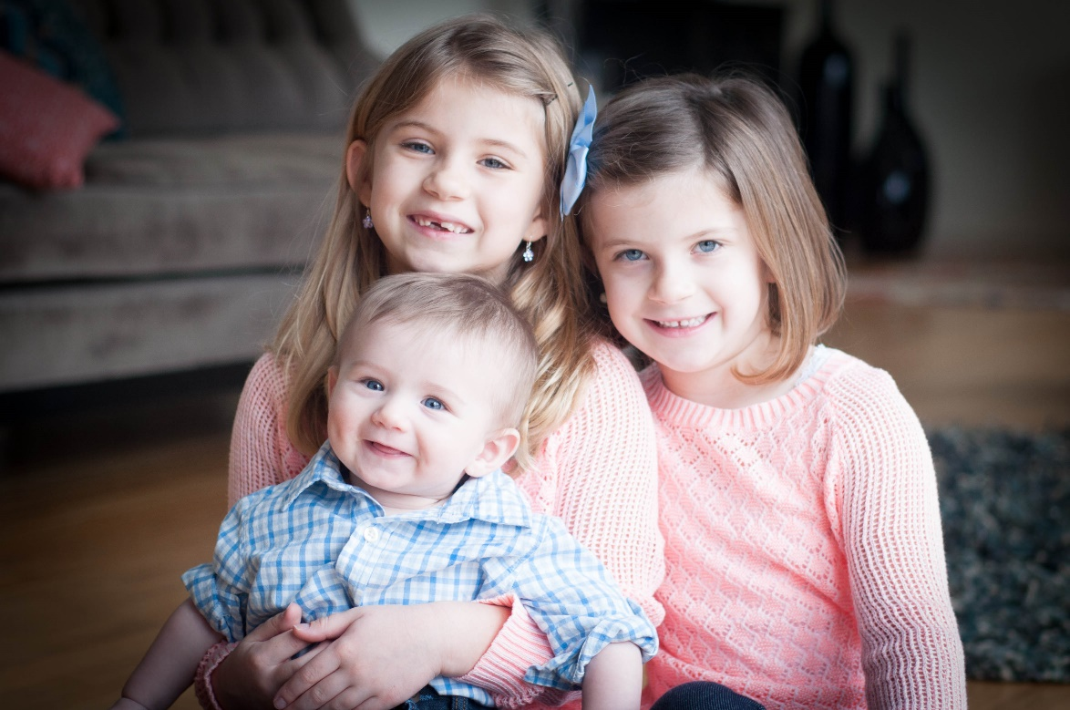
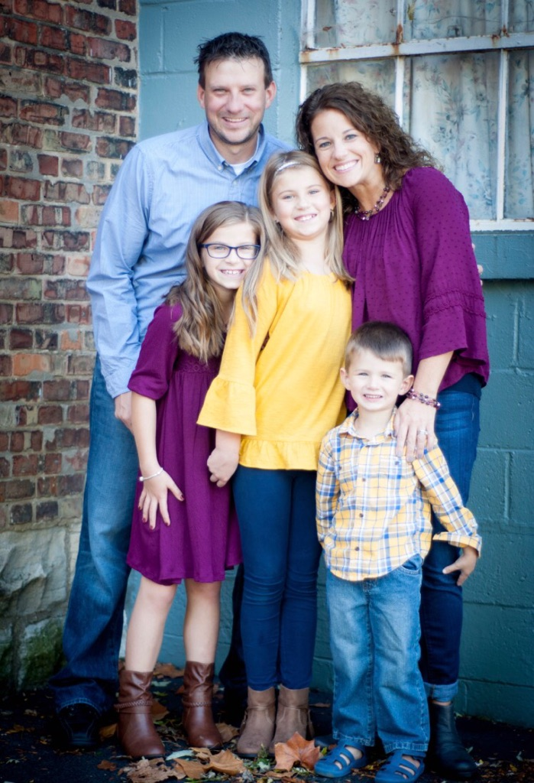
My Family
Nik & Kristy
This picture is so old! I just can’t bring myself to replace it.
Nik, Kristy,
Anie, Mia & Kyle

Slide 3
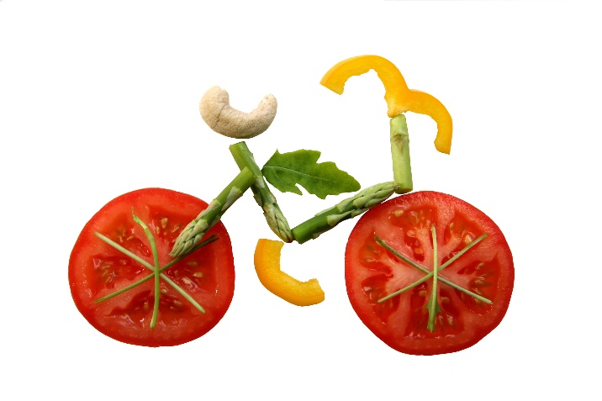





A little bit about me…
Grew up in Lowell, Indiana
Attended St. Joseph’s College
Received my master’s in 2005 from Olivet

Slide 4
Star of the Week
Reminder will be emailed or sent home
Create a poster to showcase YOU!
It can include (but is not limited to)… family photos, pets, favorite: books, foods, movies, toys, color, activities, etc.
*We will pick a time for you to share during your week.

Slide 5
PBIS
We Are Responsible
We Are Respectful
We Are Safe
WE ARE ROGUS!
We will earn rewards as a class during remote learning. Stay tuned. ☺

Slide 6


Online Resources
Schoology: Login info was sent home on supply pick-up day. This will be our main learning platform.
Seesaw: Login info was sent home on supply pick-up day. We will do some fun activities in Seesaw.
Classlink: Your child used this last year. Additional learning tools will be found here. I will link Classlink on my Schoology page.
This Photo by Unknown Author is licensed under CC BY-SA

Slide 7




Schoology
Each day, your child will start by logging on in Schoology and clicking HOMEROOM. Any links or activities needed, will be found there. Below are some of the buttons your child will be using.
Mrs. Balta’s
Website
ClassLink
Seesaw

Slide 8



Video Conference Calls
Video Calls-We will be using Zoom at the beginning of the year. Zoom allows the kids to see each other. I believe this is important to build relationships with our new class. Zoom links will be posted in Schoology under Homeroom.
Shortly after our start of the year, we will begin using Teams Meeting or Big Blue Button Conferences, both found in Schoology.

Slide 9


Reading
Journeys Reading Series
Reading test at the end of most weeks and theme
Focus on sequencing, plot, character, setting, main idea, comprehension, and vocabulary
Guided reading groups will be held virtually.

Slide 10


Spelling
Short Vowels, long vowels, blends, etc…
Friday Spelling Tests During ELA-If your child is unable to attend the live session of ELA, we will work something else out.
Weekly practice
Challenge Words-We do have challenge words that the kids will be exposed to, but not tested over while we are remote. They will begin with the story Lucia’s Neighborhood.

Slide 11
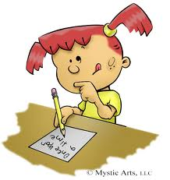
English and Writing
Sentences, nouns, verbs, adjectives
Journals, letter writing, paragraphs, and a report

Slide 12

Math
Math Series: GO MATH
Number sense, addition, subtraction, geometry, time, fractions, measurement
Chapter tests and unit tests
Basic fact practice at home is so important. Flashcards are great. ☺

Slide 13

Science
Physical, Earth, and Life Science
We will use STEMscopes and other online resources.

Slide 14

Social Studies
Social Studies:
SAVVAS Easybridge
Citizenship/Community
Geography
Holidays/Celebrations

Slide 15

Grading
Formative Assessments:
*25% of final grade
*class work, mid-chapter check points, etc.
Summative Assessments:
*75% of final grade
*chapter tests, high frequency words test, theme tests, story quizzes, etc.
BY

Slide 16
Assessments/Grading Cont.
Steps for Reassessments
If a D or F was received, the original test will come home with a slip attached communicating that there will be a retake. The teacher will reteach specific material with student and give retake when the student has a more clear understanding. There will only be ONE retake given within ONE week of the original test.
If an A,B, or C was received and your child wants to retest, they may do so once per trimester/per subject. This type of retest request must come in writing from the parent. Request must be written on original assessment and returned to school. The most recent score will be recorded.
Reassessments for summative scores receiving a D or F
Reassessments for summative scores receiving an A, B, or C
50%-100% Scale
Behaviors removed
See Comments

Slide 17
Homework
During remote learning, I will not be assigning homework. If you are looking for more, my website if filled with cool links, or I’m happy to provide other options. There may be times when your child needs to practice skills or complete a project for homework. I promise to be flexible during this time.

Slide 18
Parent Volunteers
This will look much different during remote learning. However, I’d still like to have Guest Readers while we learn from home. If you are interested in reading a story over video conference to the class, please email me. We can talk about details then. Let’s make it work. ☺
kbalta@summithill.org

Slide 19
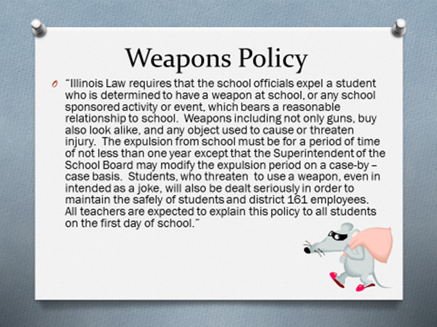

Slide 20
??? QUESTIONS ???
Please reach out with any questions or feedback. I’m here to help! We will make the best of our remote learning time together.

