Slide 1
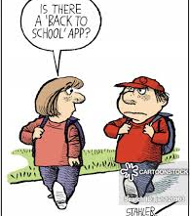
Welcome to Miss Connolly’s Class!
Curriculum Night
August 26, 2019
6:30 – 7:45

Slide 2
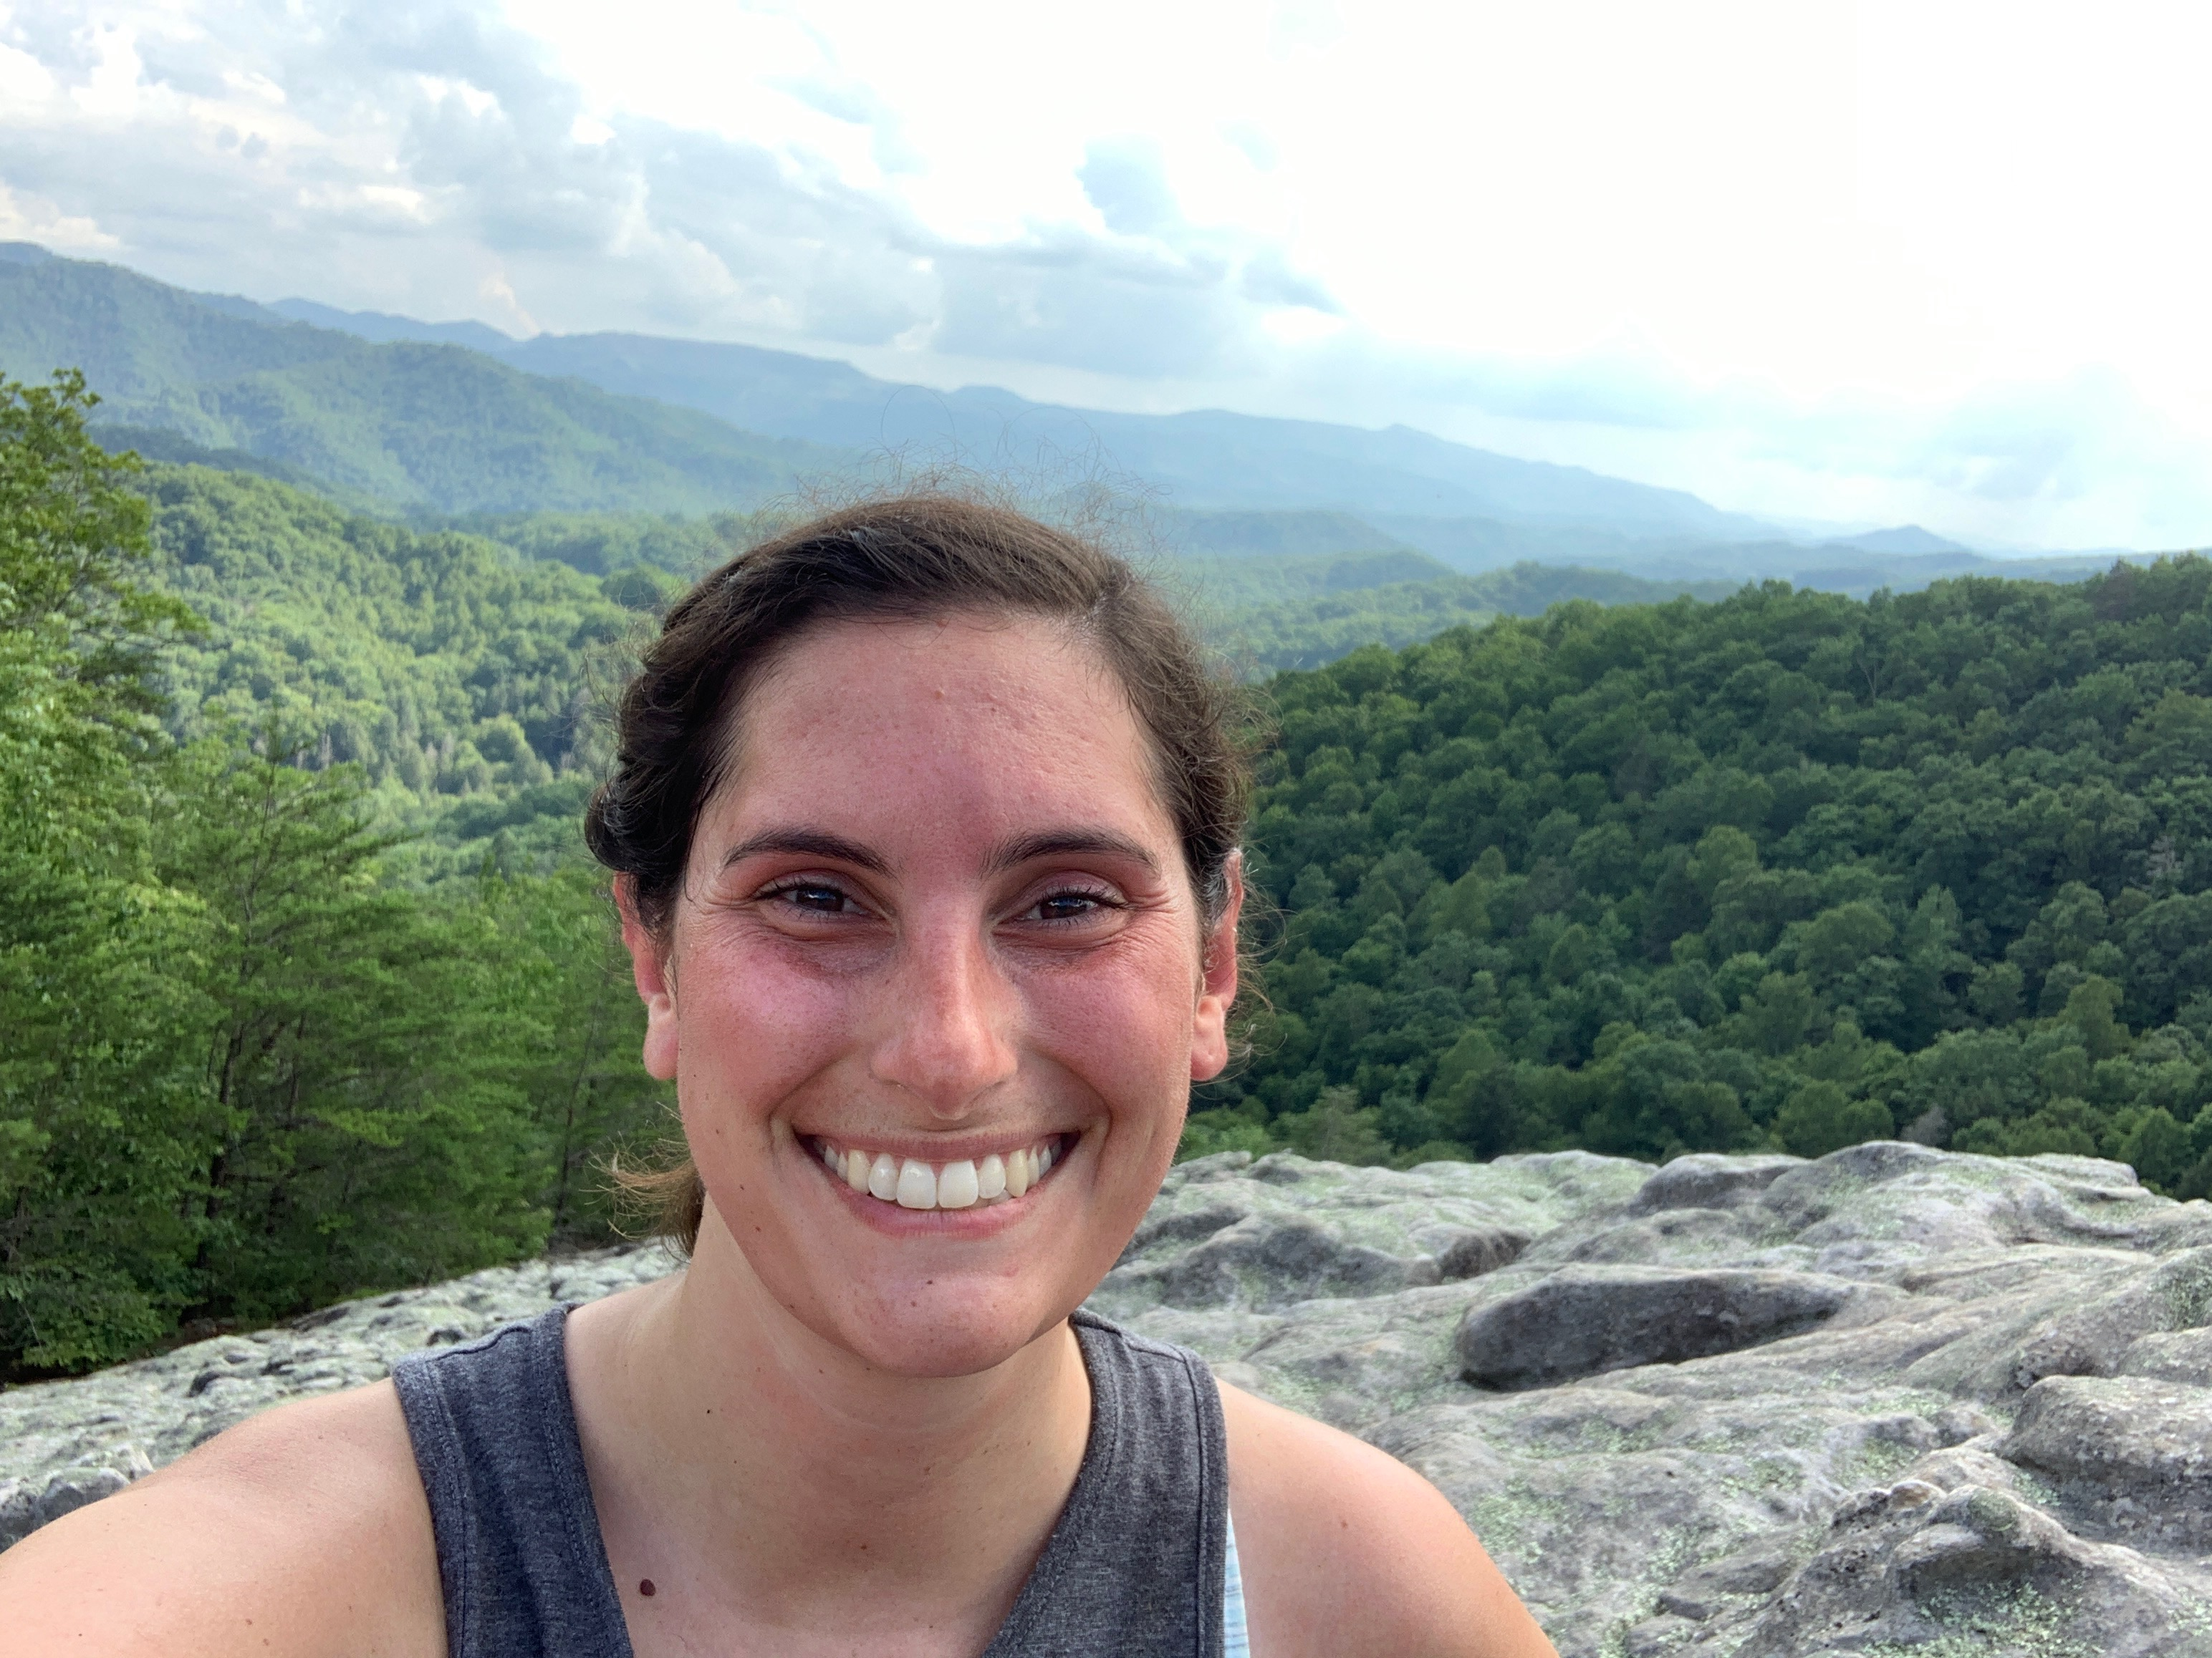
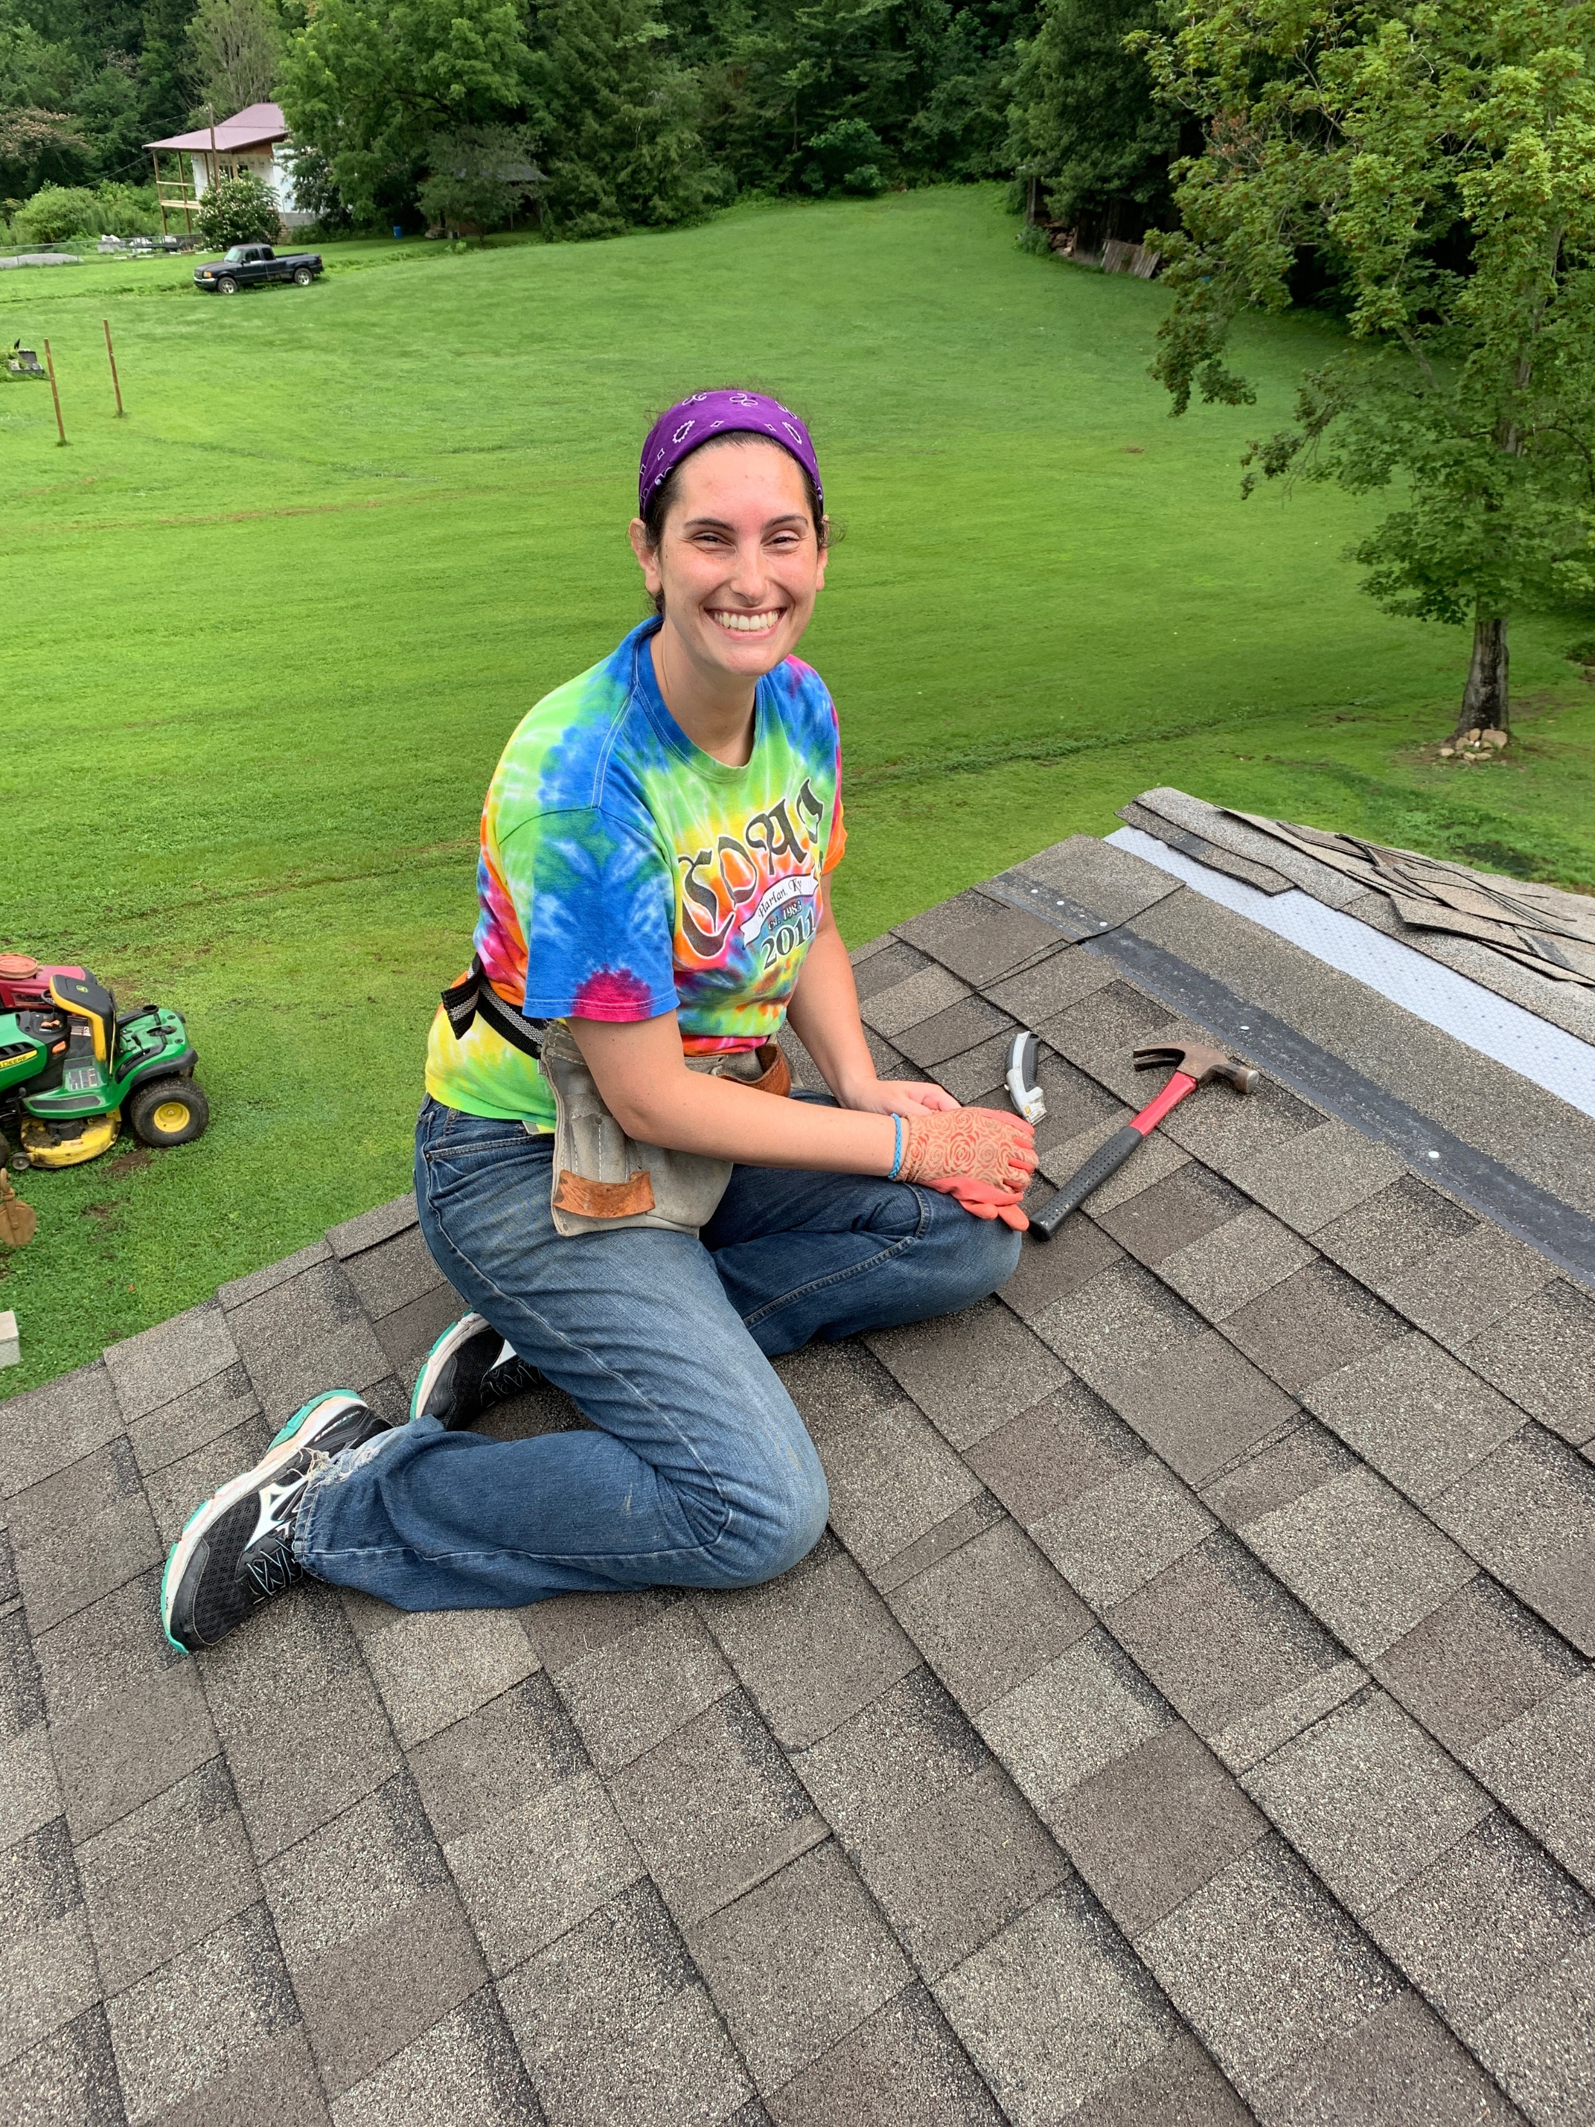
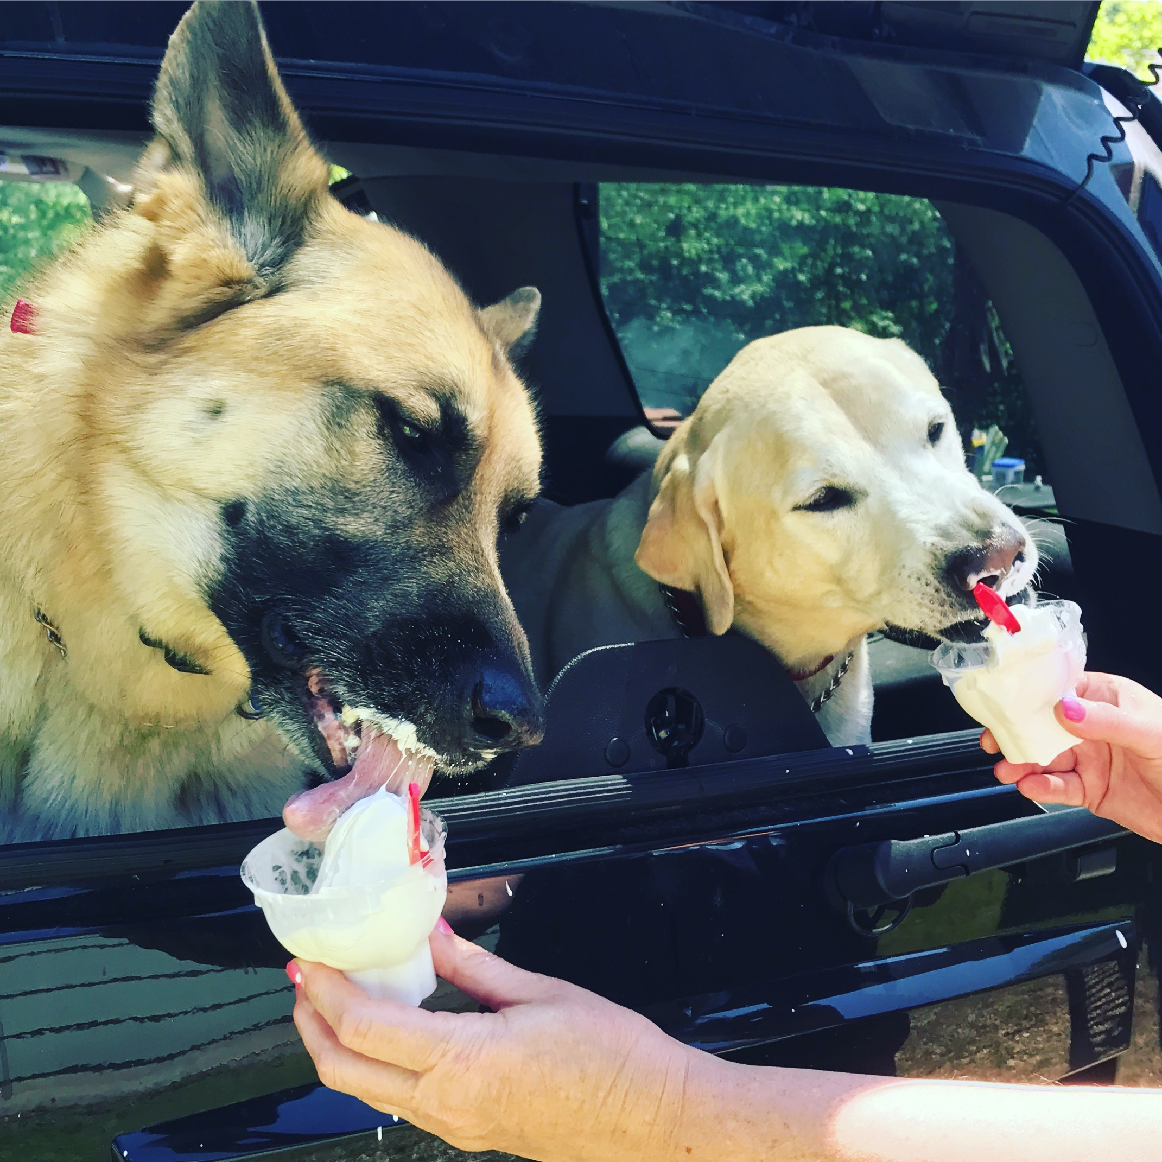
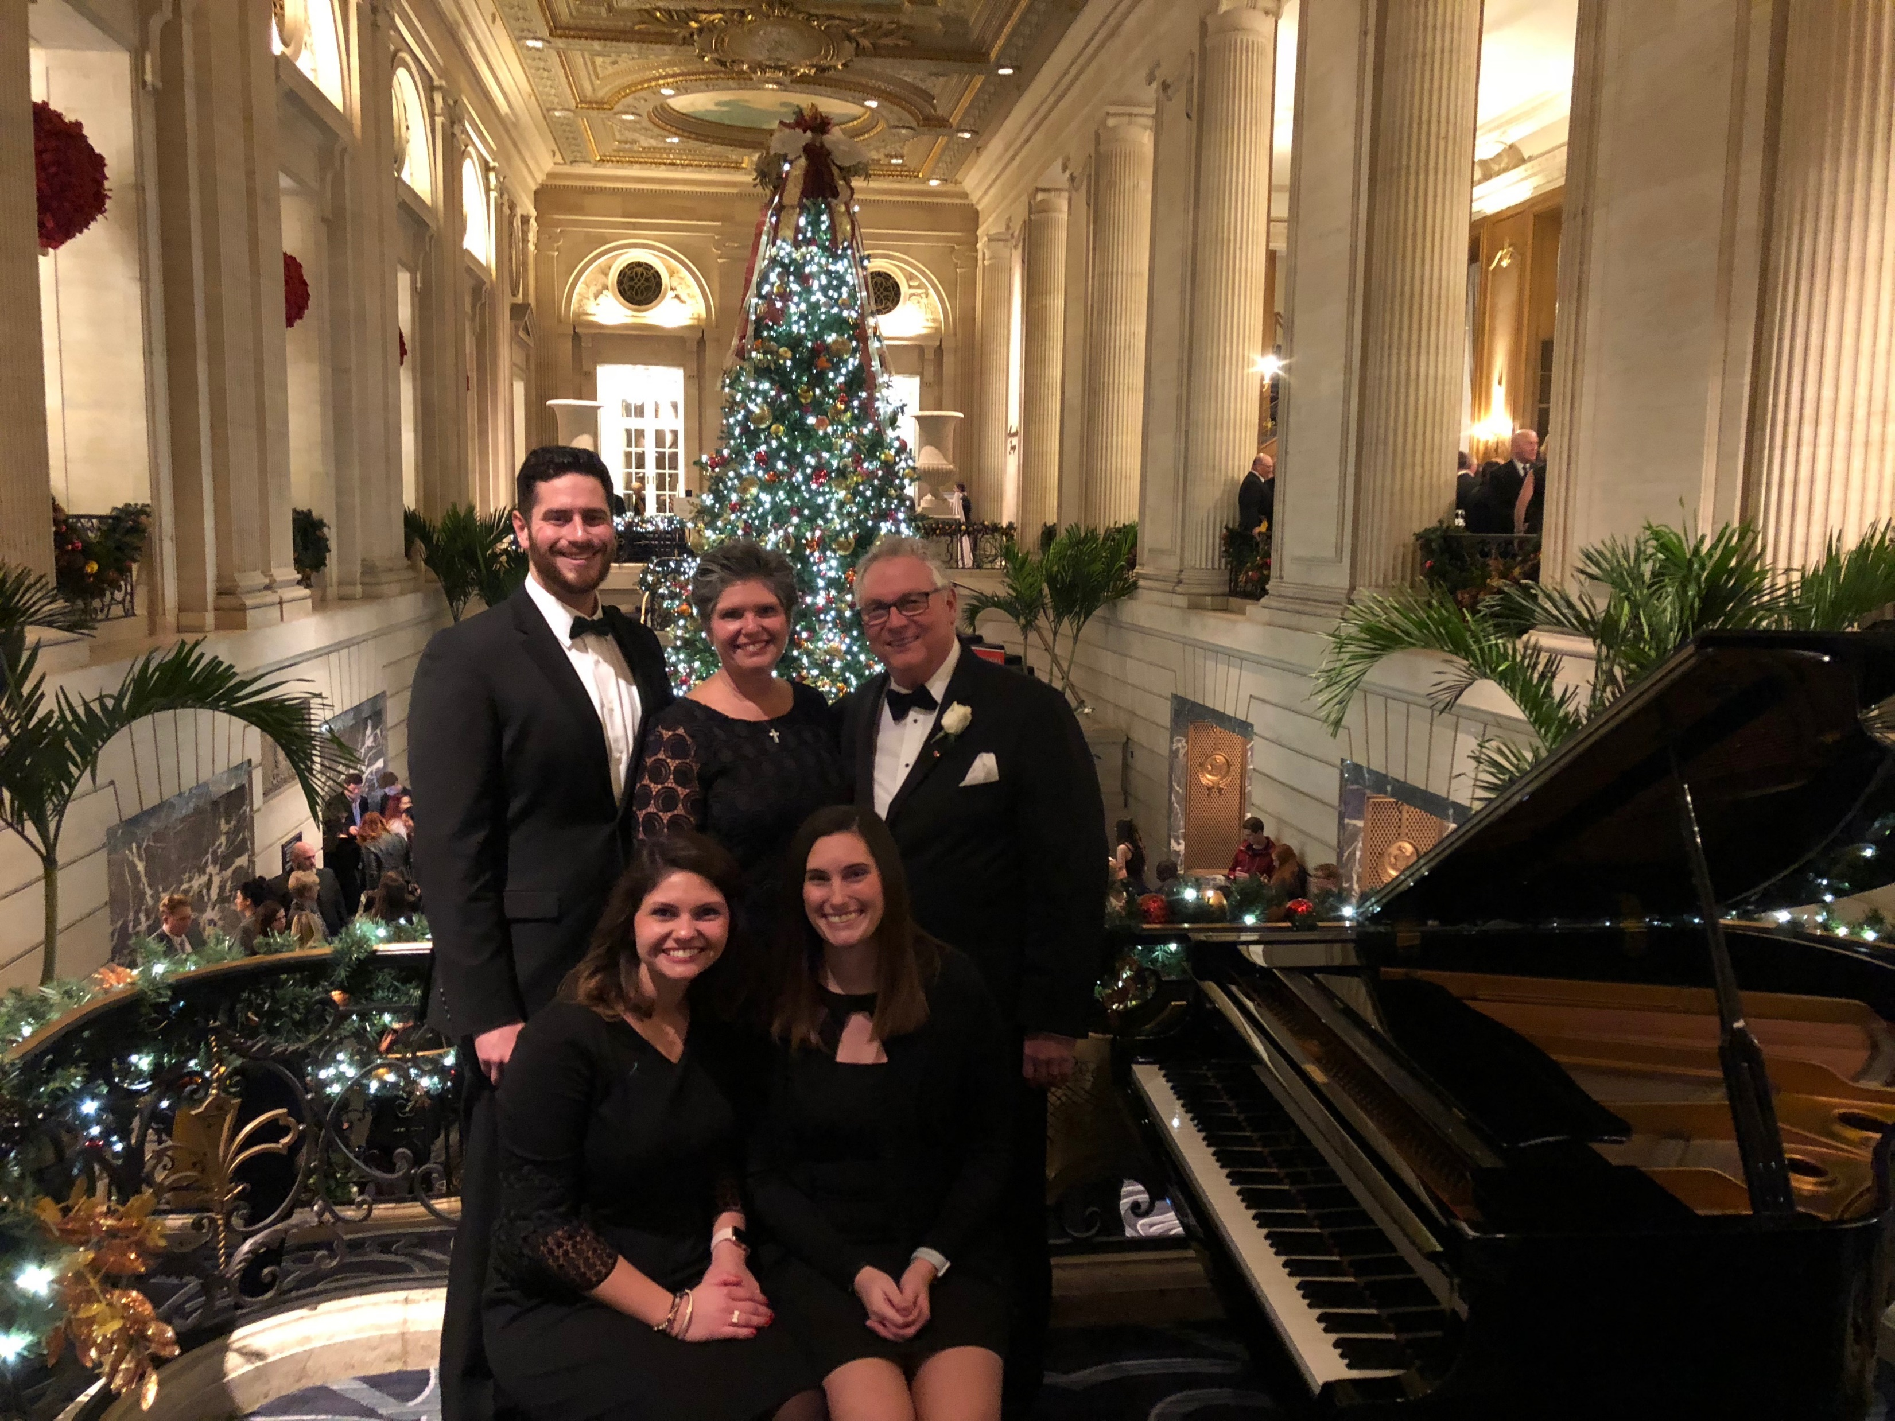
All About Me
I grew up and still live in Palos Park, IL with my Mom, Dad, younger brother, Jimmy, and younger sister, Audrey. My brother is a lawyer and my sister is a accountant. I have two dogs, Sundance and Kobe. I played basketball and danced all the way through high school.
When I’m not teaching, I love to go to my lake house, with my family, swim, watch movies, sing, play the guitar/ukulele, travel, and go on mission trips.

Slide 3
My Education
Attended District 118 schools in Palos for grades K-8.
Graduated from Providence Catholic High School
Bachelors degree in Elementary Education and an endorsement in Spanish from Benedictine University
An LBS1 endorsement from St. Francis University
Volunteered one year in Boston at a low income school for pre-k through 8th grade as a substitute teacher
5th year in the District - Three years as a paraprofessional in the Early Childhood Individualized Instruction classroom, FMLA in a first through fourth grade Individualized Instructional classroom, and two years as the third and fourth grade TIP teacher.
I am currently in graduate school for reading specialty.

Slide 4
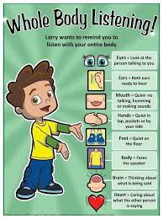
Classroom Expectations
Listening Ears
Eyes Watching
Quiet Voice when someone else is speaking
Quiet Hands
Calm Body
Follow Directions
Raise Your Hand

Slide 5
Class Positive Behavior System
All students start at Ready to Learn
As student shows they are following class
expectations, they move their clip up one
step.
Students will be given two warnings
After two warning, the student must move
their clip down.
When clip reaches Parent Contact,
that will result in a note home that needs to
be signed and returned the next day, in addition to a think about it work sheet for the student.

Slide 6
PBIS Expectations
Students can earn tickets from any staff member. Tickets are earned for good behavior in school. Students will collect their tickets on a chart called a raffle ticket. When all of the squares on the raffle ticket are full, they get to bring it to the office where he or she will be entered in a grade level raffle. For turning in their ticket, the student immediately gets a bracelet. The winners of the grade level raffle will choose from a menu of items.

Slide 7
Homework Expectations
Homework will be sent home in a packet every Monday night.
There will be four or five pages in the packet, one page to complete for each day of the week.
You may turn in the homework packet before Friday if it is complete.
Work included in the packet will be reading, math, and IEP Goals.
Homework will be taken as a Formative participation grade.
If the homework is too easy or too hard, please let me know and I will individualize it.

Slide 8
Grade Level Projects & Activities
Some special activities include:
Field Trips
Holiday Parties
PBIS Assemblies

Slide 9
Curriculum
Fundations – Phonics, Sight Words, Letters, Sounds, Decoding (Reading Words), and Encoding (Writing/Spelling)
Michael Heggerty/Phonemic Awareness
Reading Milestones – Leveled Reading, Reading Skills, and Comprehension
EnVision Math – Leveled Math Skills
Our Curriculum is adjusted to each child’s needs and abilities. Accommodations of lessons will be made daily.
Meeting your child’s needs is my main priority.

Slide 10
IEP Notes
Parents will receive IEP goal updates at the end of each quarter (sent home with report card).
You will receive an IEP Notification of Conference (“invite”) prior to each meeting.
Each student will have an Annual Review each calendar year.
Please see me with specific questions.
If your child is due for their 3-year re-evaluation, I will be in contact with you to let you know the date for the Domain Conference.

Slide 11
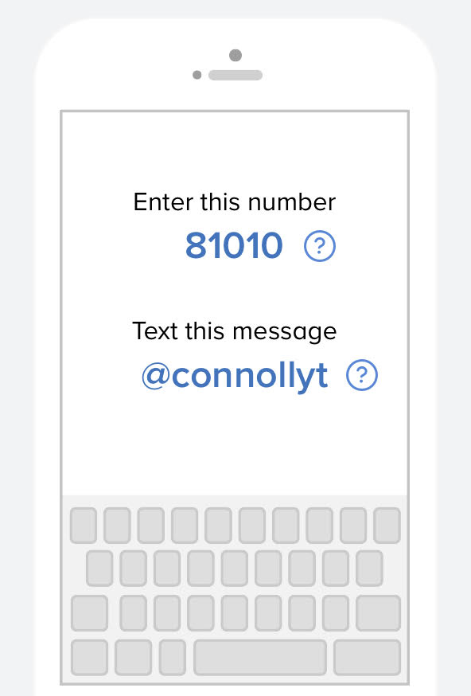
Communication
Monthly Newsletter
Behavior Sheet
App: Remind
Email: cconnolly@summithill.org
Phone: 815-464-2285

Slide 12
Report Cards
Second Graders will receive a letter grade for each subject:
Reading/Language Arts
Math
Science
Social Studies
All Specials (Music, Art, Technology, P.E.)
Formative vs. Summative
Formative – class work, writing samples, etc.
Summative – tests, quizzes and projects
Formative – 25%
Summative – 75%

Slide 13
District Wide Testing / NWEA MAP
Retakes are available for summative tasks (if a D or an F is received). The most recent score will be recorded.
We have a new equal interval grading scale. This will include 50%-100% and still includes “F.”​ If a student receives a 27% on an assignment, a 50% will be recorded in the grade book and a comment will be made to indicate the 27%
Academic behaviors have been removed from affecting grades, but behavioral comments will be recorded in the comment box. (no name, late, etc.)
We assess our students using NWEA MAP.
NWEA (Northwest Evaluation Association) is our new assessment tool that provides research-based adaptive assessments based on the child’s score. As a result of NWEA tests, us teachers can make informed decisions to promote your child’s academic growth.
You will receive your child’s score.

Slide 14
Weapons Policy
“Illinois Law requires that the school officials expel a student who is determined to have a weapon at school, or any school sponsored activity or event, which bears a reasonable relationship to school. Weapons including not only guns, buy also look alike, and any object used to cause or threaten injury. The expulsion from school must be for a period of time of not less than one year except that the Superintendent of the School Board may modify the expulsion period on a case-by –case basis. Students, who threaten to use a weapon, even in intended as a joke, will also be dealt seriously in order to maintain the safely of students and district 161 employees. All teachers are expected to explain this policy to all students on the first day of school.”

