Slide 1
Cell Energy

Slide 2
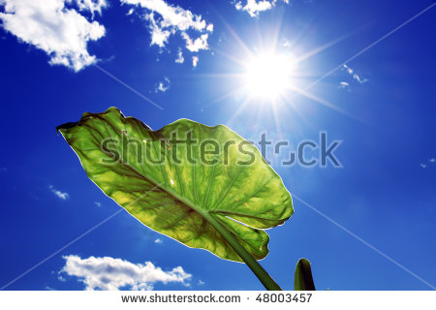
From the sun to the cell
Nearly all the energy that fuels life comes from the sun
Plants capture energy from the sun and change it into food through a process called photosynthesis.
The food that the plant makes supplies energy to the plant, any plant consumer in turn consumes that energy as well.

Slide 3
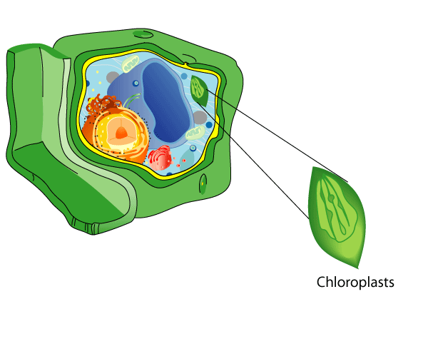
Photosynthesis
Plants have molecules that absorb light energy.
These molecules are called pigments
Chlorophyll is the main pigment used in photosynthesis (gives plants the green color)
The chlorophyll is found in the chloroplast.

Slide 4
How Photosynthesis works
Plants use the energy captured by chlorophyll to change carbon dioxide and water into food.
The food is composed of simple sugar called glucose
Glucose is a simple sugar with the molecular formula C₆H₁₂O₆, which means that it is a molecule that is made of six carbon atoms, twelve hydrogen atoms, and six oxygen atoms. Glucose circulates in the blood of animals as blood sugar. It is made during photosynthesis from water and carbon dioxide, using energy from sunlight. It is the most important source of energy for cellular respiration.

Slide 5
Glucose is a Carbohydrate
When plants make glucose, they convert the sun’s energy into a form of energy that can be stored. The energy in glucose is used by the plant’s cells.
PHOTOSYNTHESIS also produces oxygen

Slide 6
Getting Energy for food
Animals have a different way to get energy from food.
Cellular respiration- the process by which cells use oxygen to produce energy from food
Fermentation- the break down of food without the use of oxygen
****Cellular Respiration will release more energy from a given food than fermentation will

Slide 7
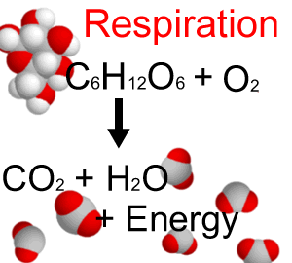
Cellular respiration
Let’s break this down
Respiration = breating
Cellular respiration is different from breathing but breathing provides oxygen needed for cellular respiration
Breathing removes carbon dioxide which is a waste product of cellular respiration
It is a chemical process that occurs in the cell

Slide 8
The Process of cellular respiration
During cellular respiration food (glucose) is broken down into CO2 and H2O and energy is released.
This energy also maintains bodies temperature.
Some of this energy is used to form ATP which supplies energy to the cell.
In eukaryotes cellular respiration takes place mostly in the mitochondria.

Slide 9
Checking for understanding
What is the difference between cellular respiration and breathing?
Cellular respiration is a chemical process by which cells produce energy from food…….. Breathing supplies oxygen for cellular respiration and removes the carbon dioxide which is produced by cellular respiration
Oxygen (O2) is released during ……
Cellular respiration
Photosynthesis
Breathing
Fermentation
How are photosynthesis and cellular respiration related?
Photosynthesis uses waste materials of cellular respiration, Co2 and H2O, to generate glucose. Cellular respiration uses the waste material of photosynthesis,O2, to break down glucose

Slide 10
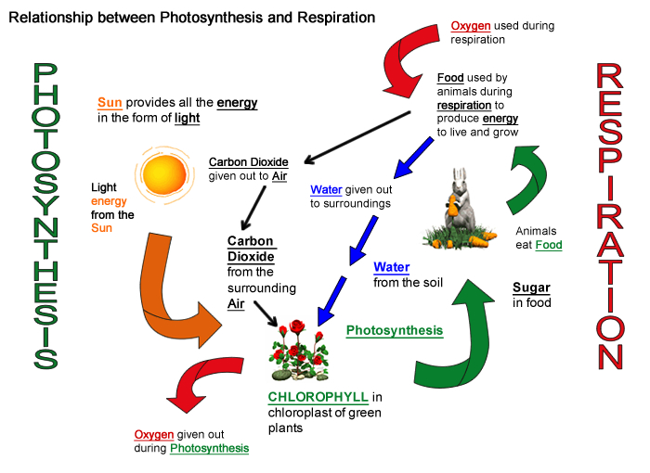

Slide 11
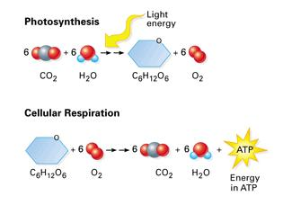
Connections between Photosynthesis and Cellular respiration
Photosynthesis transforms energy from the sun into glucose. During photosynthesis, cells use CO2 (carbon dioxide) to make glucose and release O2 (oxygen)
Cellular Respiration cells use O2 (oxygen) to break down glucose and releases energy to CO2 (carbon dioxide)
Each process makes the materials that are needed for the other process to occur

Slide 12
Fermentation
Happens when….
When have you felt that burning sensation in your muscles???
When muscle cells can’t get the oxygen needed for cellular respiration, they use the process of fermentation for energy.
When fermentation happens in your muscles you create lactic acid… this is the burning and muscle fatigue you feel when you’re active…

Slide 13
https://www.youtube.com/watch?v=8B_64G2SI_8
https://www.youtube.com/watch?v=xmfhKbmQhq0

