Slide 1
Significant Events of the Civil War
A timeline of events

Slide 2
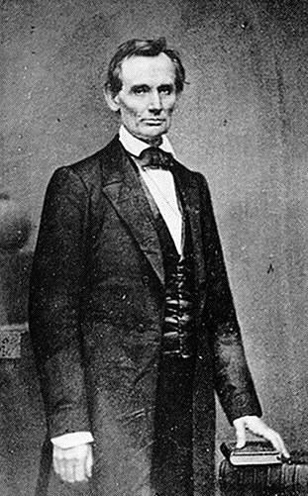
November 1860
Abraham Lincoln is elected President

Slide 3
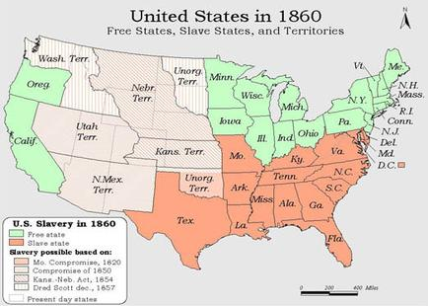
December 1860- June 1861
Eleven states succeed from the Union

Slide 4
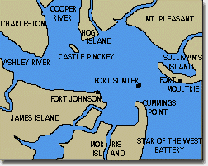
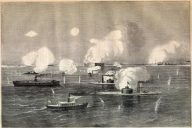
April 1861
Battle of Fort Sumter
Casualties = NONE
Considered a Confederate victory

Slide 5
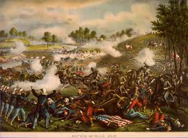
July 1861
Battle of Bull Run
Casualties = 4878
Confederate victory

Slide 6
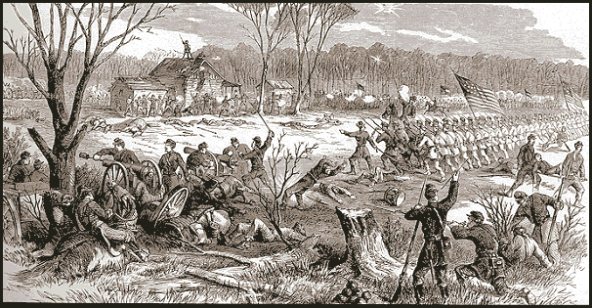
April 1862
Battle of Shiloh
Casualties= 23,746
Union Victory

Slide 7
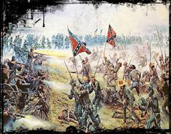
June- July 1862
Seven Days Battles
Casualties= 35,000
Confederacy win

Slide 8
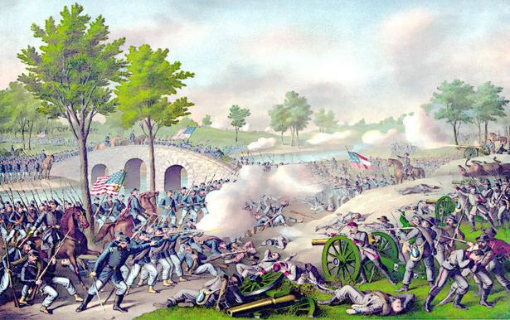
September 1862
Battle of Antietam
Considered to be a tie between the Union and the Confederacy
Casualties= 22,717

Slide 9
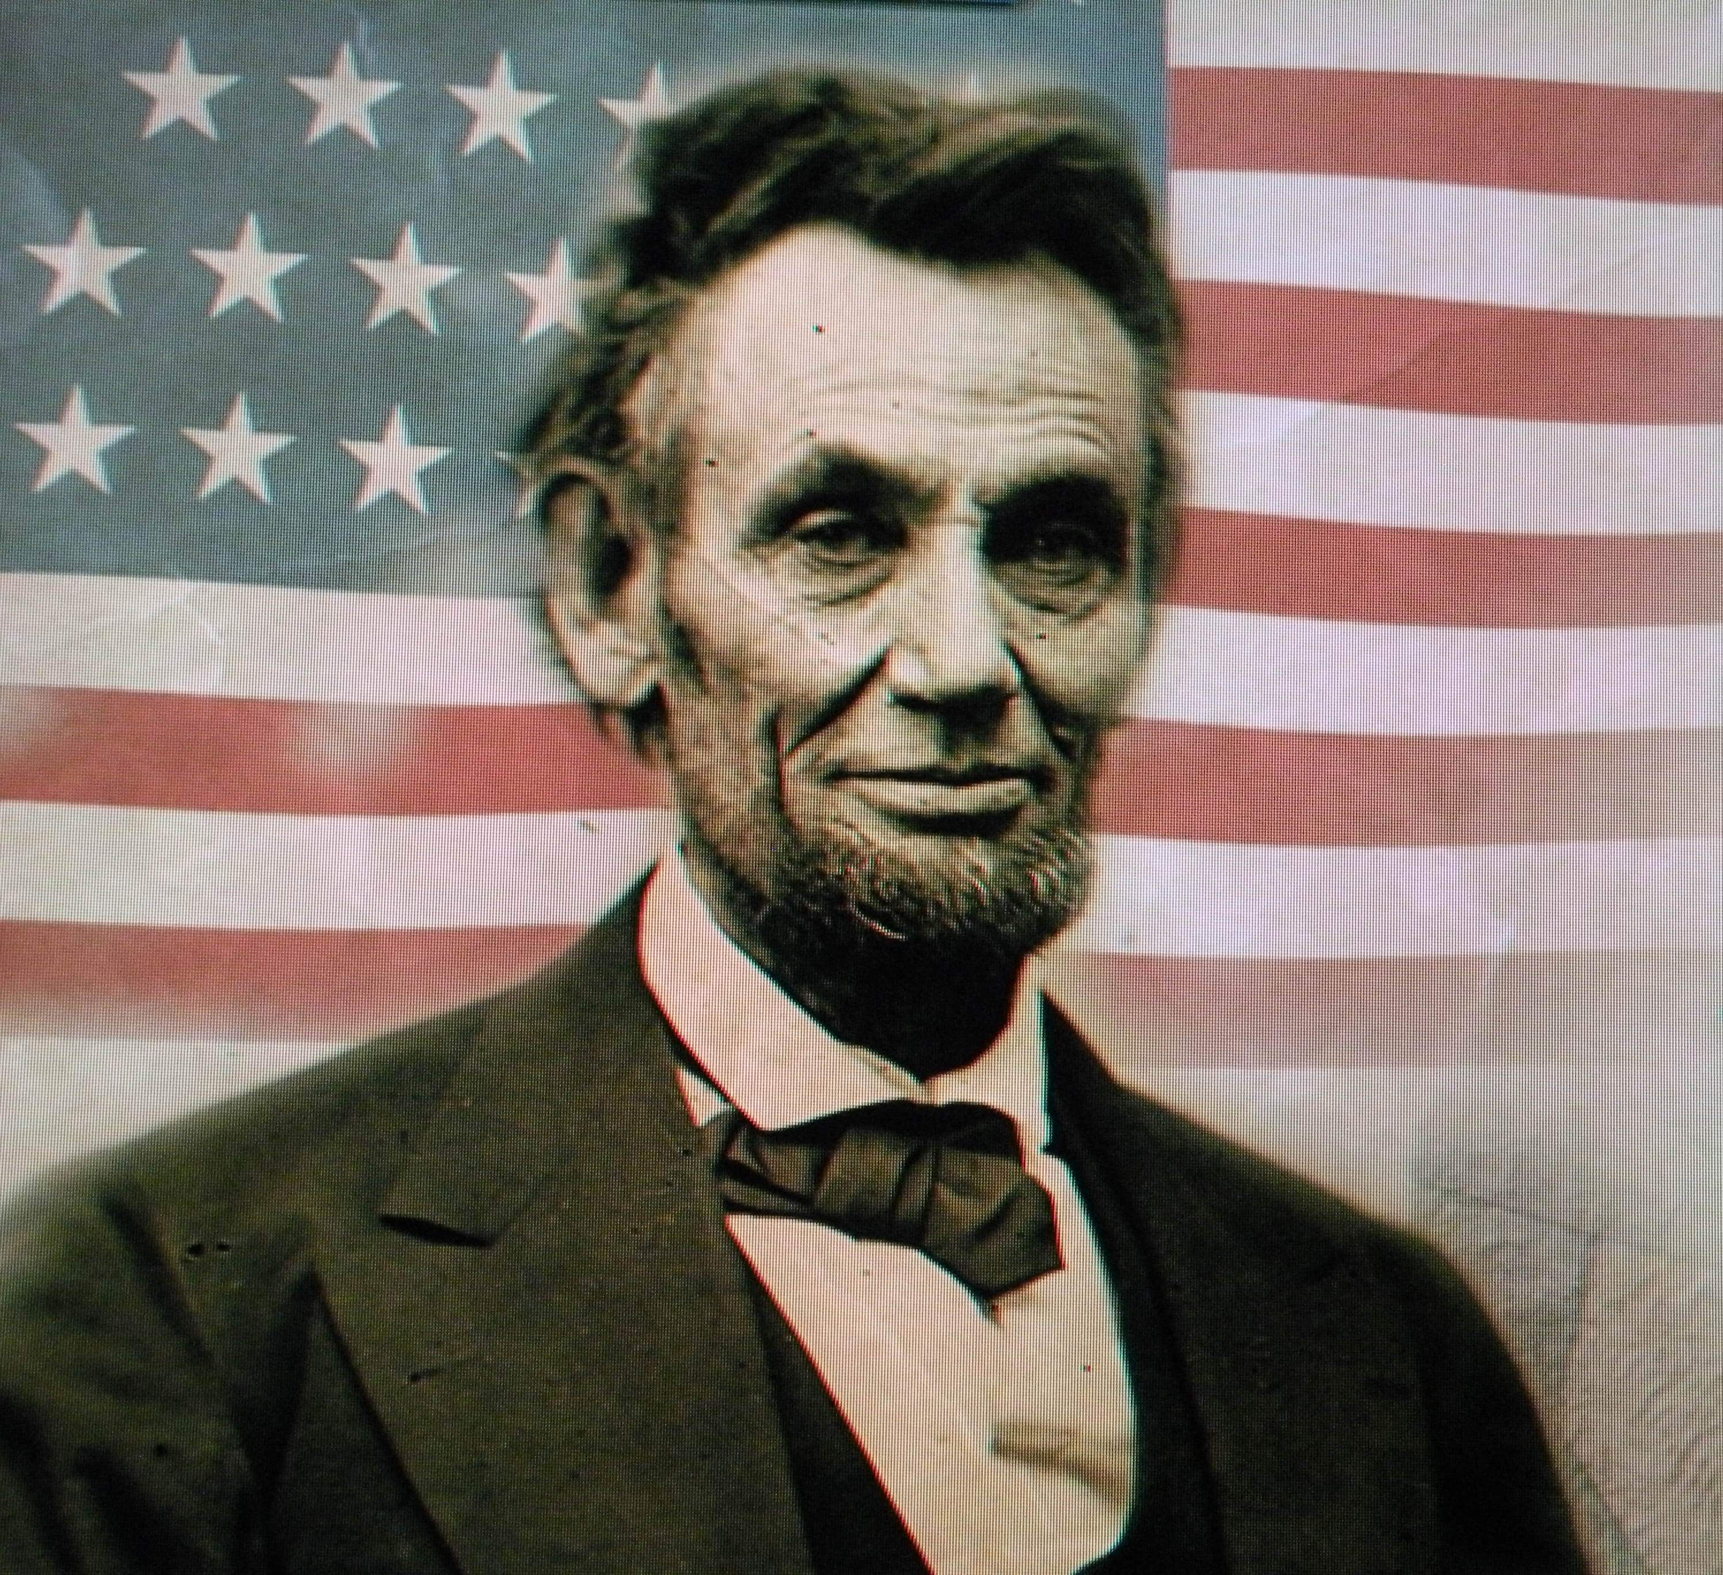
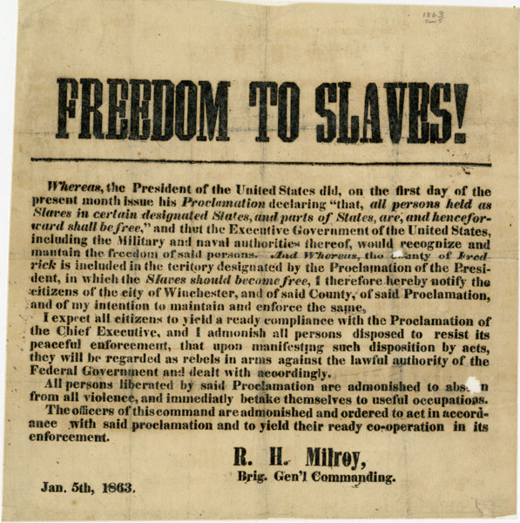
Jan. 1863
Lincoln issues the Emancipation Proclamation

Slide 10
STOP PART 1
Pick up on Emancipation Proclamation writing assignment

Slide 11
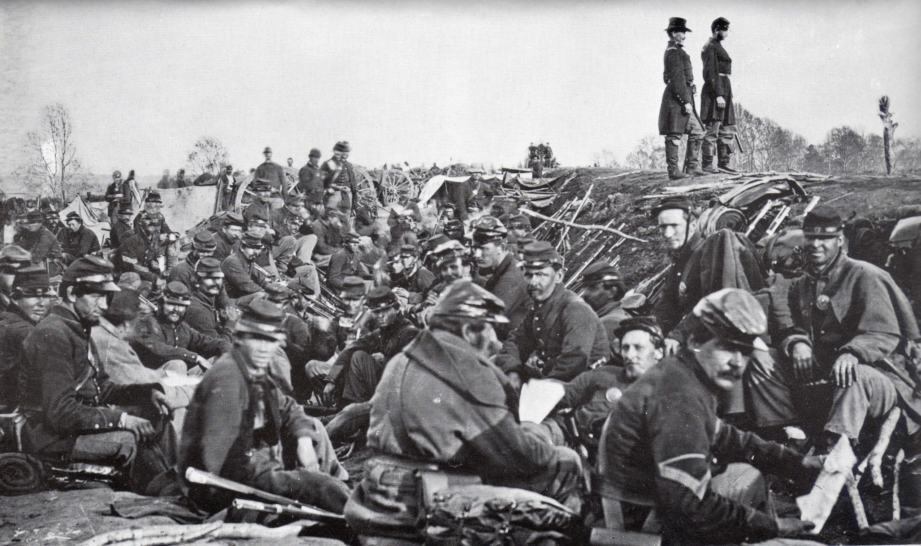
April – May 1863
Battle of Chancellorsville
Casualties = 30,764
Confederacy victory

Slide 12
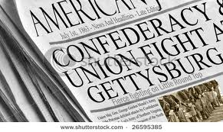
July 1863
Battle of Gettysburg
Casualties = 51,112
Union victory

Slide 13
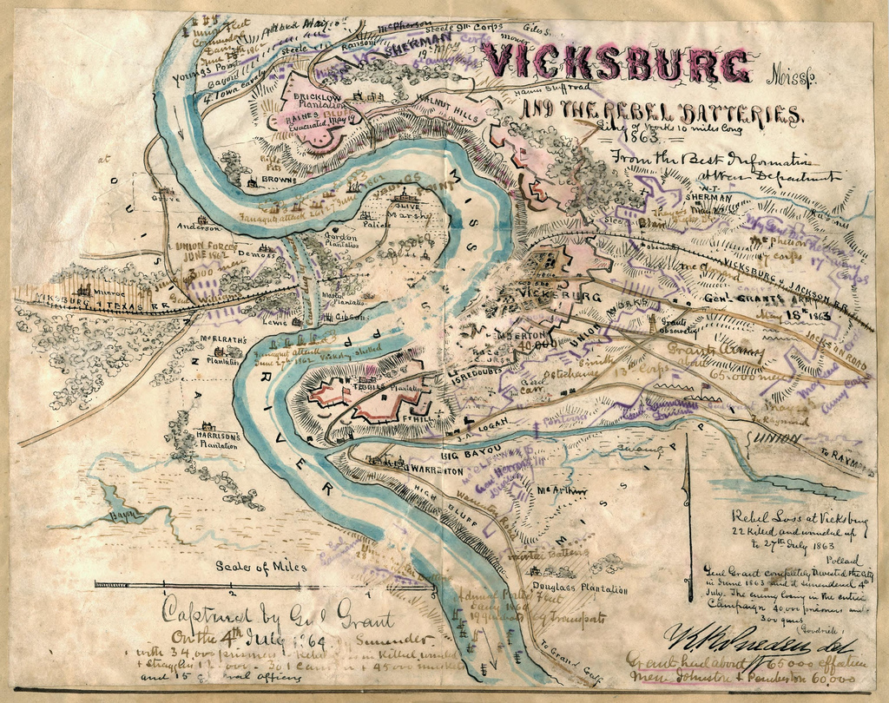
May-July 1863
Battle of Vicksburg
Casualties = 37,402
Union victory

Slide 14
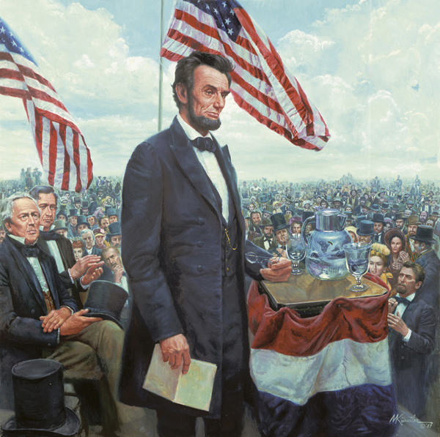
November 1863
Lincoln gives the Gettysburg Address

Slide 15
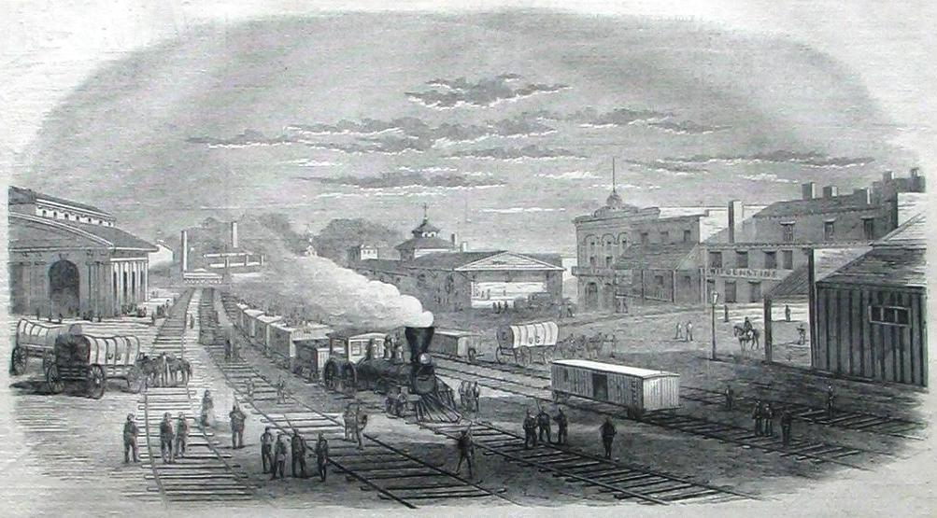
July 1864
Fall of Atlanta
Casualties = 9,222
Union victory

Slide 16
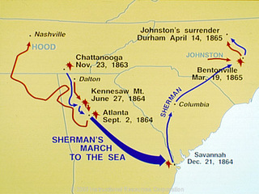
November – December 1864
Sherman’s March to the Sea
Casualties = 3,000
Union Victory

Slide 17
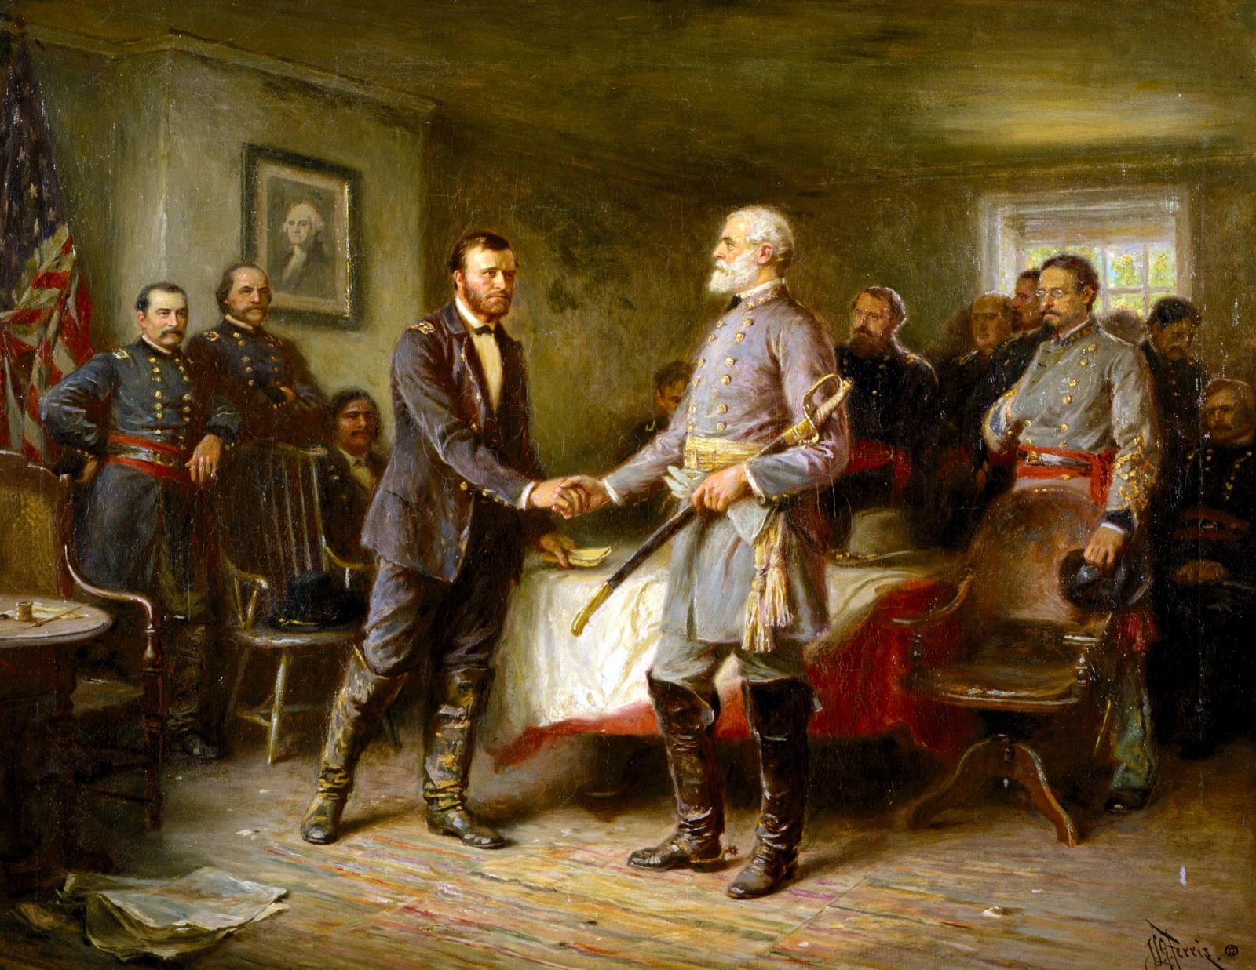
April 1865
Surrender at Appomattox
Casualties = 700
Union victory

