Slide 1
The Bill of Rights

Slide 2
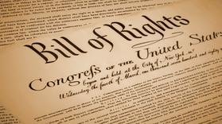
Why do we have a Bill of Rights?
The Constitution built a strong national government….so why would this scare some people? Think back to Great Britain…..
Some delegates – the Anti-Federalists- refused to sign with a bill of rights to protect the freedoms and the right of the people.
The Bill of Rights were the first changes or amendments to the Constitution.

Slide 3
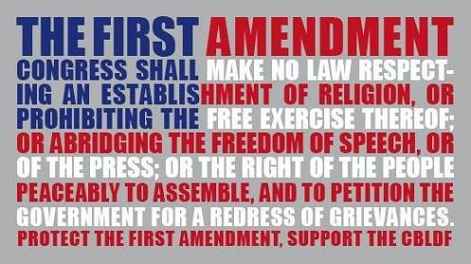
1st Amendment – Freedom of Religion, Speech, and the Press: The Right to Assemble and Petition What does that mean??
It allows people to establish and practice their religions freely
To speak ideas and opinions
Protects the right of citizens holding meetings
Allows for petition of government
It gives the press the freedom to publish the news and ideas for the American people

Slide 4
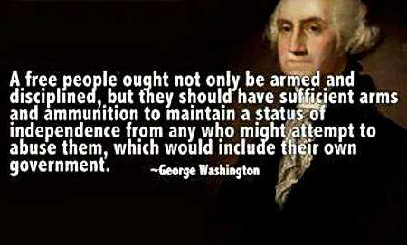
2nd Amendment – The Right to Bear Arms
Very controversial
The Second Amendment gives citizens the rights to own guns.
There has been much discussion about whether to limit the kinds of guns that can be sold.
Do you think that infringes on your rights as a citizen?
Is this right still relevant?

Slide 5
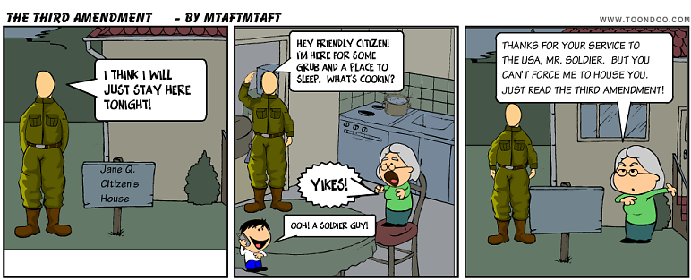
3rd Amendment – Housing of Soldiers
When colonists were ruled by England, people were forced to house and feed soldiers.
This amendment made it unlawful for government to make a private citizen house its soldiers.

Slide 6
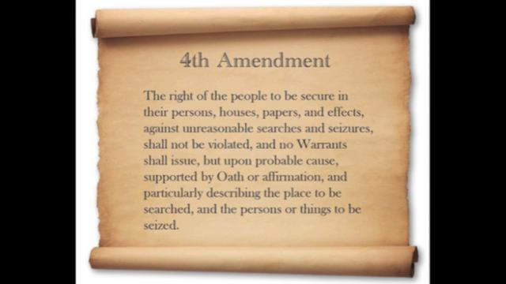
4th Amendment – Search, Seizure, and Warrants
During the Revolutionary War Great Britain searched any houses or places of business or worship it wanted….
This amendment protects people from law enforcement entering their home without their permission or an order from a court called a warrant.

Slide 7
5th Amendment – Rights in Criminal Trials and Rights of Property
Persons cannot be made to testify against themselves in a criminal trial. A person cannot be tried for the same crime twice. It is called Double Jeopardy. People’s property can not be taken away without being paid for it.

Slide 8
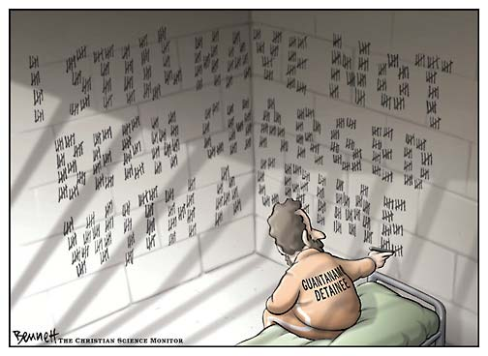
6th Amendment – Rights to a Fair Trial
A person accused of a crime shall receive a speedy public trial by jury.
During this time in England, people were held for years without a trial and the trial was held in secret.

Slide 9
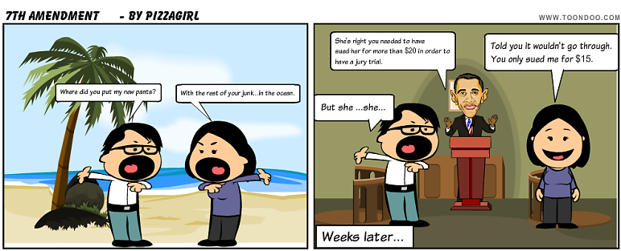
7th Amendment – Rights in a Civil Trial
A civil trial is brought by a person to get back property, to have a contract enforced, or to protect a person’s rights.
The 7th Amendment allows a civil case to be decided by a jury trial when the amount of money is over $20

Slide 10
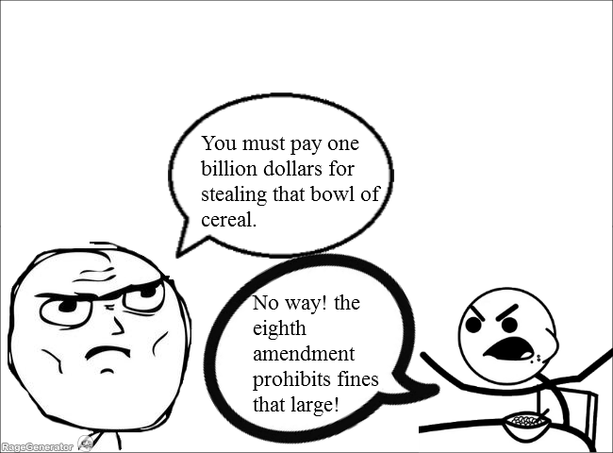
Amendment 8- Bail, Fines and Punishment
Amendment 8 doesn’t allow for any unfair bail for fines.
No cruel and unusual punishment

Slide 11
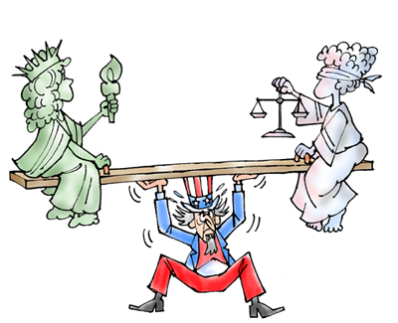
Amendment 9- Rights Kept by the People
Some of the delegates thought that if a right wasn’t clearly labeled in the Bill of Rights than it would be taken away from the people.
The 9th Amendment protects the rights of people that is not written into the Constitiution

Slide 12
10th Amendment – Powers Kept by the States and the People
The rights not given to the national government are given to the states and the people.

